Slide 1
























Fig. 1
a
$$σ$$
Undamage
$$σ_{t}$$
$$D=0$$
Stress
$G_{f}$: Fracture energy
$$E$$
$$1$$
Perfectly fracture
$$1$$
$$\left(1−D\right)E$$
$$D=1$$
$$O$$
$$κ_{0}$$
$$κ$$
$$ε$$
Strain
$$\overline{κ }$$
b
$$σ$$
Undamage
$$σ_{t}$$
$$D=0$$
Stress
Strength
Stiffness
Perfectly fracture
$$D=1$$
$$O$$
$$κ_{0}$$
$$κ$$
$$ε$$
$$κ_{s}$$
$$\overline{κ }$$
Strain

Slide 2







Fig. 2
$$σ$$
$$c$$
$$R_{b}$$
$$\overline{ρ}$$
$$R$$
$$R$$
$$σ$$

Slide 3
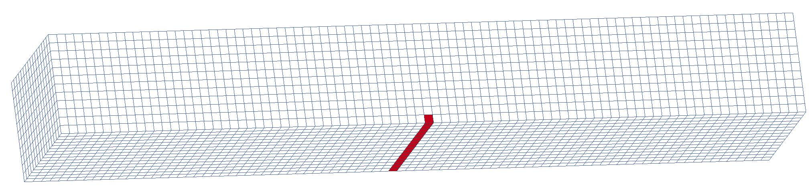
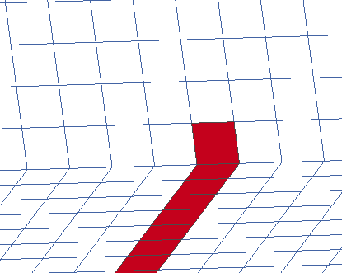
Fig. 3
a
22
Unit: mm
b = 4
Forced Y-displacement
Material 1
Y
Z
h = 3
X
L = 16
b
c
0.25
Internal defect
(Material 1)
0.25
Material 2
Pre-crack
(Material 2)

Slide 4
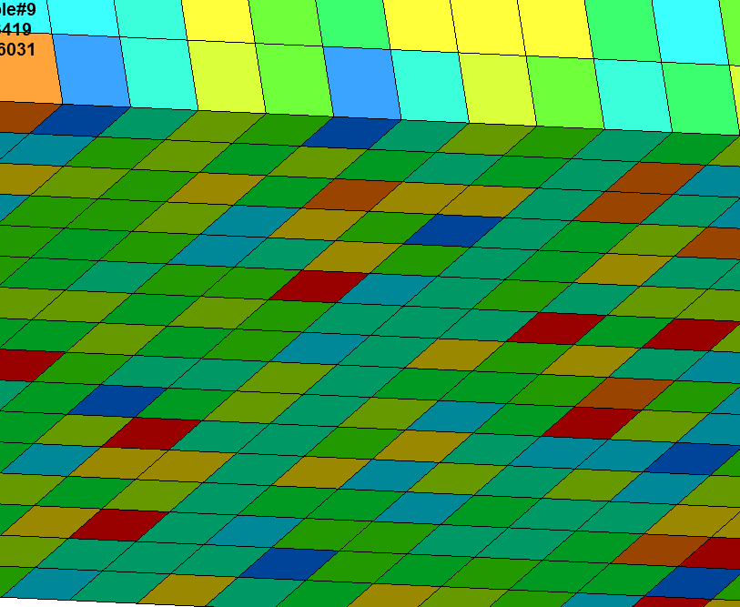
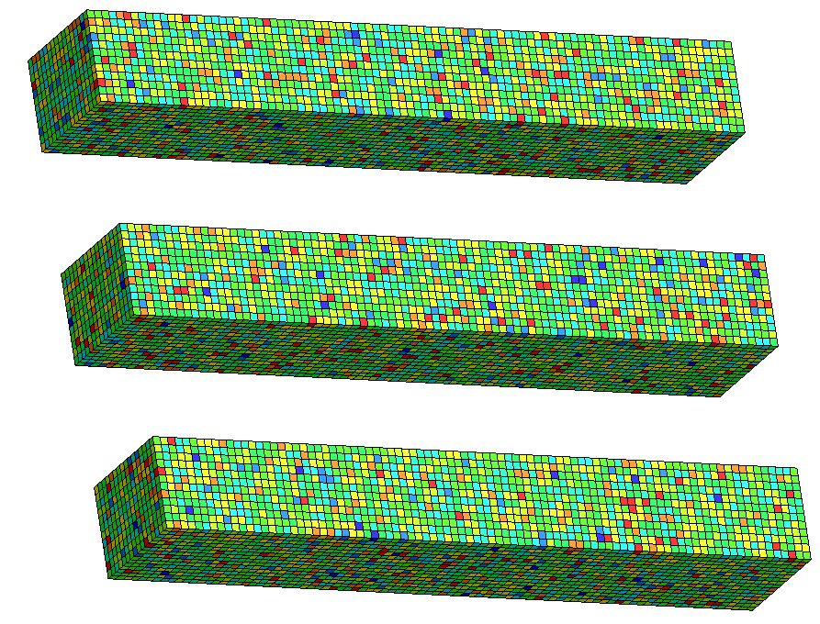
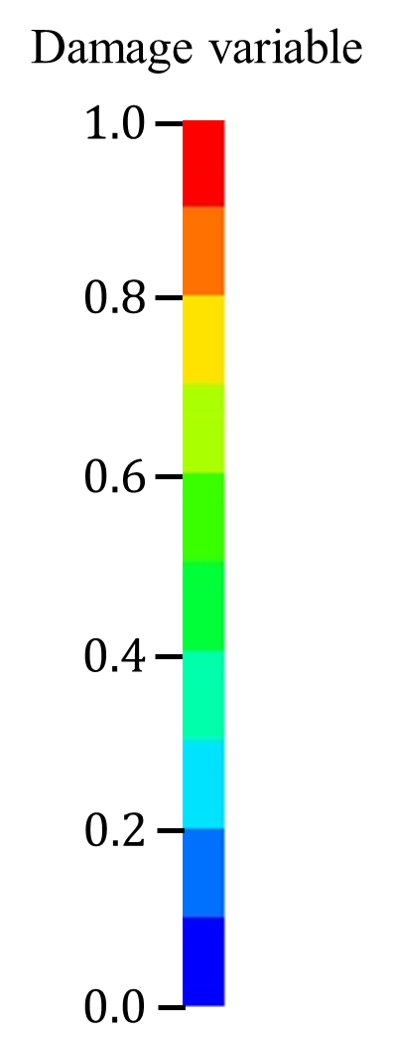
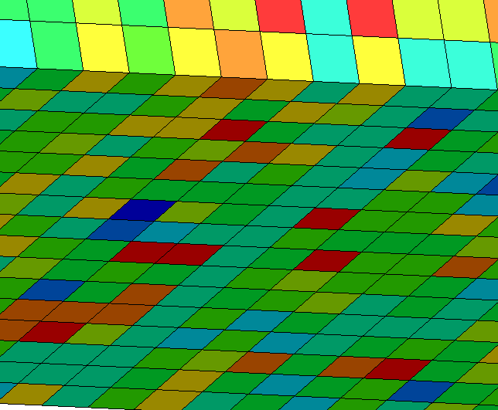
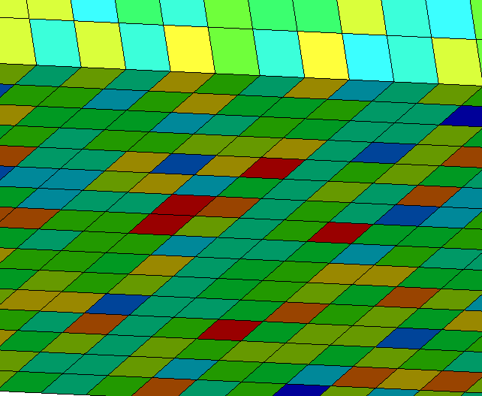
Fig. 4
Pre-crack
2500
Around pre-crack
2000
1500
Local fracture stress [MPa]
1000
500

Slide 5









Fig. 5
Time
0 s
10 s
15 s
20 s
30 s
40 s
Temperature
0.6
800 $\text{℃}$
0.4
1000 $\text{℃}$
Damage variable
0.2
1200 $\text{℃}$
0.0
Y
Crack-healing
X

Slide 6
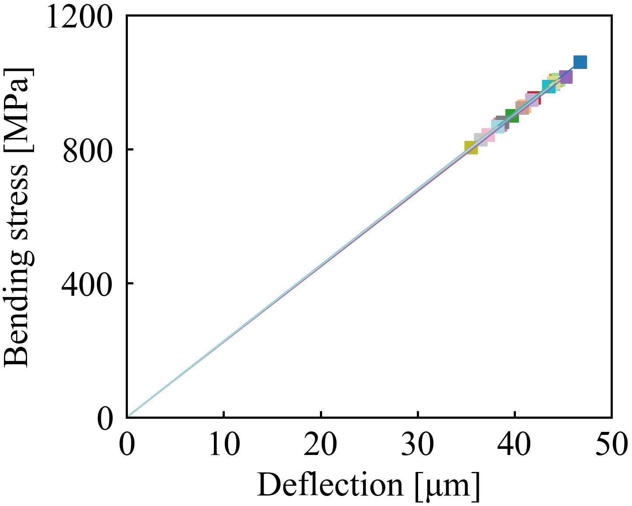
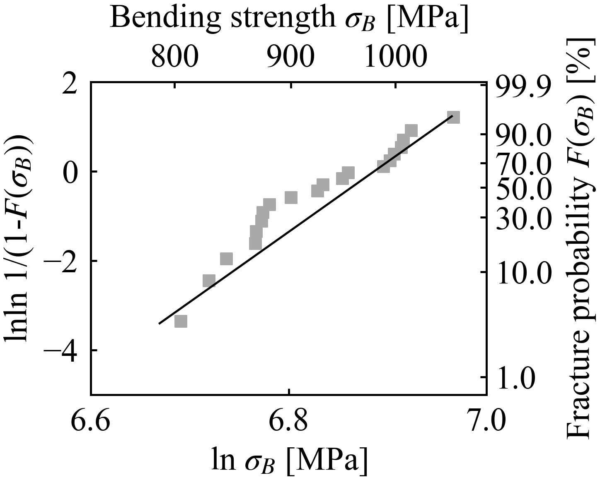
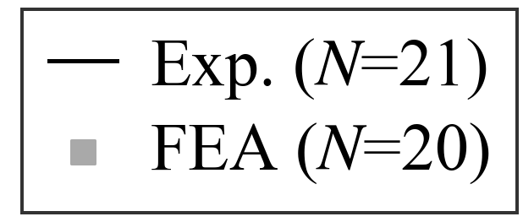
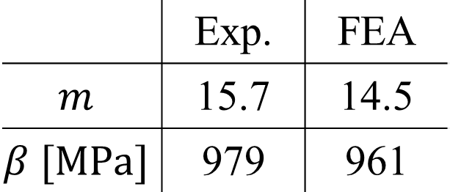
Fig. 6
a
Crack initiation
b

Slide 7
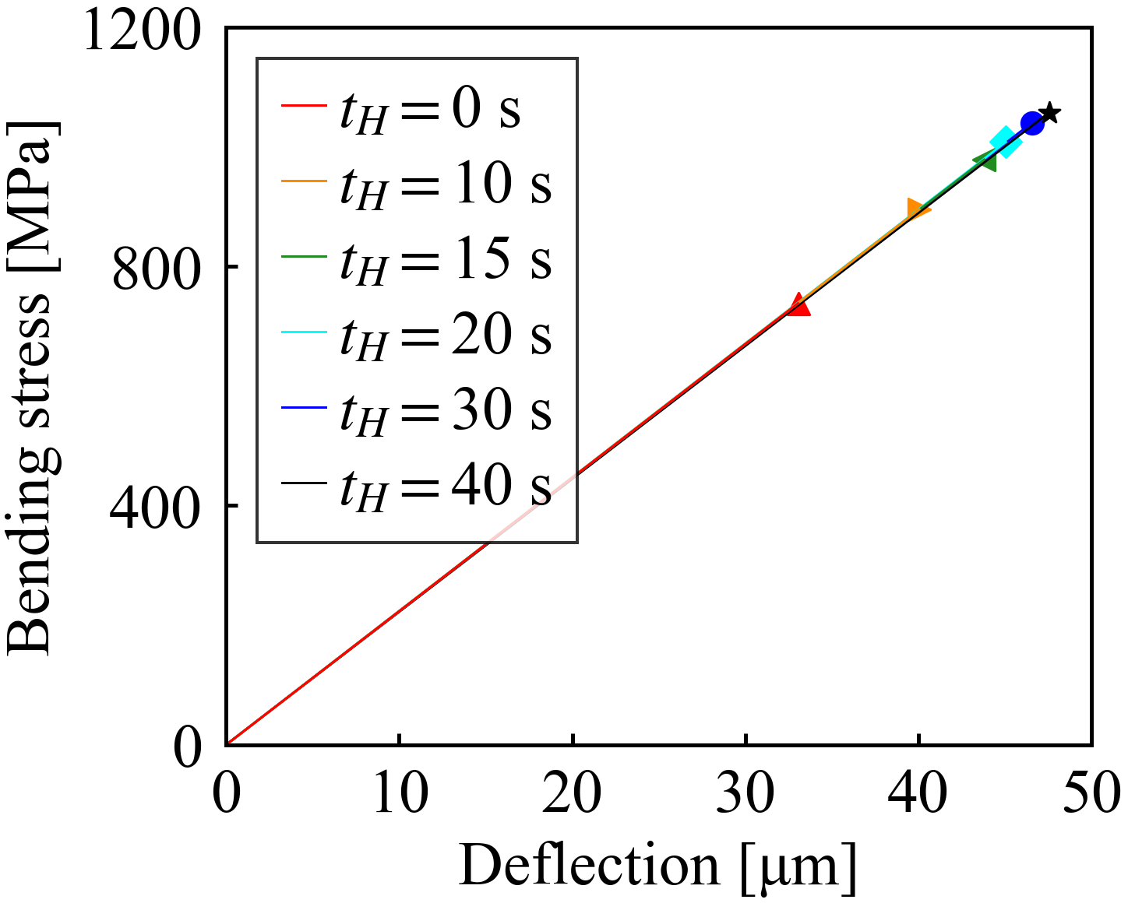
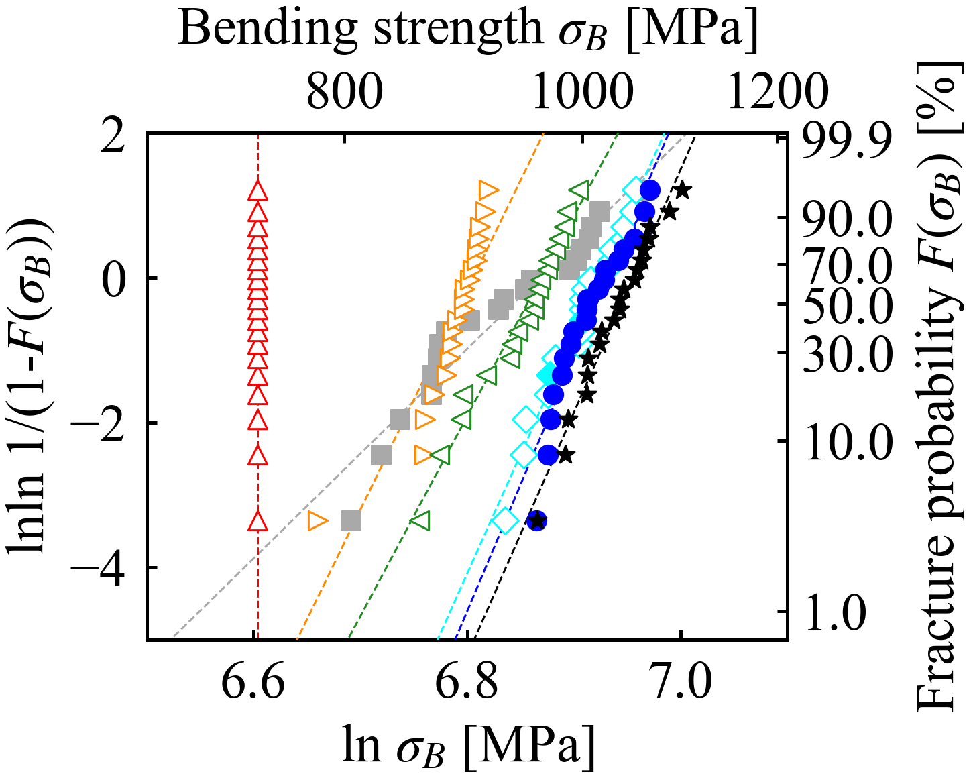
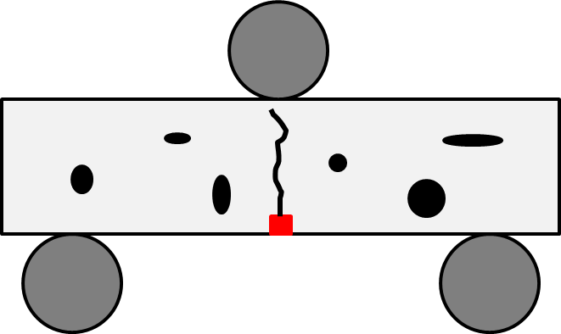
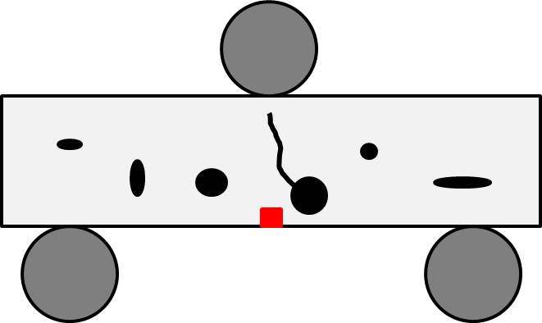
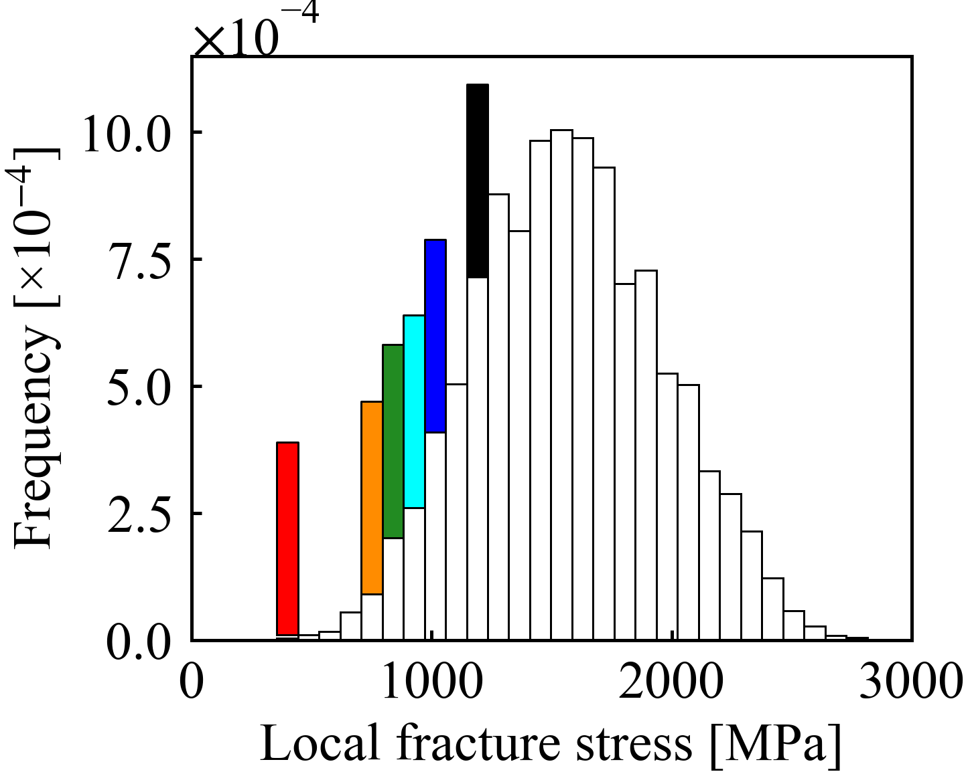
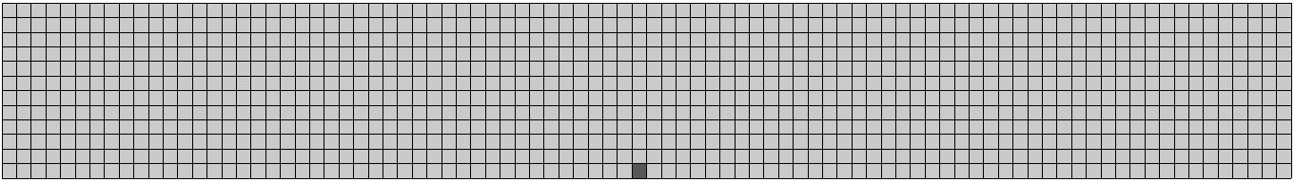

Fig. 7
Healed specimen:
t_{H} = 0 s
t_{H} = 10 s
t_{H} = 15 s
a
t_{H} = 20 s
t_{H} = 30 s
t_{H} = 40 s
Recovery
b
Smooth
specimen
Fully healed
specimen
c
Surface cracks
Other elements
Healing($T_{H}, t_{H}$)

Slide 8
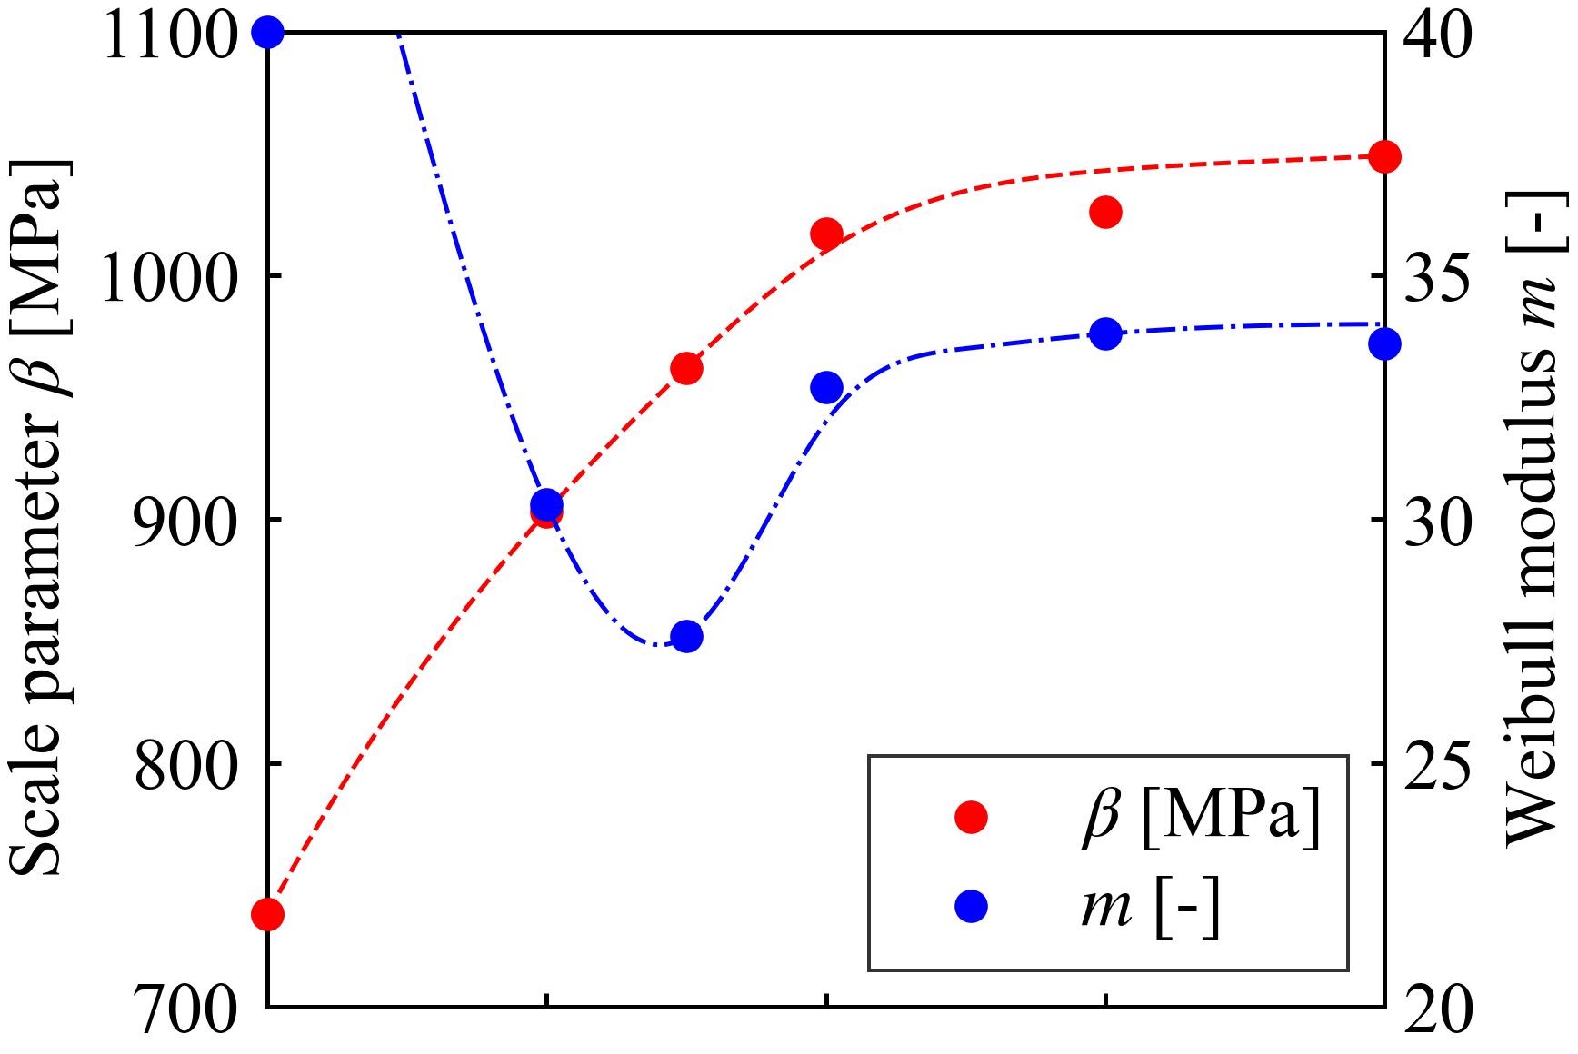
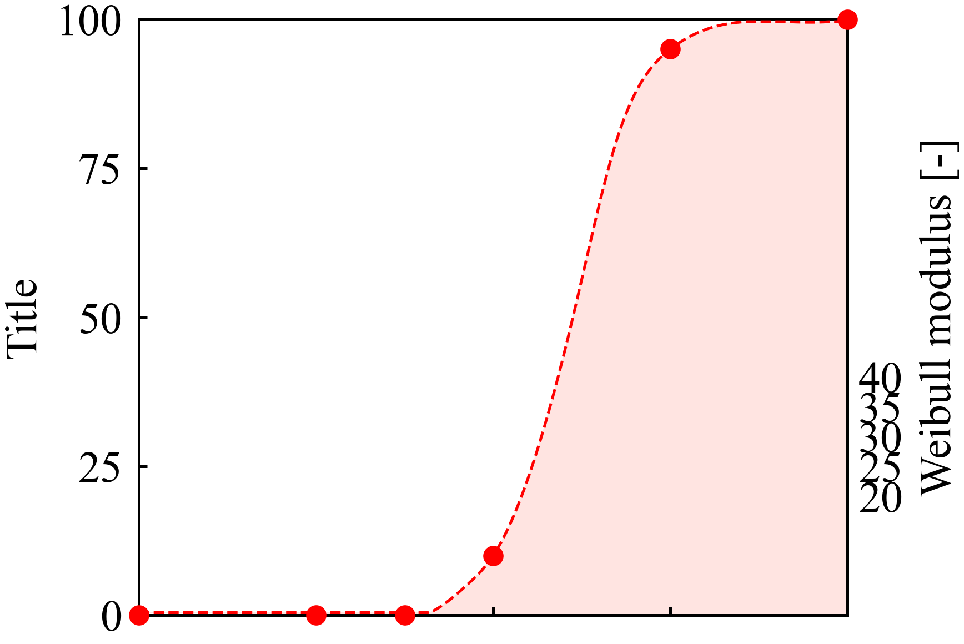
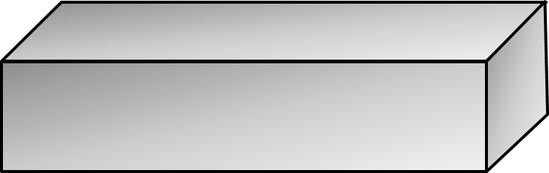
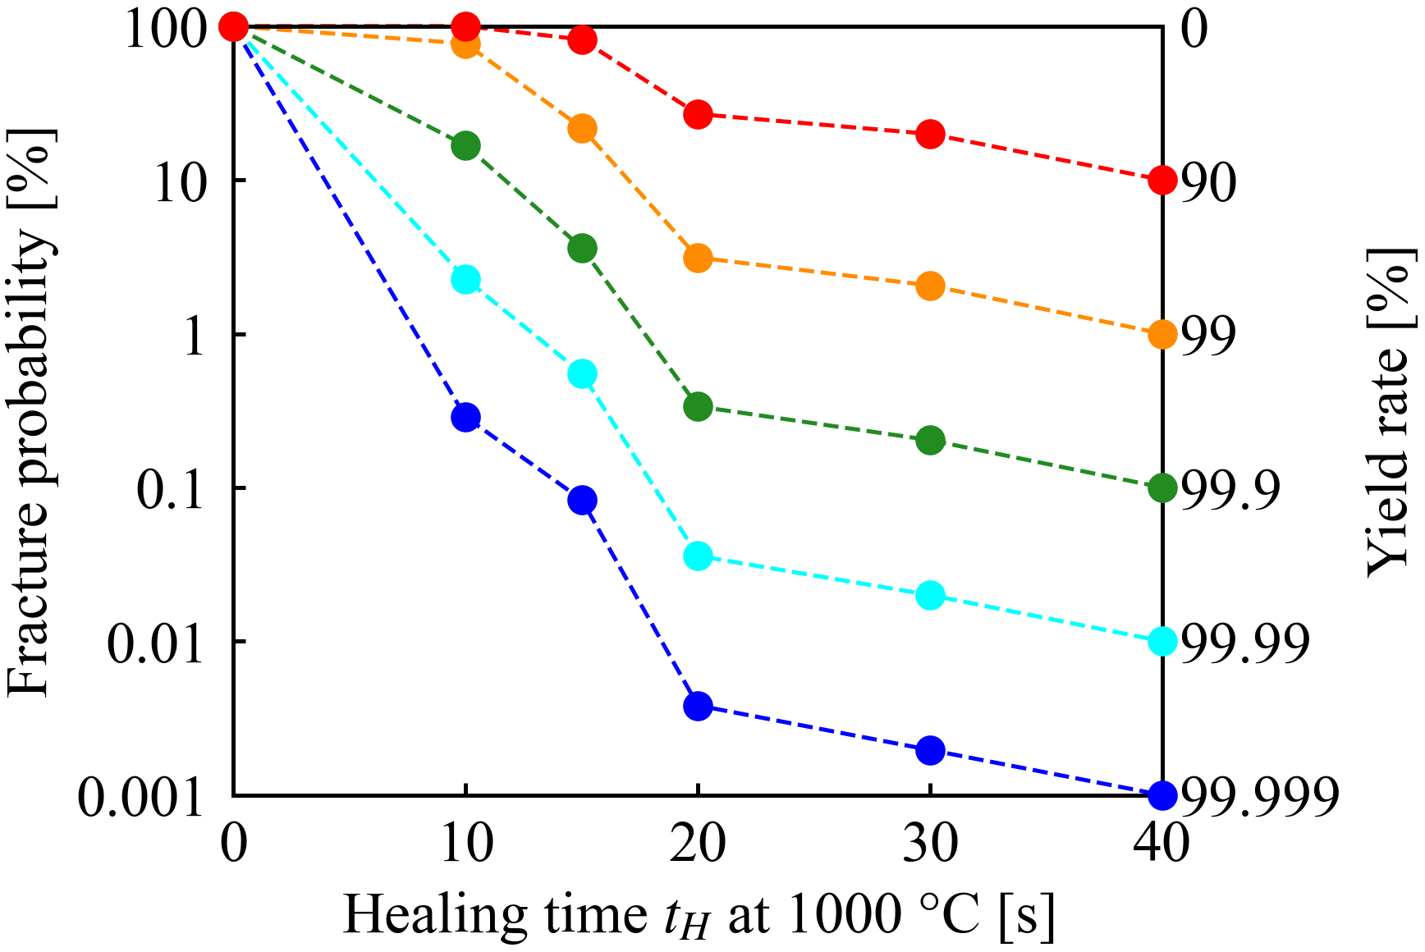
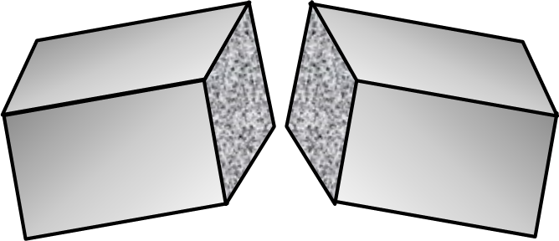






Fig. 8
a
Appearance of specimen fracture from internal defect
Weibull modulus $m$ [-]
b
Probability of fracture
from internal defects [%]
Fracture from
inadequate healed crack
Fracture from
internal defect
c
Survive
$σ_{p}$= 981 MPa
$σ_{p}$= 915 MPa
Fracture probability
during proof test [%]
$σ_{p}$= 854 MPa
Yield rate [%]
$σ_{p}$= 797 MPa
Fracture
$σ_{p}$= 745 MPa

