Slide 1



Figure: 01
Font size: 12
(a)
Notch tip
Crack
Crack tip
$$\text{D} \text{=} \text{0}$$
(1)
(2)
(3)
(3)
$${\text{G}}_{\text{f}}$$
Stress
c
(2)
(1)
$$\text{0}$$
$$\text{D} \text{=} \text{1}$$
(b)
Strain
Healing
Healing
Healing
$$\text{D} \text{=} \text{0}$$
Stress
Recovery of strength and stiffness due to crack-gap filling
$$\text{0}$$
$$\text{D} \text{=} \text{1}$$
Oxidative products
Matrix
Healing agents
Strain

Slide 2
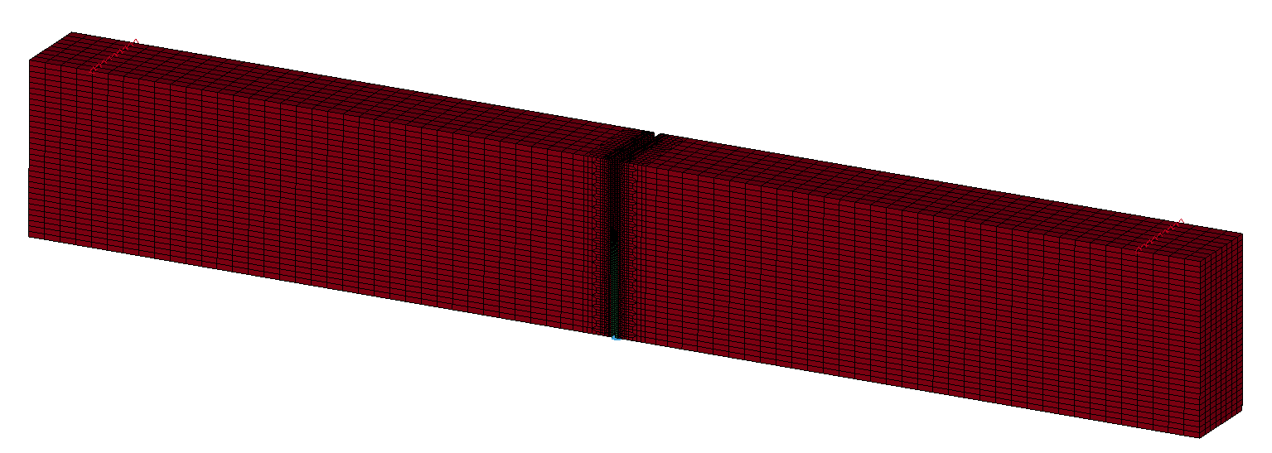
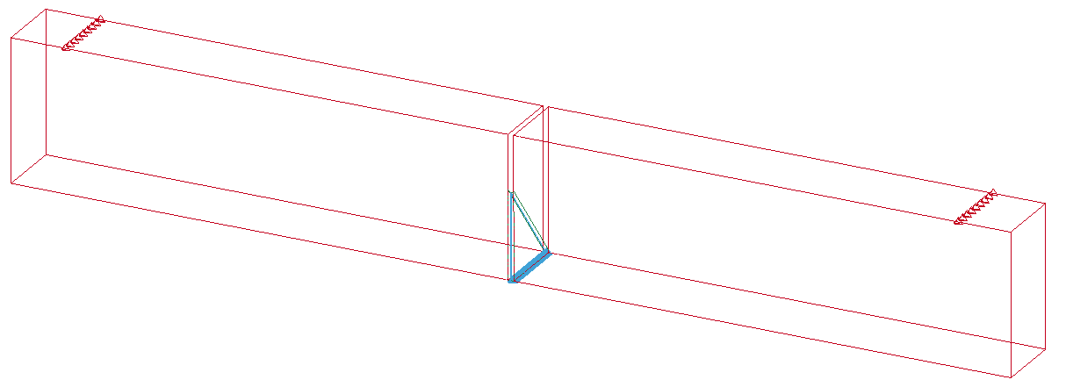

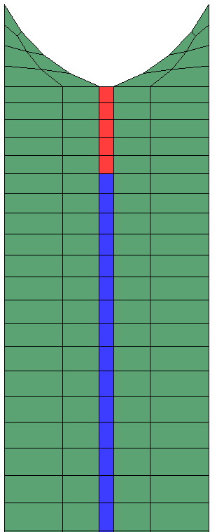
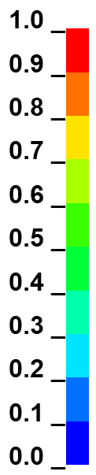
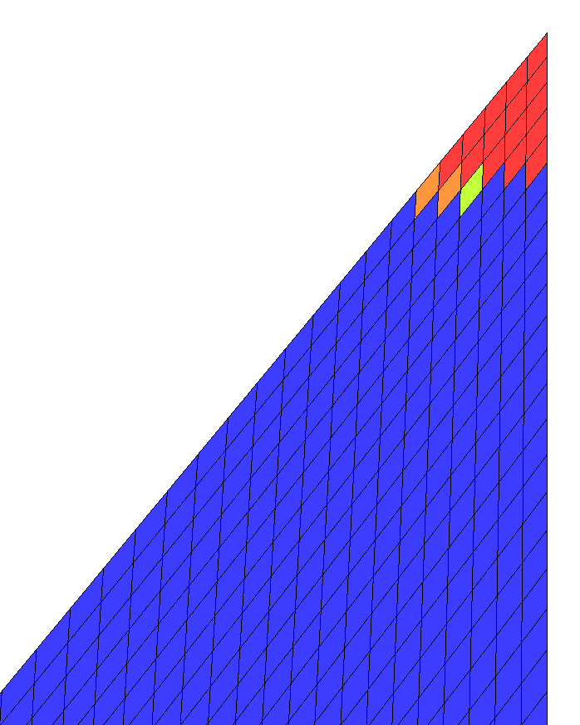
Figure: 02
(a)
Forced y-displacement
CMOD
(crack-mouth opening displacement)
Forced y-displacement
Surrounding part (III)
Pre-crack (2.54)
(b)
3.86
40
45
View A
View B
3.2
6.4
Unit: mm
(c)
Surrounding part (II)
Chevron
notch
Crack length
Distance from notch tip
Damage variable, D
Center part (I)
100 μm
View A
View B

Slide 3
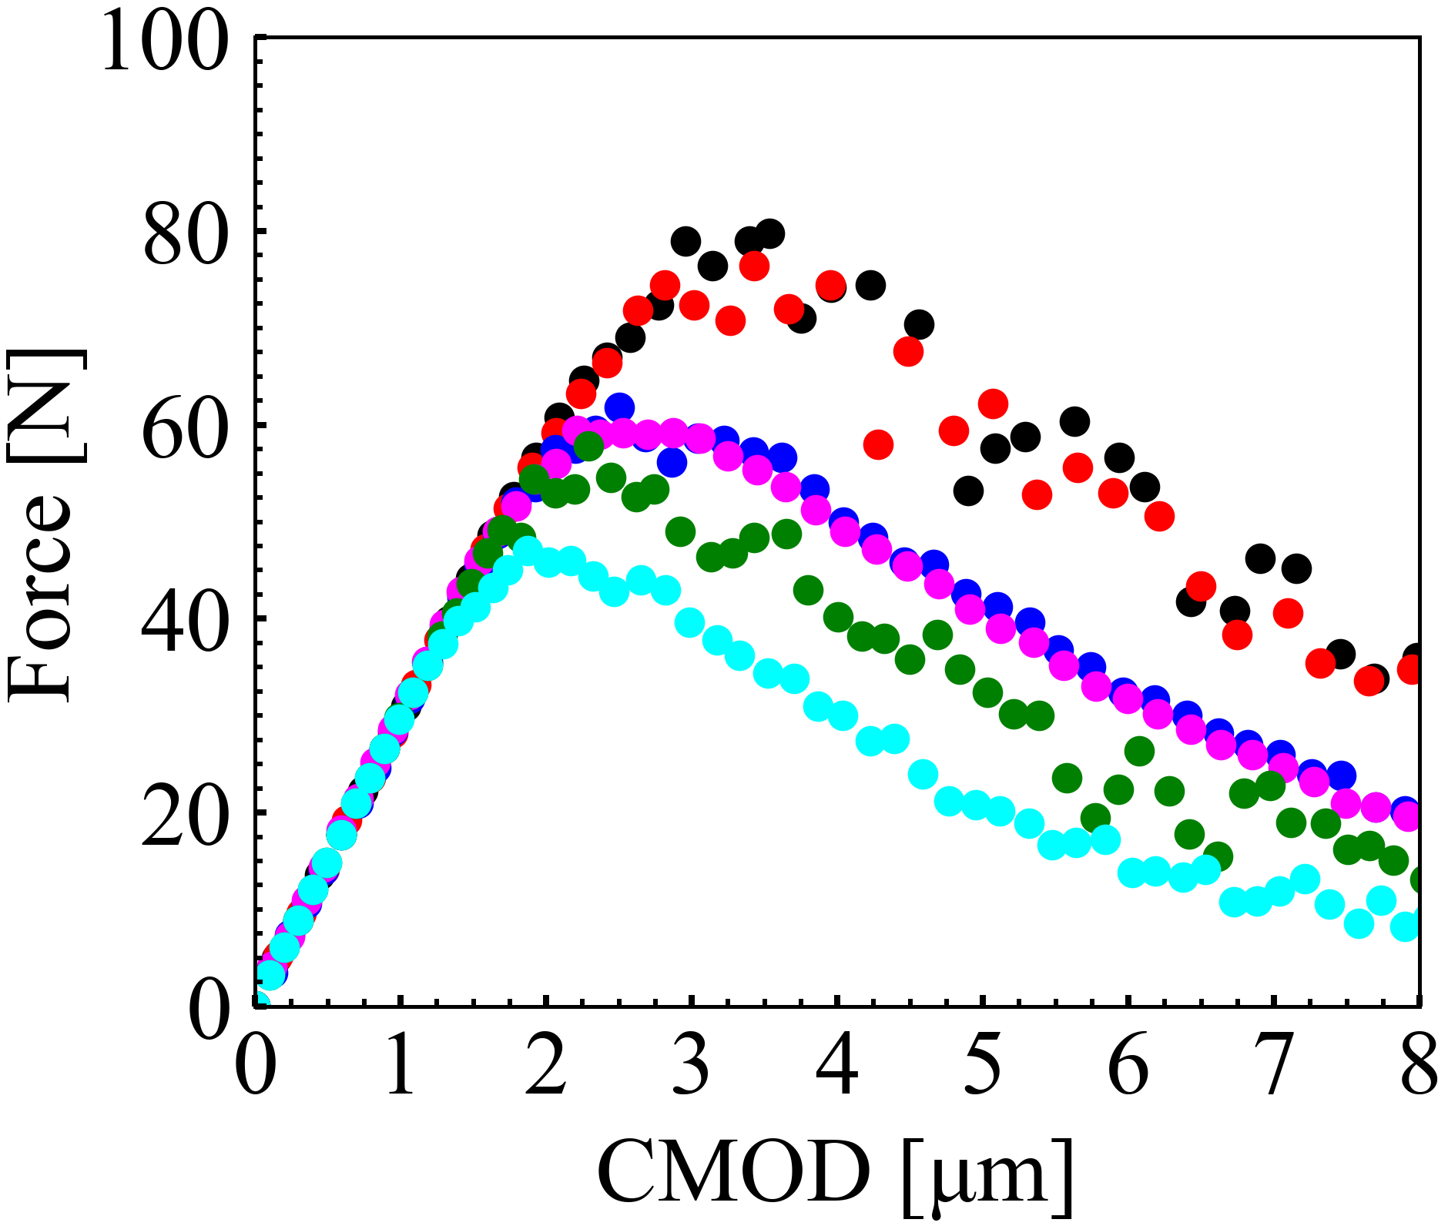
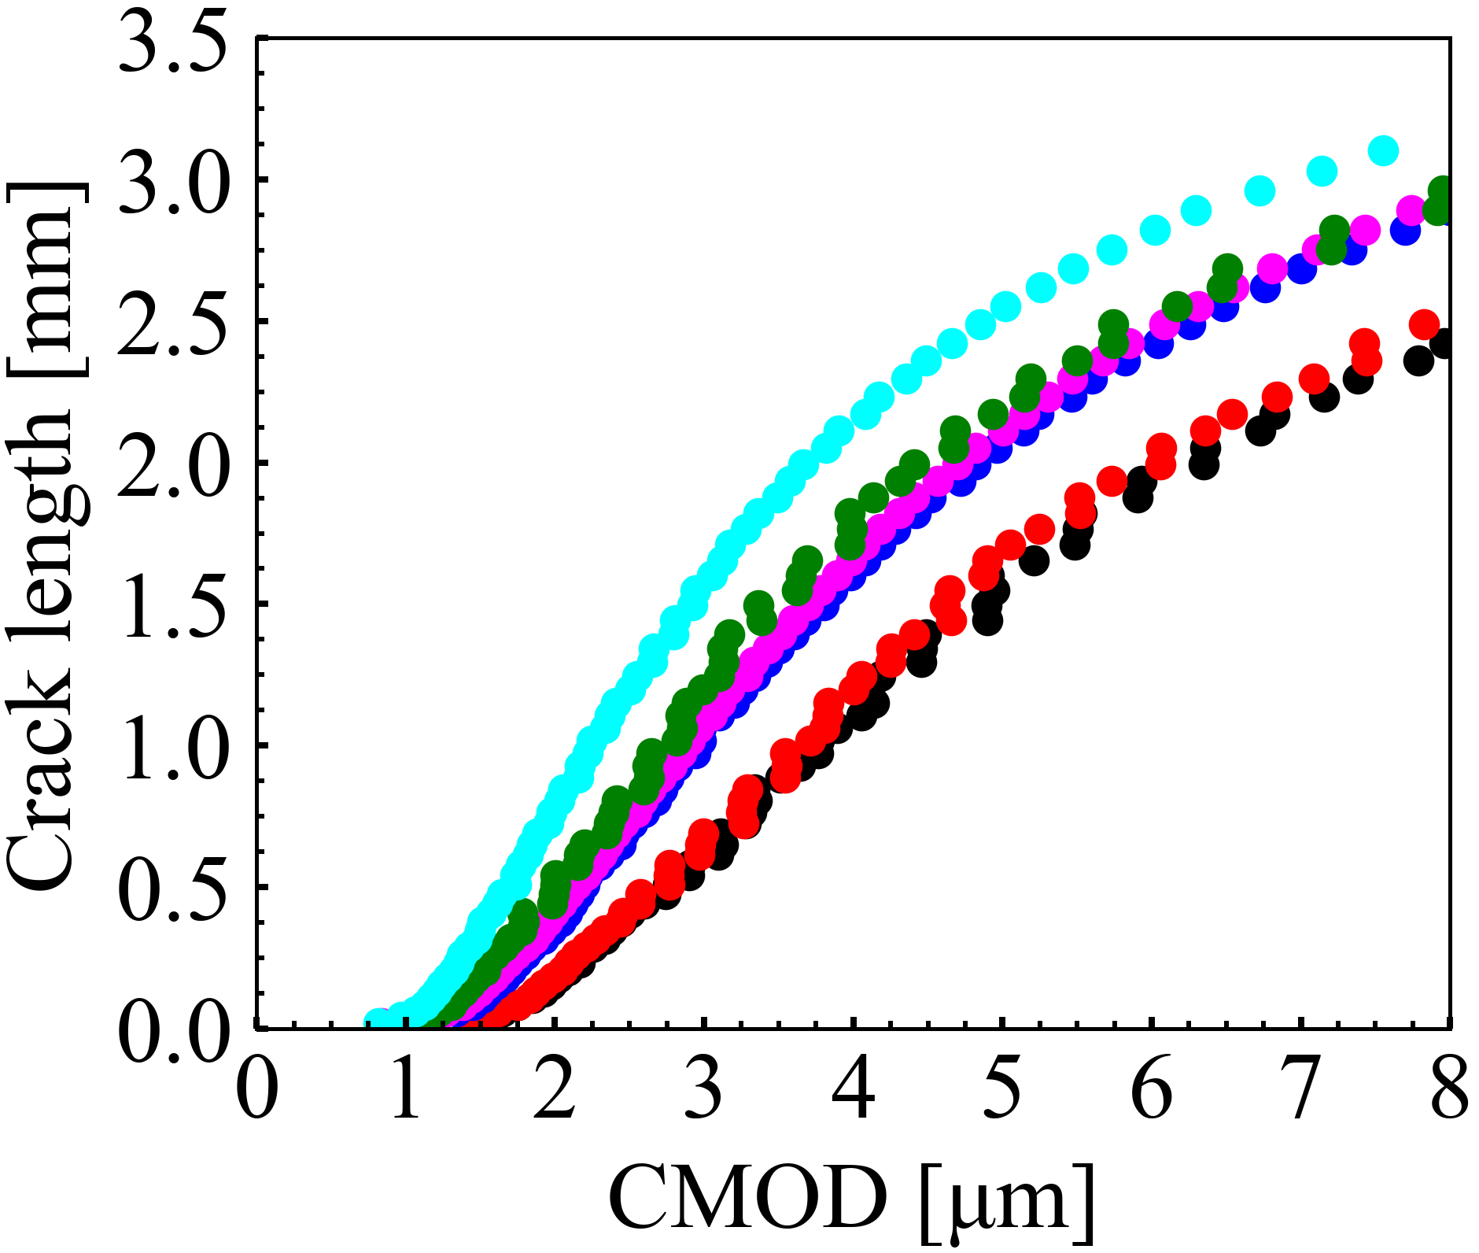
Figure: 03
AS15P
AS30P
MS15P
MS20P
AT15P
AT30P
(a)
Crack initiation force, F_{c}
(b)
Crack growth length [mm]

Slide 4
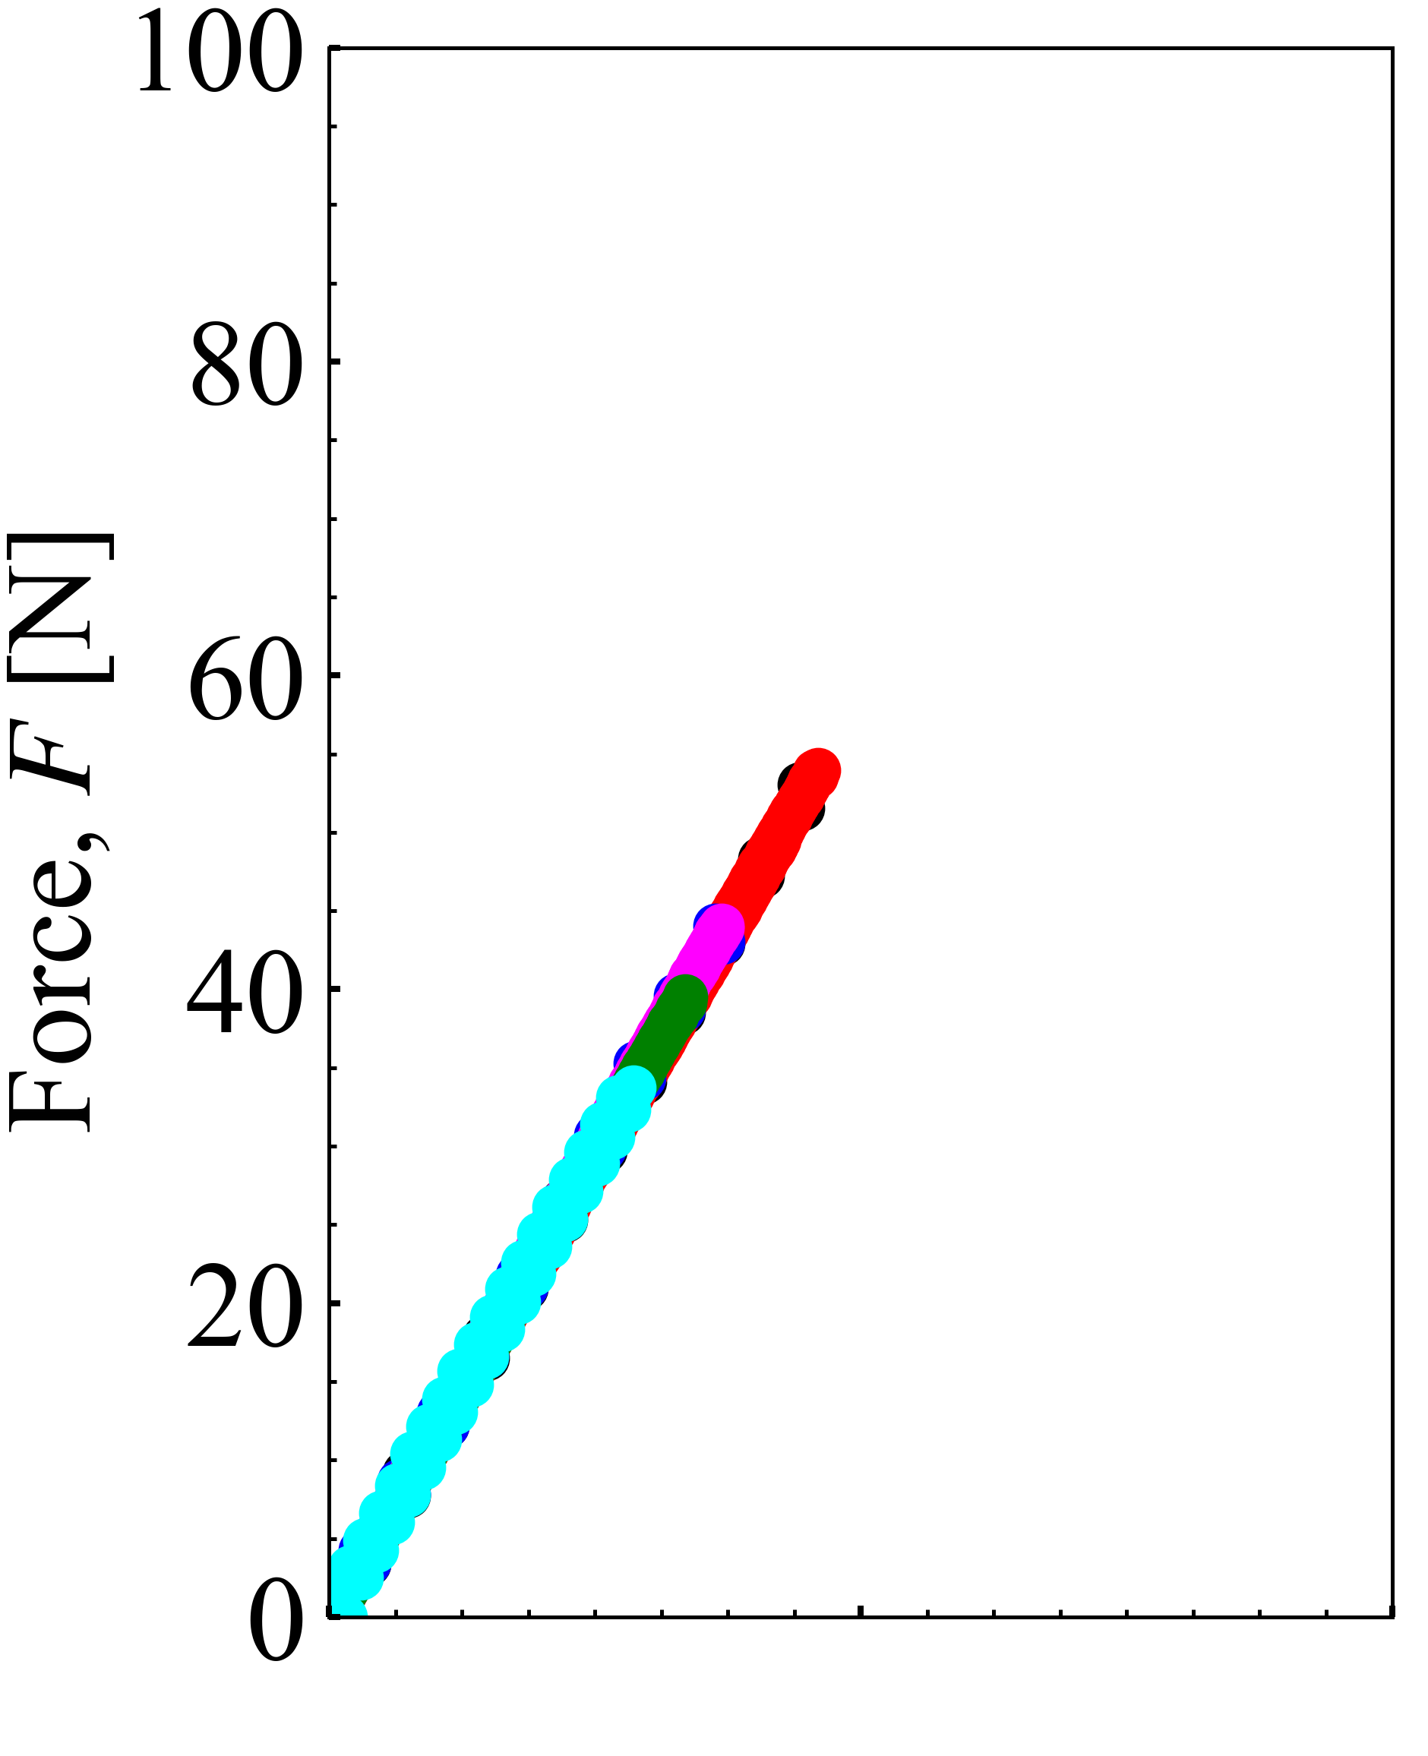
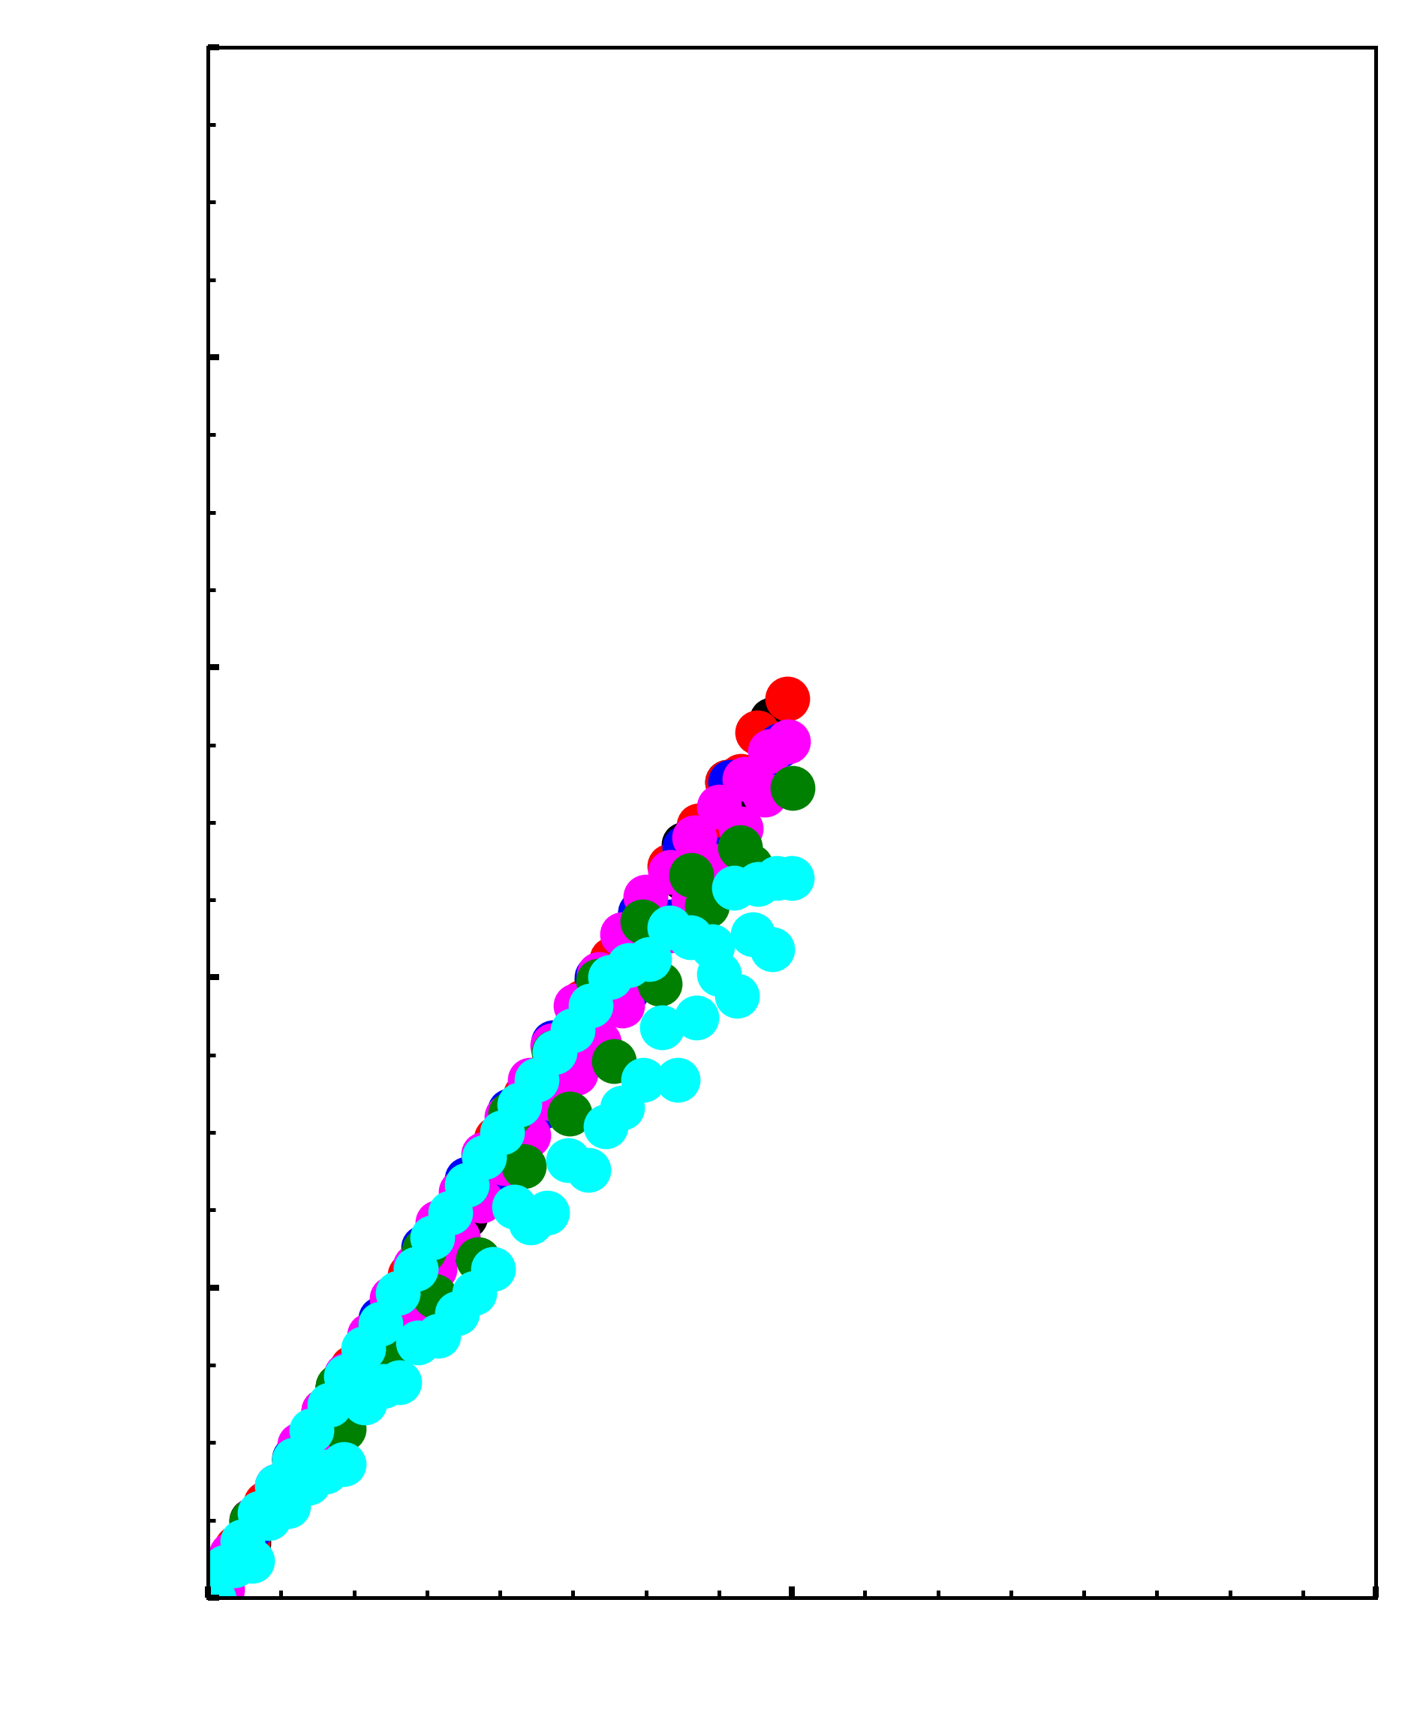
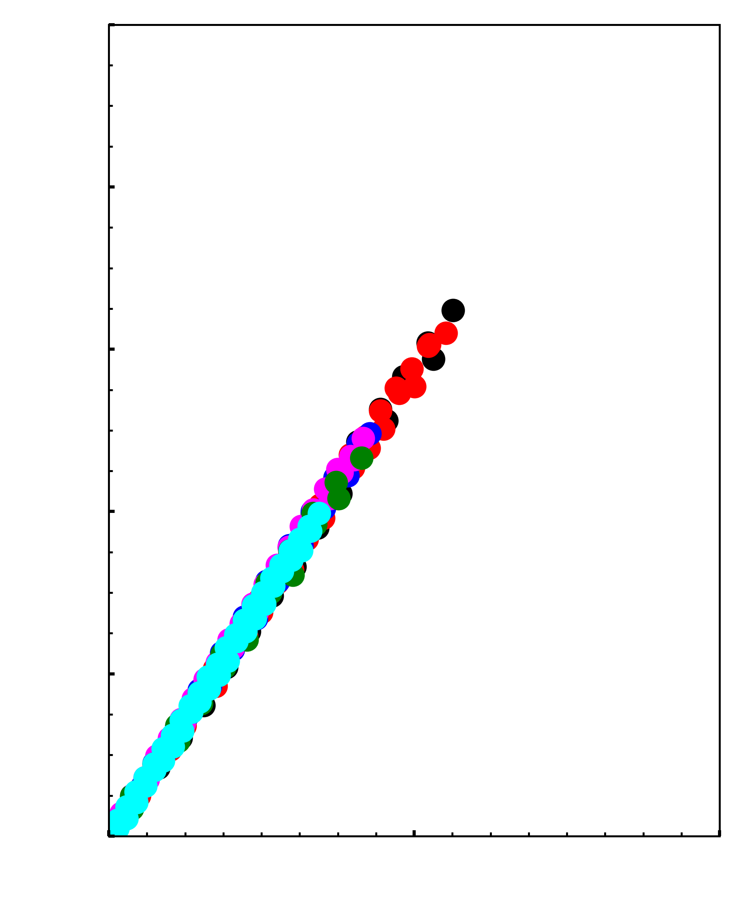
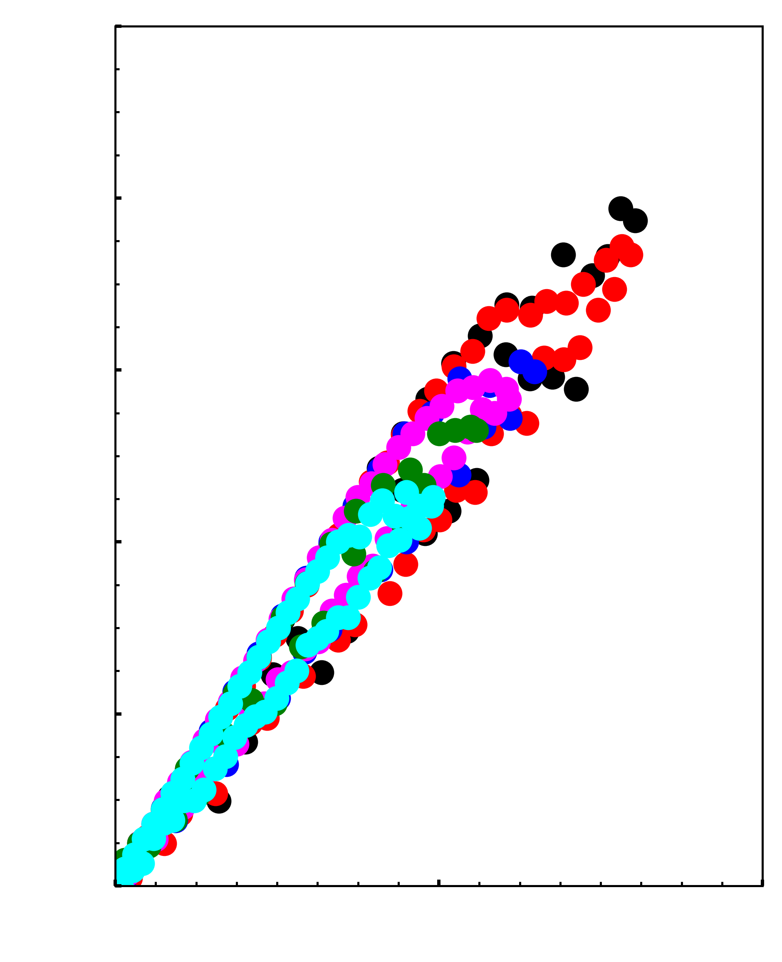
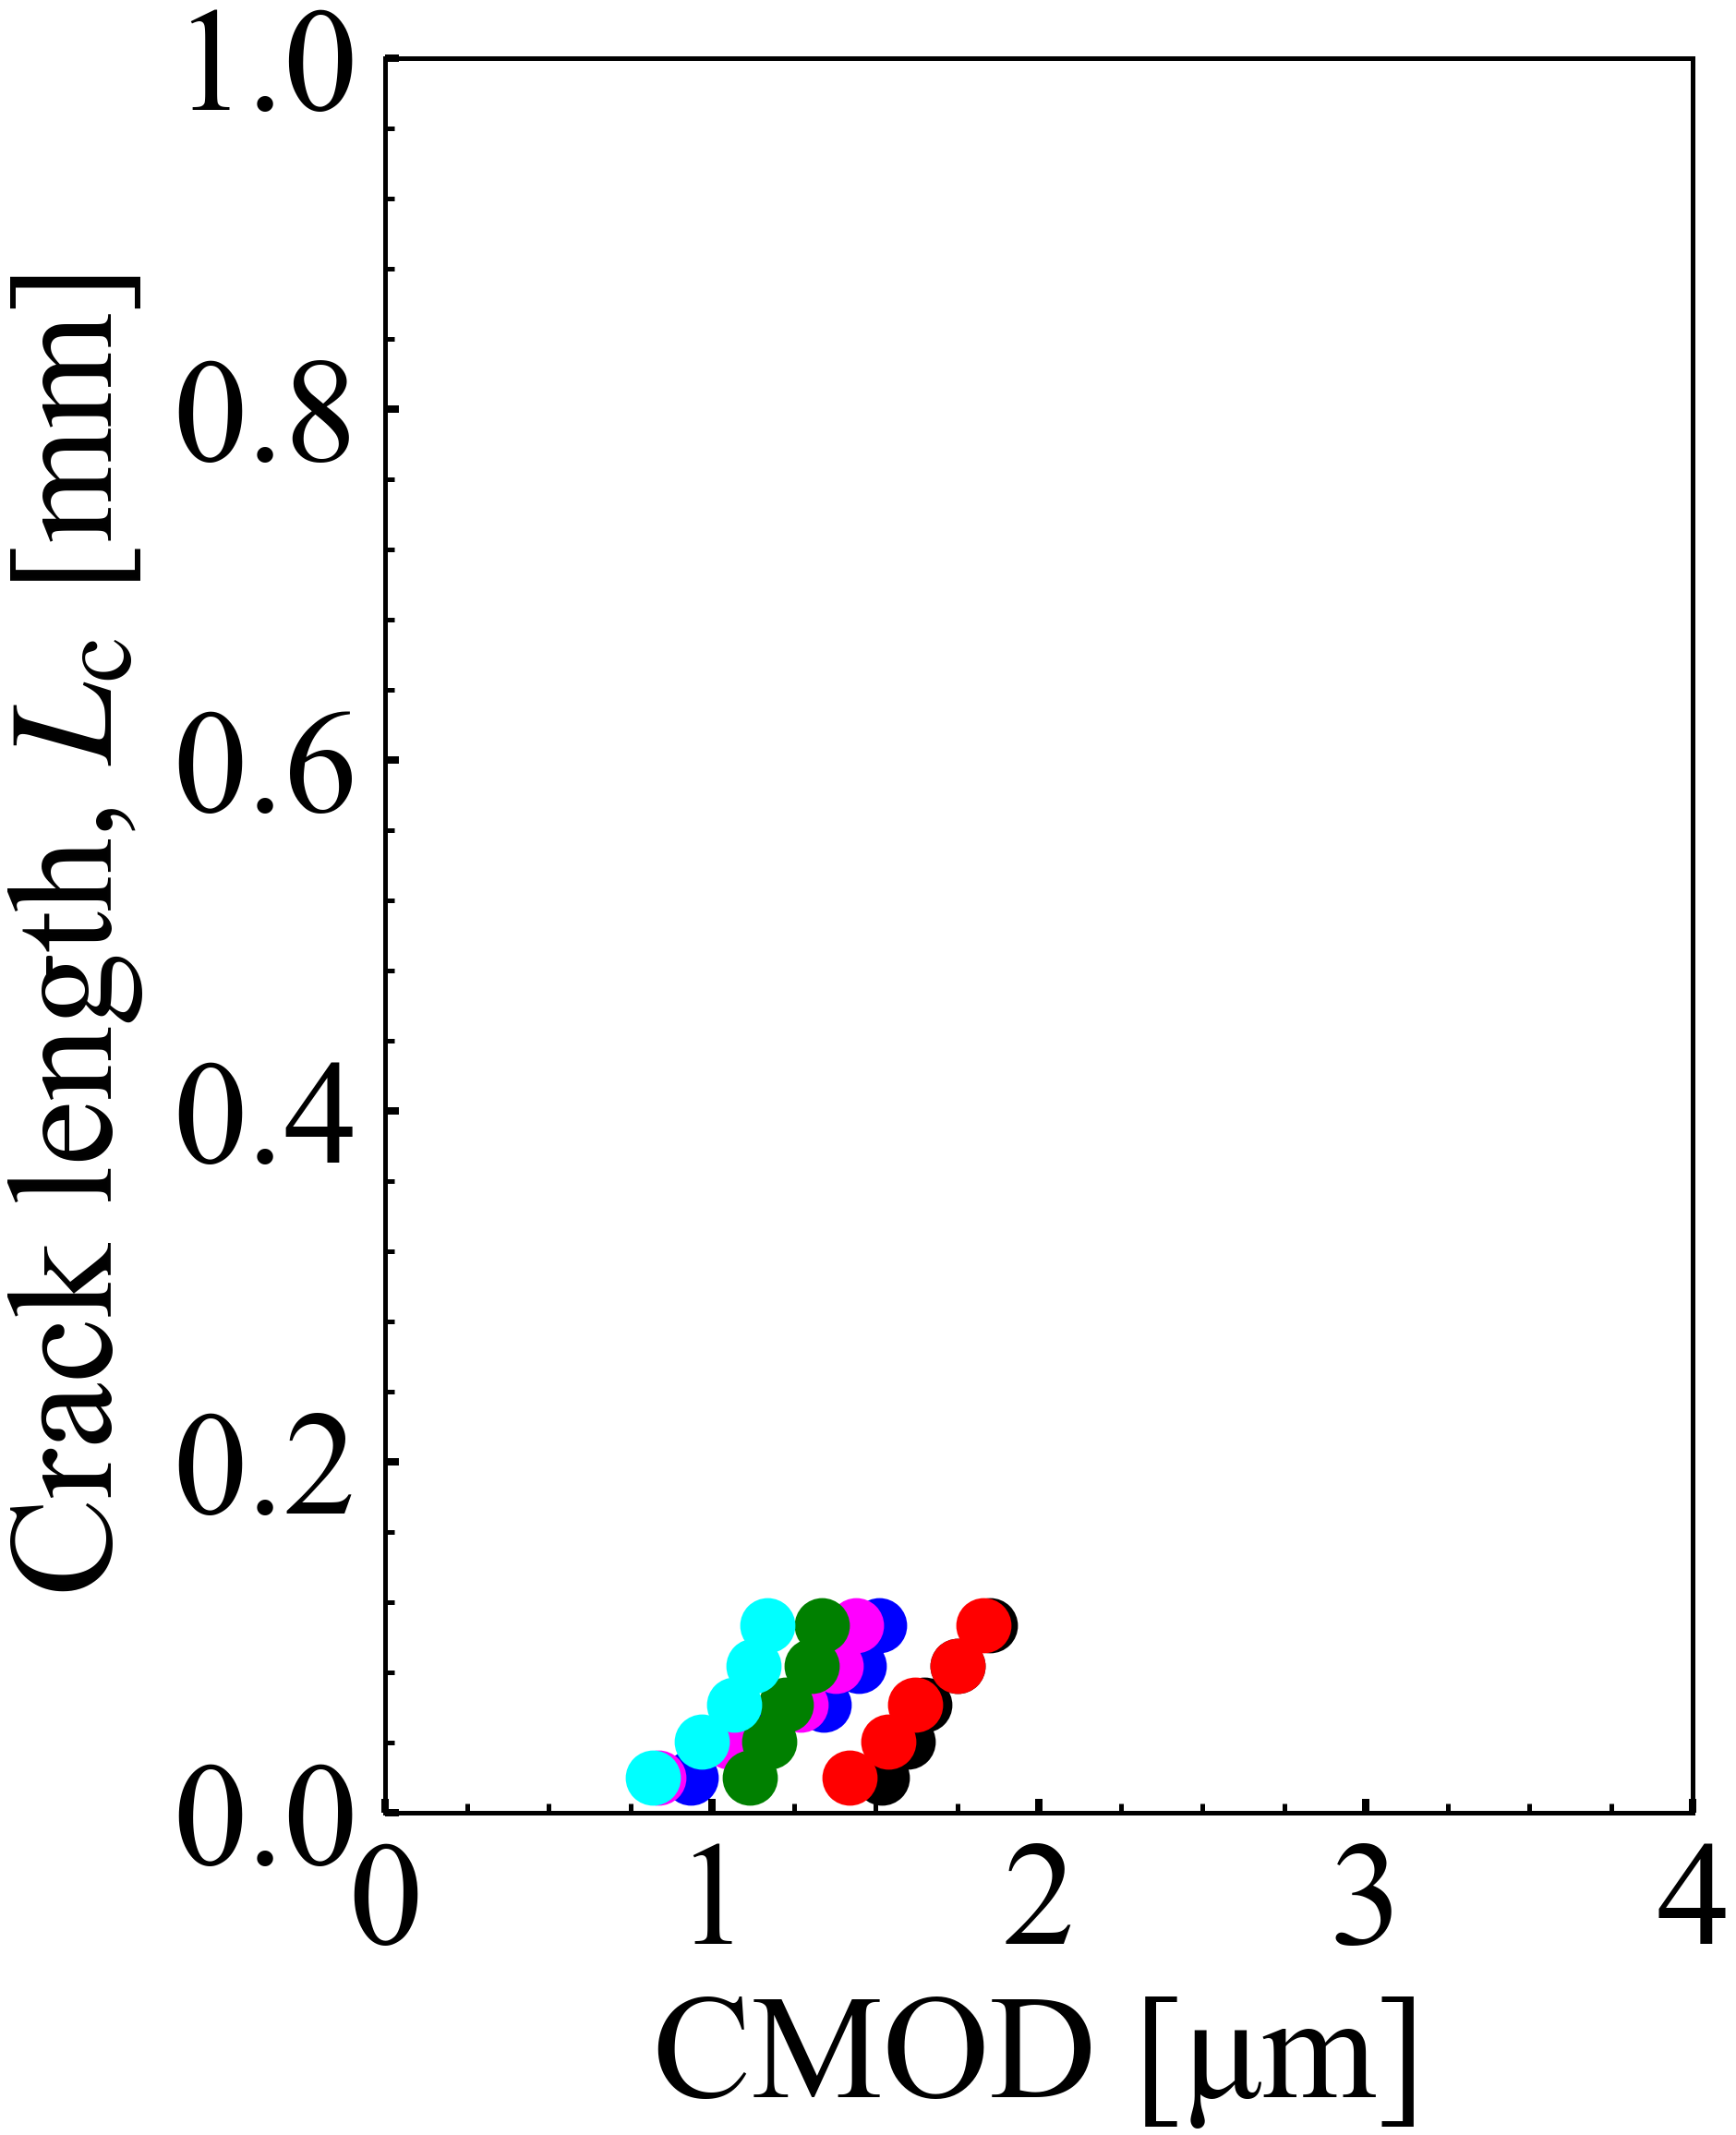
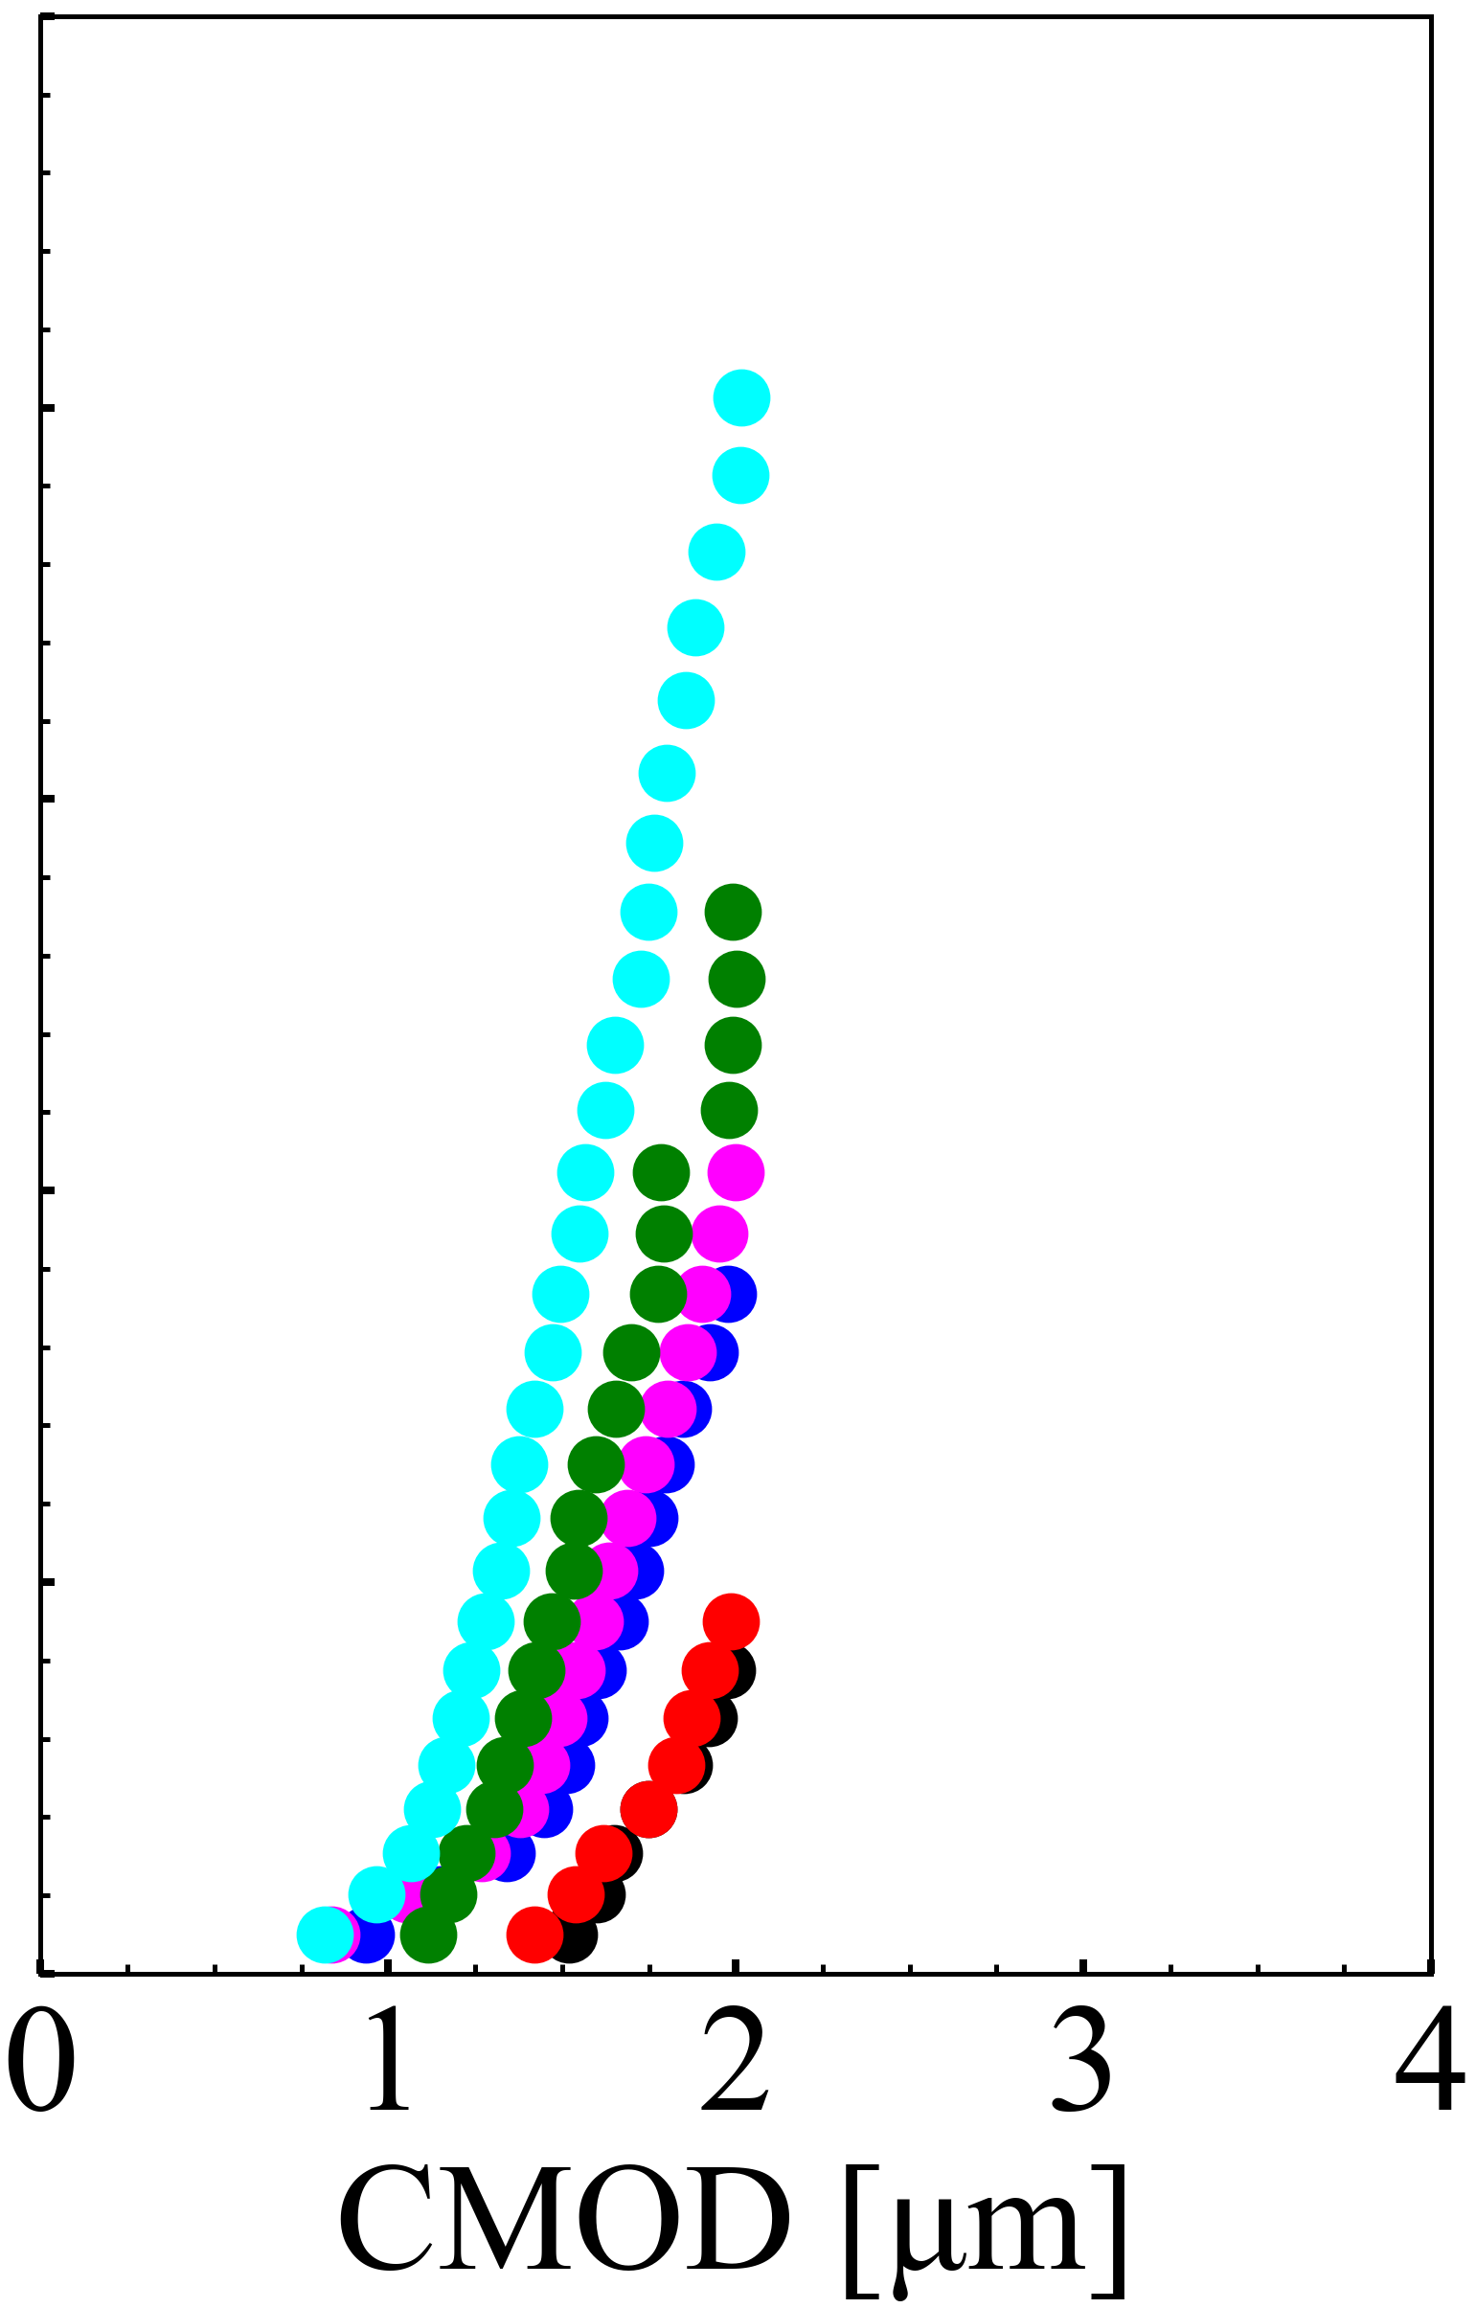
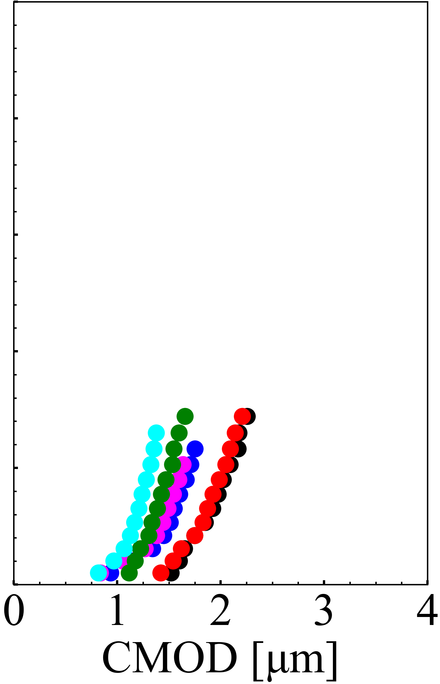
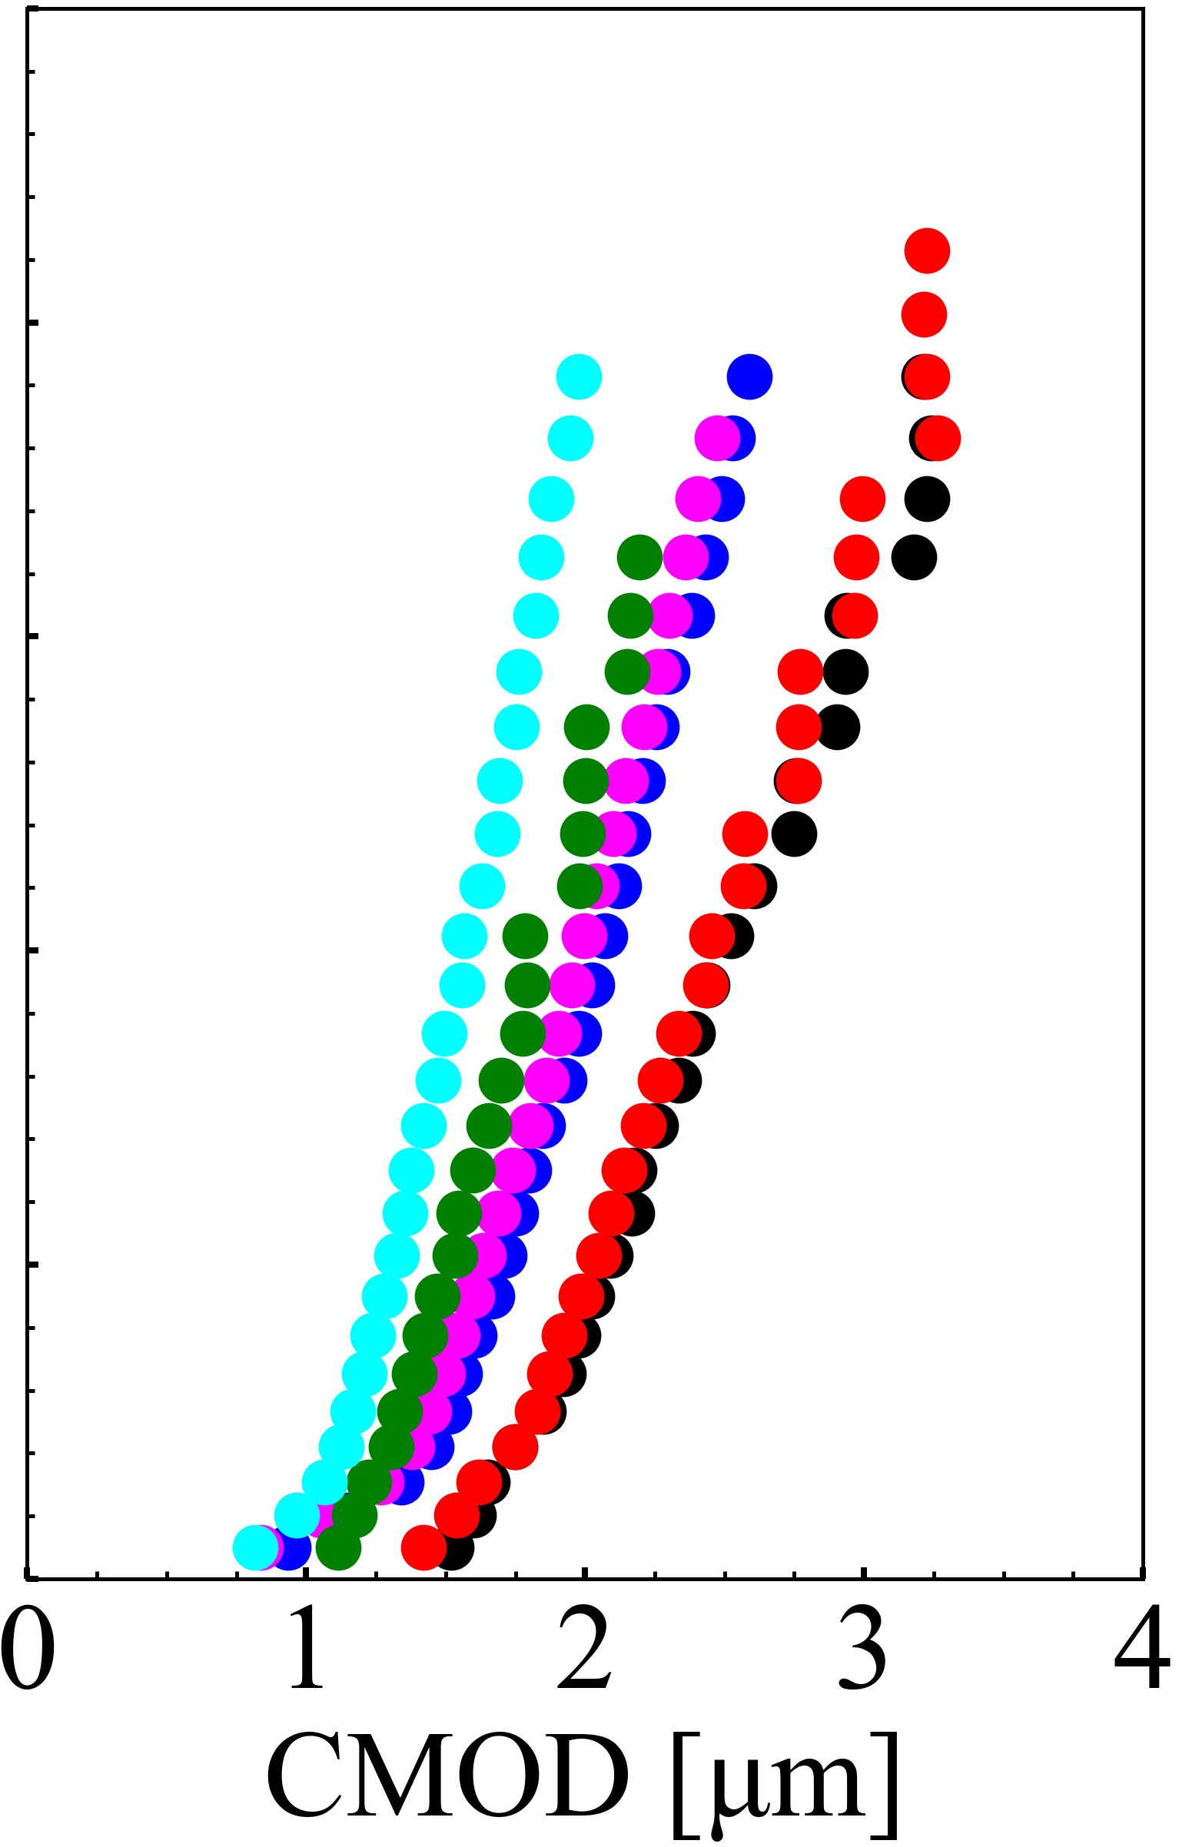
Figure: 04
AS15P
AS30P
MS15P
MS20P
AT15P
AT30P
Crack initiation force, F_{c}
100
Damage 1
Damage 2
Damage 3
Damage 4
(a)
(b)
(c)
(d)
80
60
Force, F [N]
40
20
0
1.0
0.8
0.6
Crack growth length, L_{c} [mm]
0.4
0.2
0.0
0
1
2
3
4
0
1
2
3
4
0
1
2
3
4
0
1
2
3
4
CMOD [µm]
CMOD [µm]
CMOD [µm]
CMOD [µm]

Slide 5
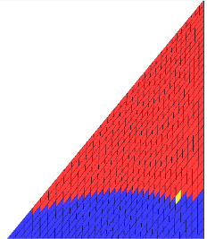
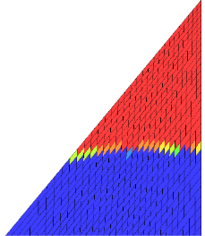
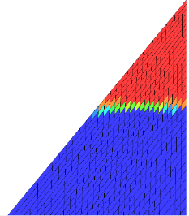
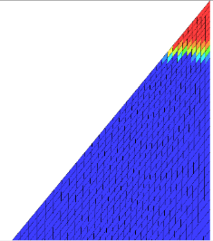
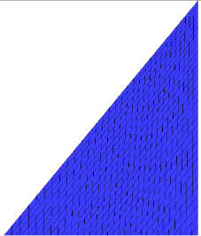
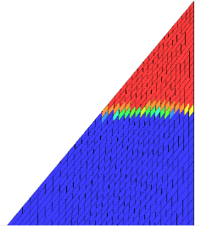
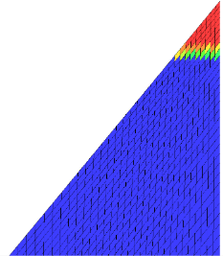
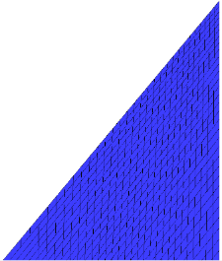
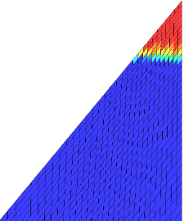

Figure: 05
0 h
15 h
30 h
60 h
90 h
Crack length
1473 K
1573 K
Damage variable, D
1673 K

Slide 6
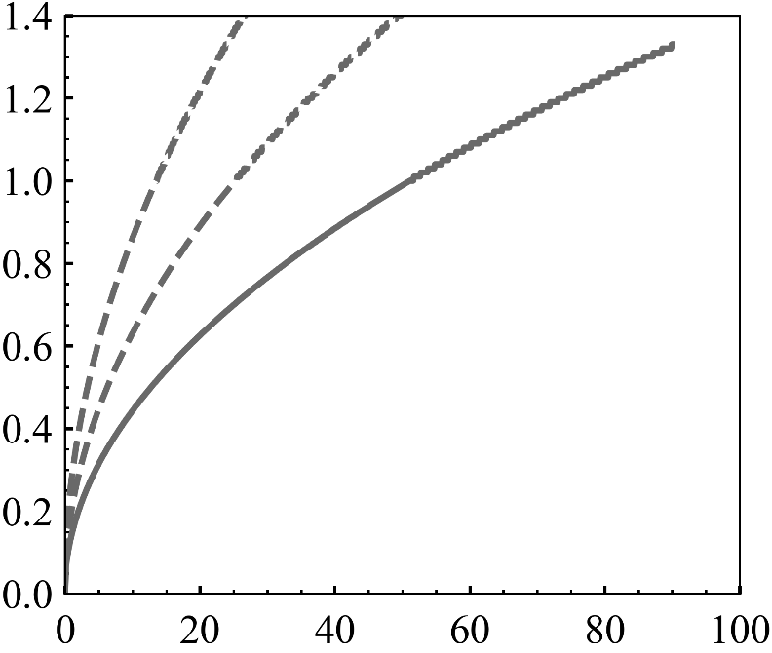
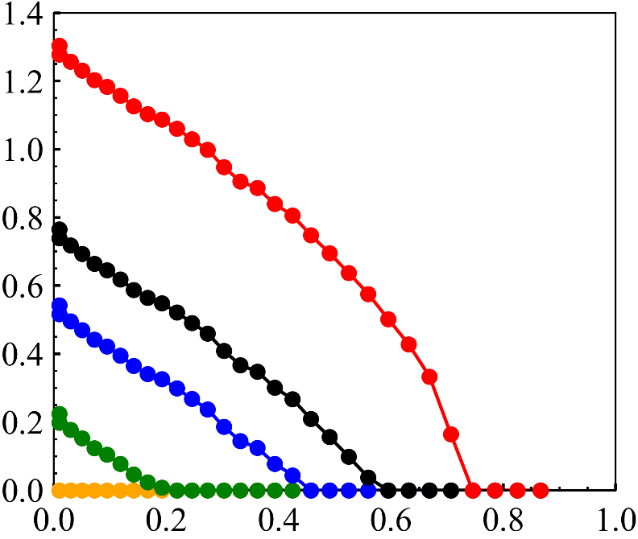
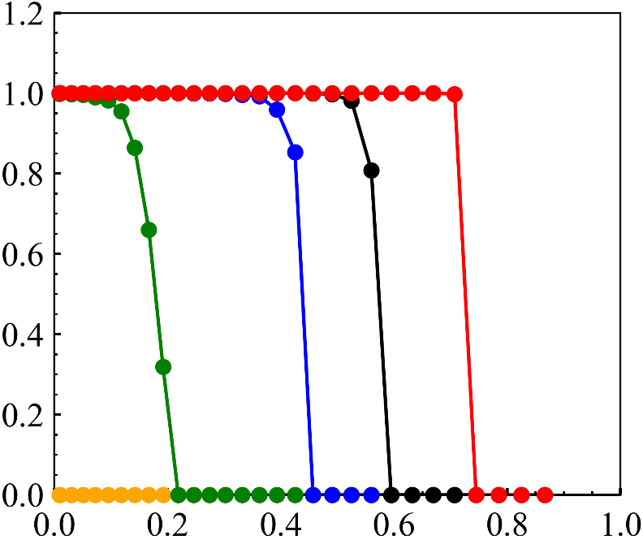
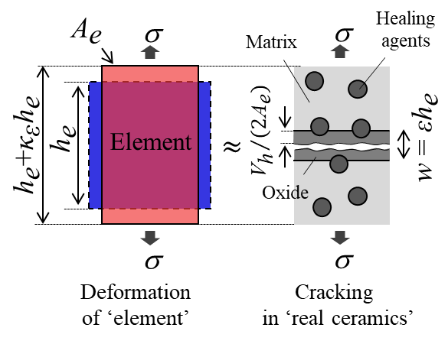

Figure: 06
(a)
(b)
AS30P
T_{h}=1473 K
1673 K
1573 K
1473 K
0 h
V_{h}/A_{e} [µm]
Thickness of oxidation products
Crack width, W [µm]
15 h
30 h
AS30P
60 h
90 h
Healing time, t_{h} [hour]
Distance from notch tip [mm]
(c)
(d)
AS30P
T_{h}=1473 K
W=($ε−ε0$)h_{e}
Damage variable, D [-]
90 h
60 h
30 h
15 h
0 h
Distance from notch tip [mm]

Slide 7
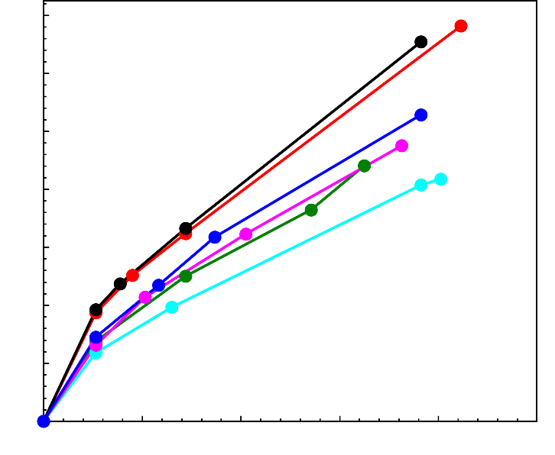
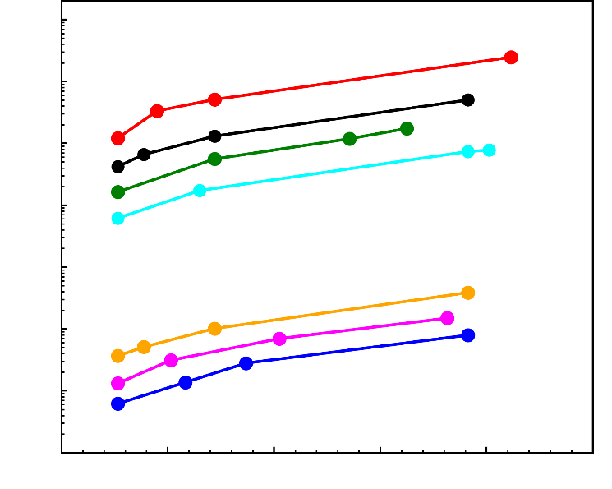
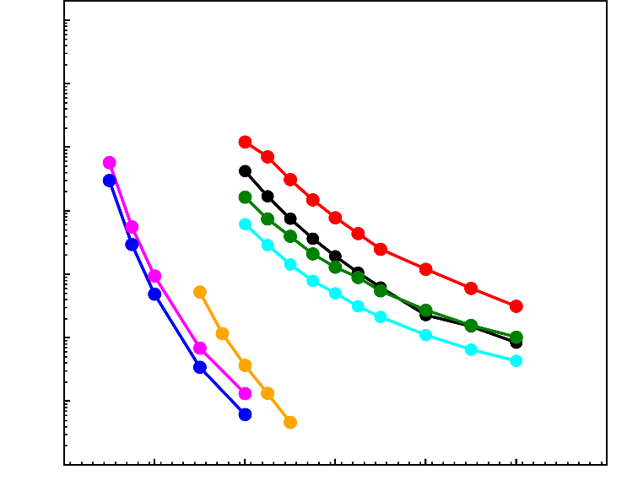









Figure: 07
AS15P
AS30P
AS30P0.2MnO
MS15P
MS20P
AT15P
AT30P
(a)
1.4
1.2
1.0
0.8
Maximum crack width, W [µm]
0.6
0.4
0.2
Damage 1
Damage 1 - 4
0.0
0.0
0.2
0.4
0.6
0.8
1.0
(b)
Crack length, L_{c} [mm]
$${\text{10}}^{\text{4}}$$
$${\text{10}}^{\text{3}}$$
Damage 1
$${\text{10}}^{\text{2}}$$
$${\text{10}}^{\text{1}}$$
Minimum healing time, ${\text{t}}_{\text{h}}^{\text{min}}$[h]
$${\text{10}}^{\text{0}}$$
$${\text{10}}^{\text{−1}}$$
$${\text{10}}^{\text{−2}}$$
T_{h}=1273K
$${\text{10}}^{\text{−3}}$$
0.0
0.2
0.4
0.6
0.8
1.0
(c)
Crack length, L_{c} [mm]
$${\text{10}}^{\text{4}}$$
$${\text{10}}^{\text{3}}$$
$${\text{10}}^{\text{2}}$$
$${\text{10}}^{\text{1}}$$
Minimum healing time, ${\text{t}}_{\text{h}}^{\text{min}}$[h]
$${\text{10}}^{\text{0}}$$
$${\text{10}}^{\text{−1}}$$
$${\text{10}}^{\text{−2}}$$
Damage 1
$${\text{10}}^{\text{−3}}$$
473
873
1273
1673
2073
2473
2873
Healing temperature, T_{h} [K]

Slide 8
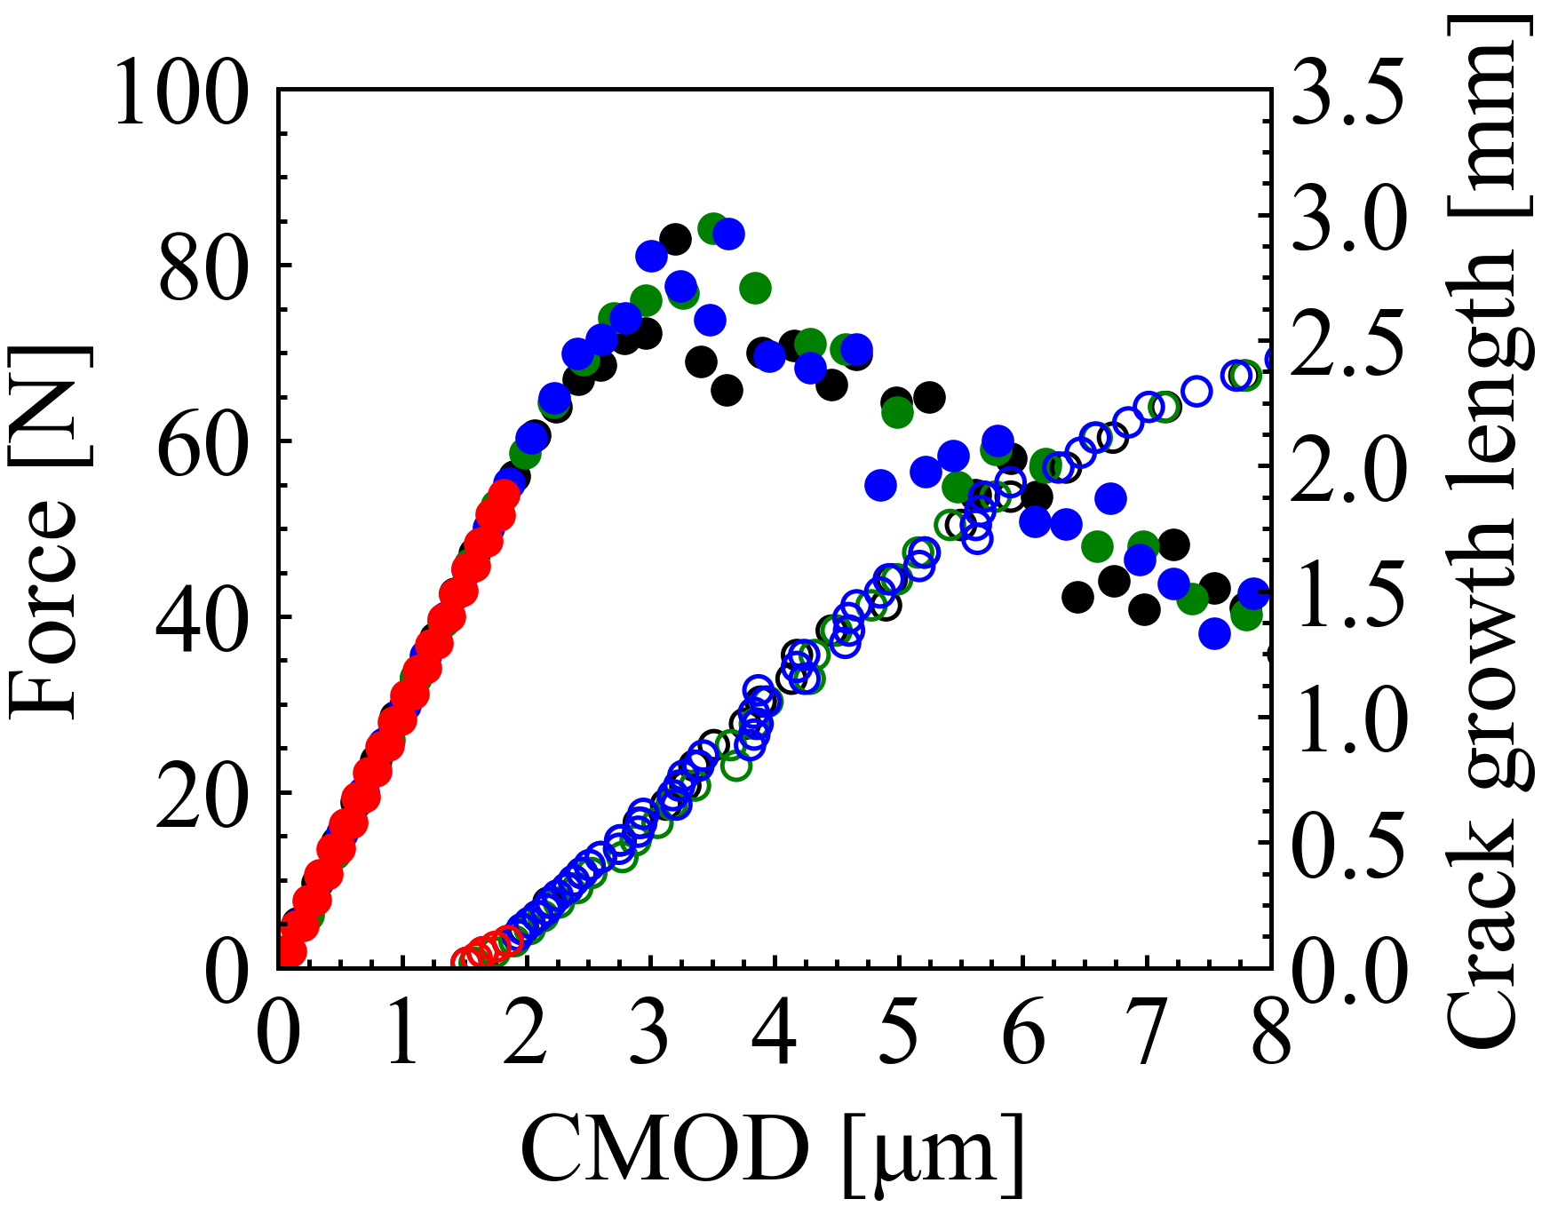

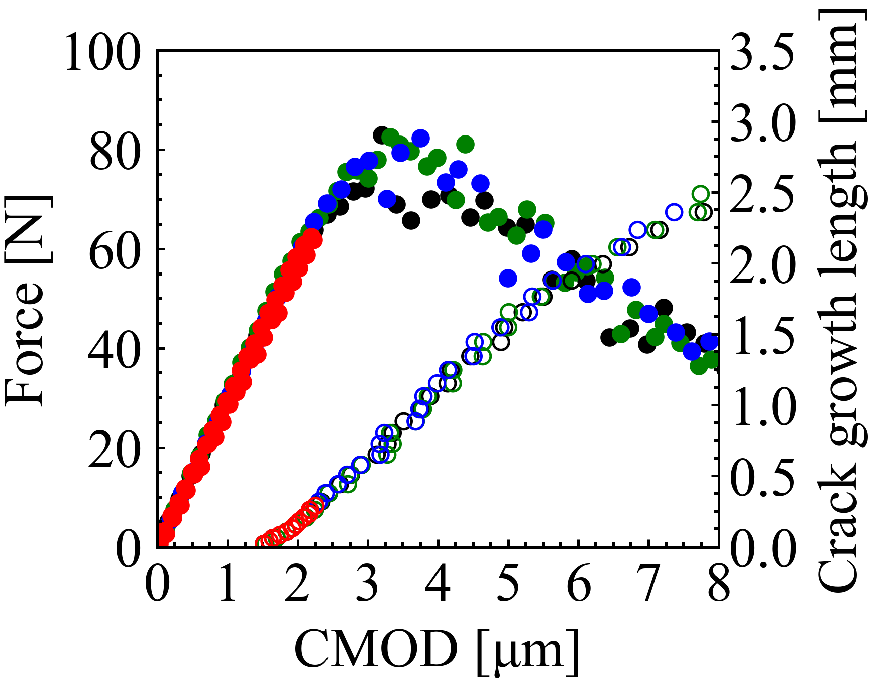
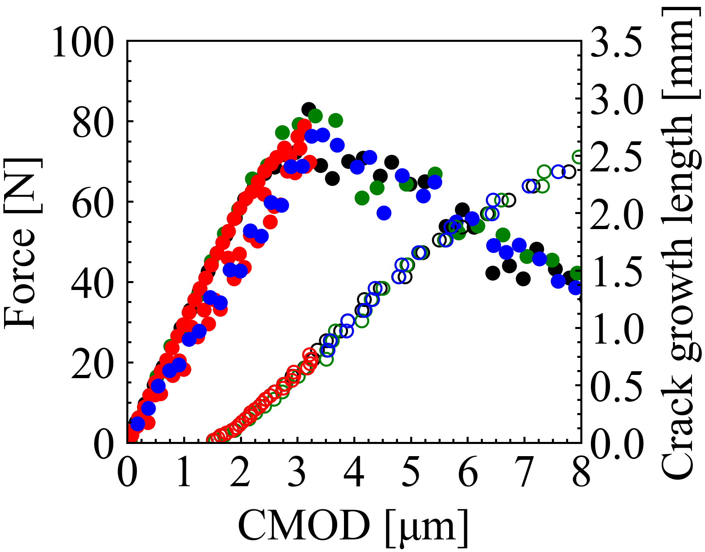
Figure: 08
Loading
Closed
Open
: Force
Loading-unloading
: Crack growth length
Reloading after healing
Reloading without healing
(a)
(b)
Damage 1
Damage 2
(c)
(d)
Damage 3
Damage 4

Slide 9
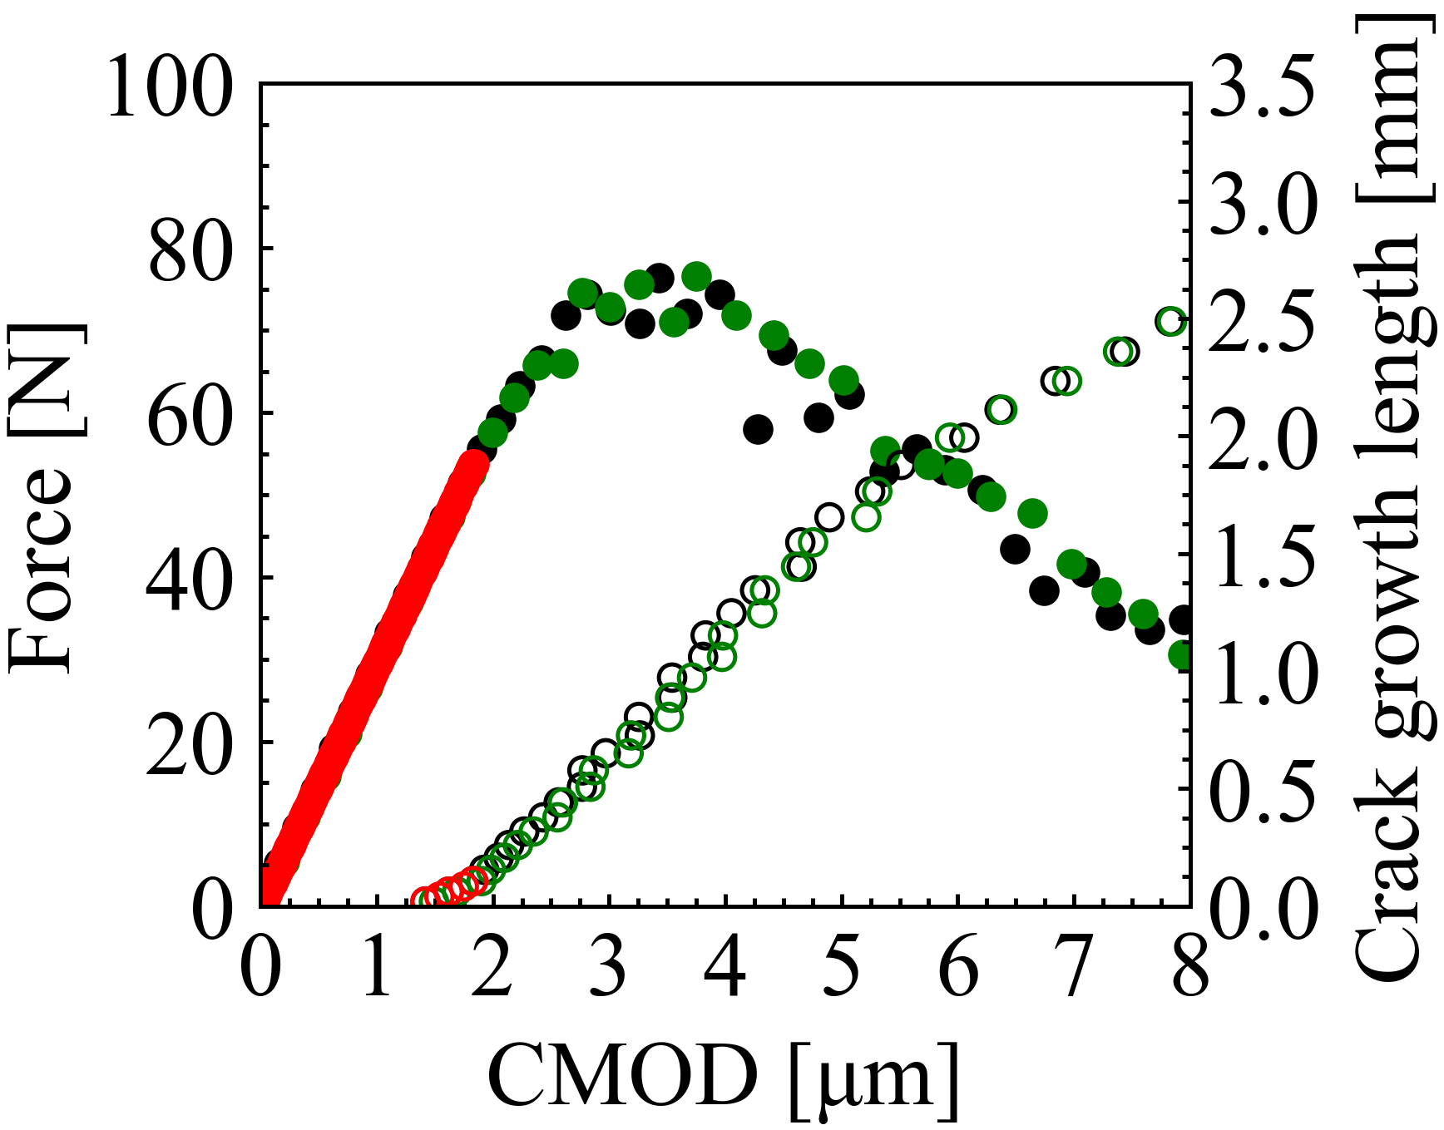
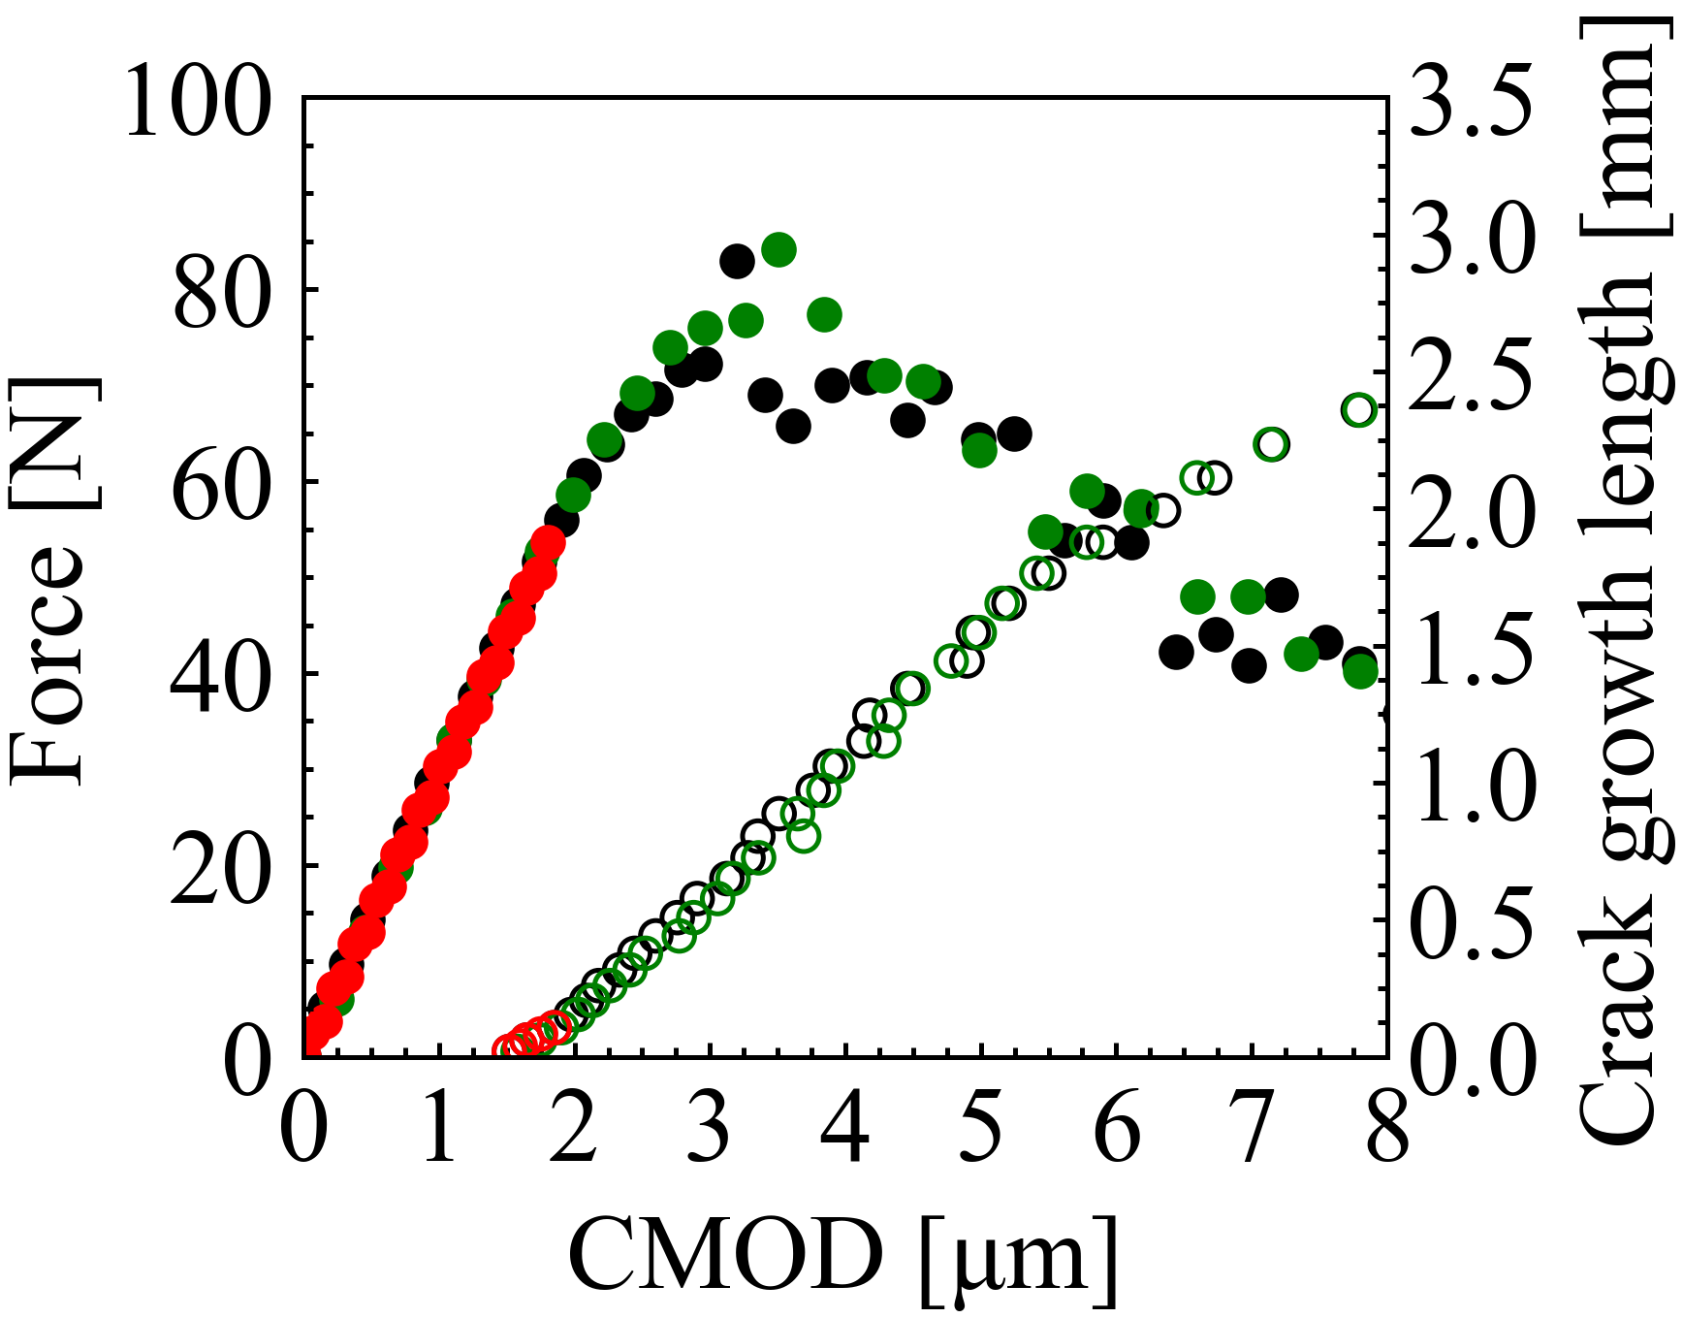
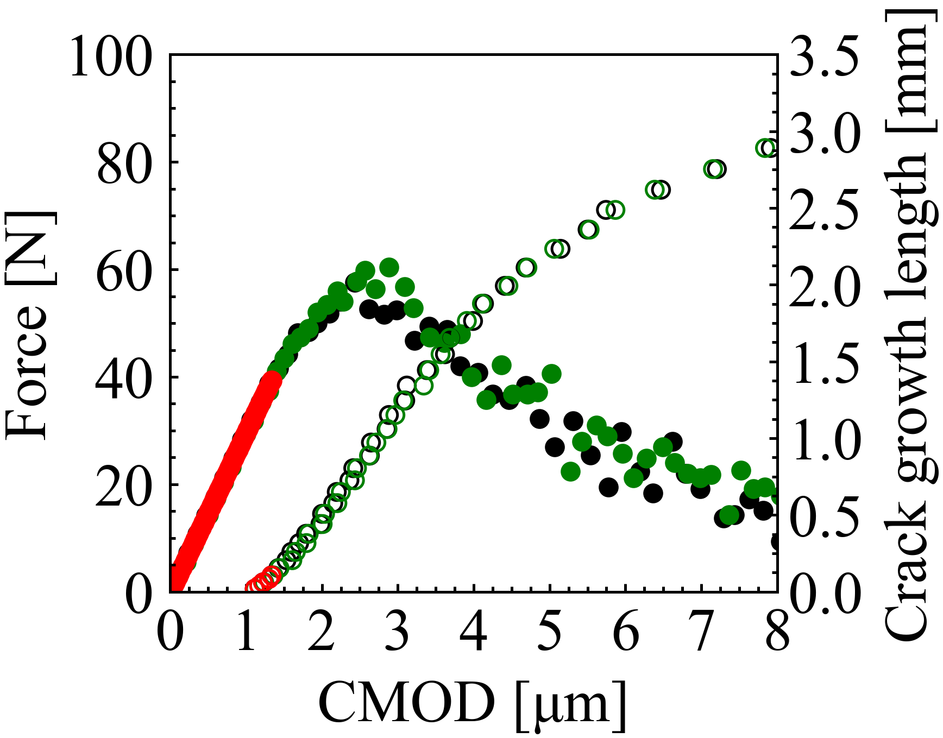
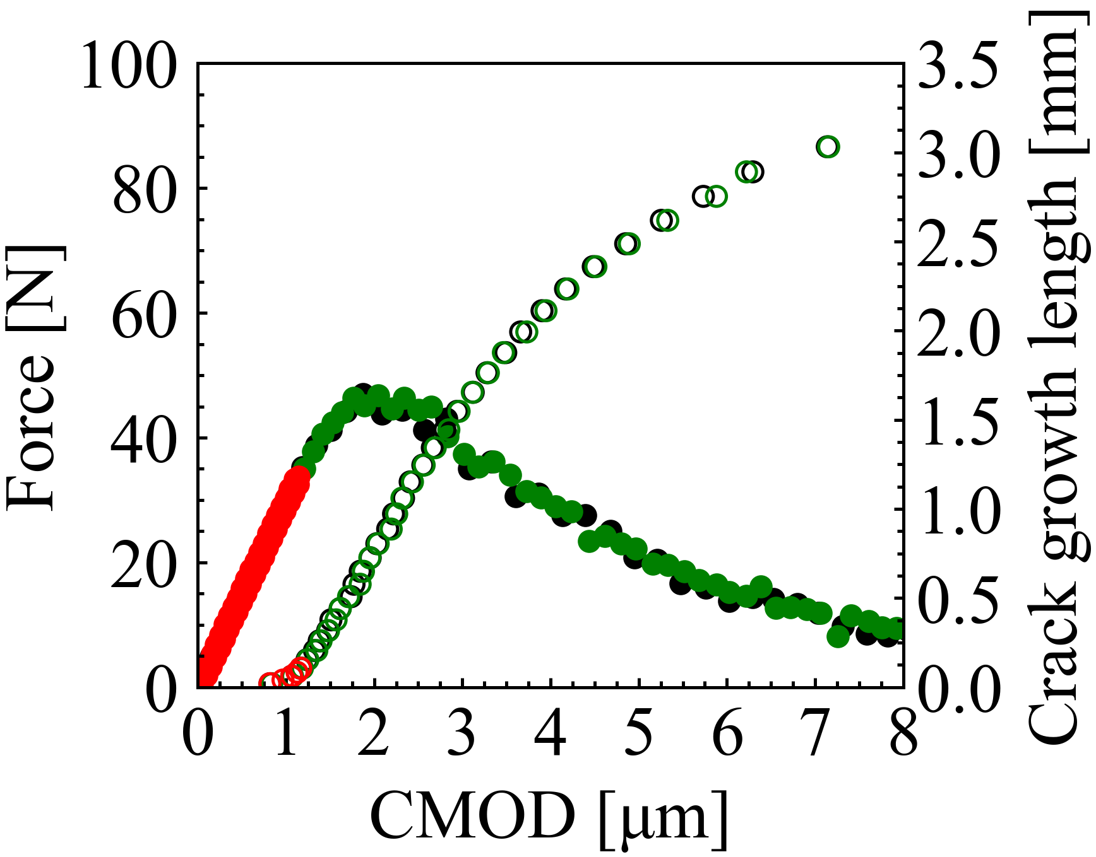
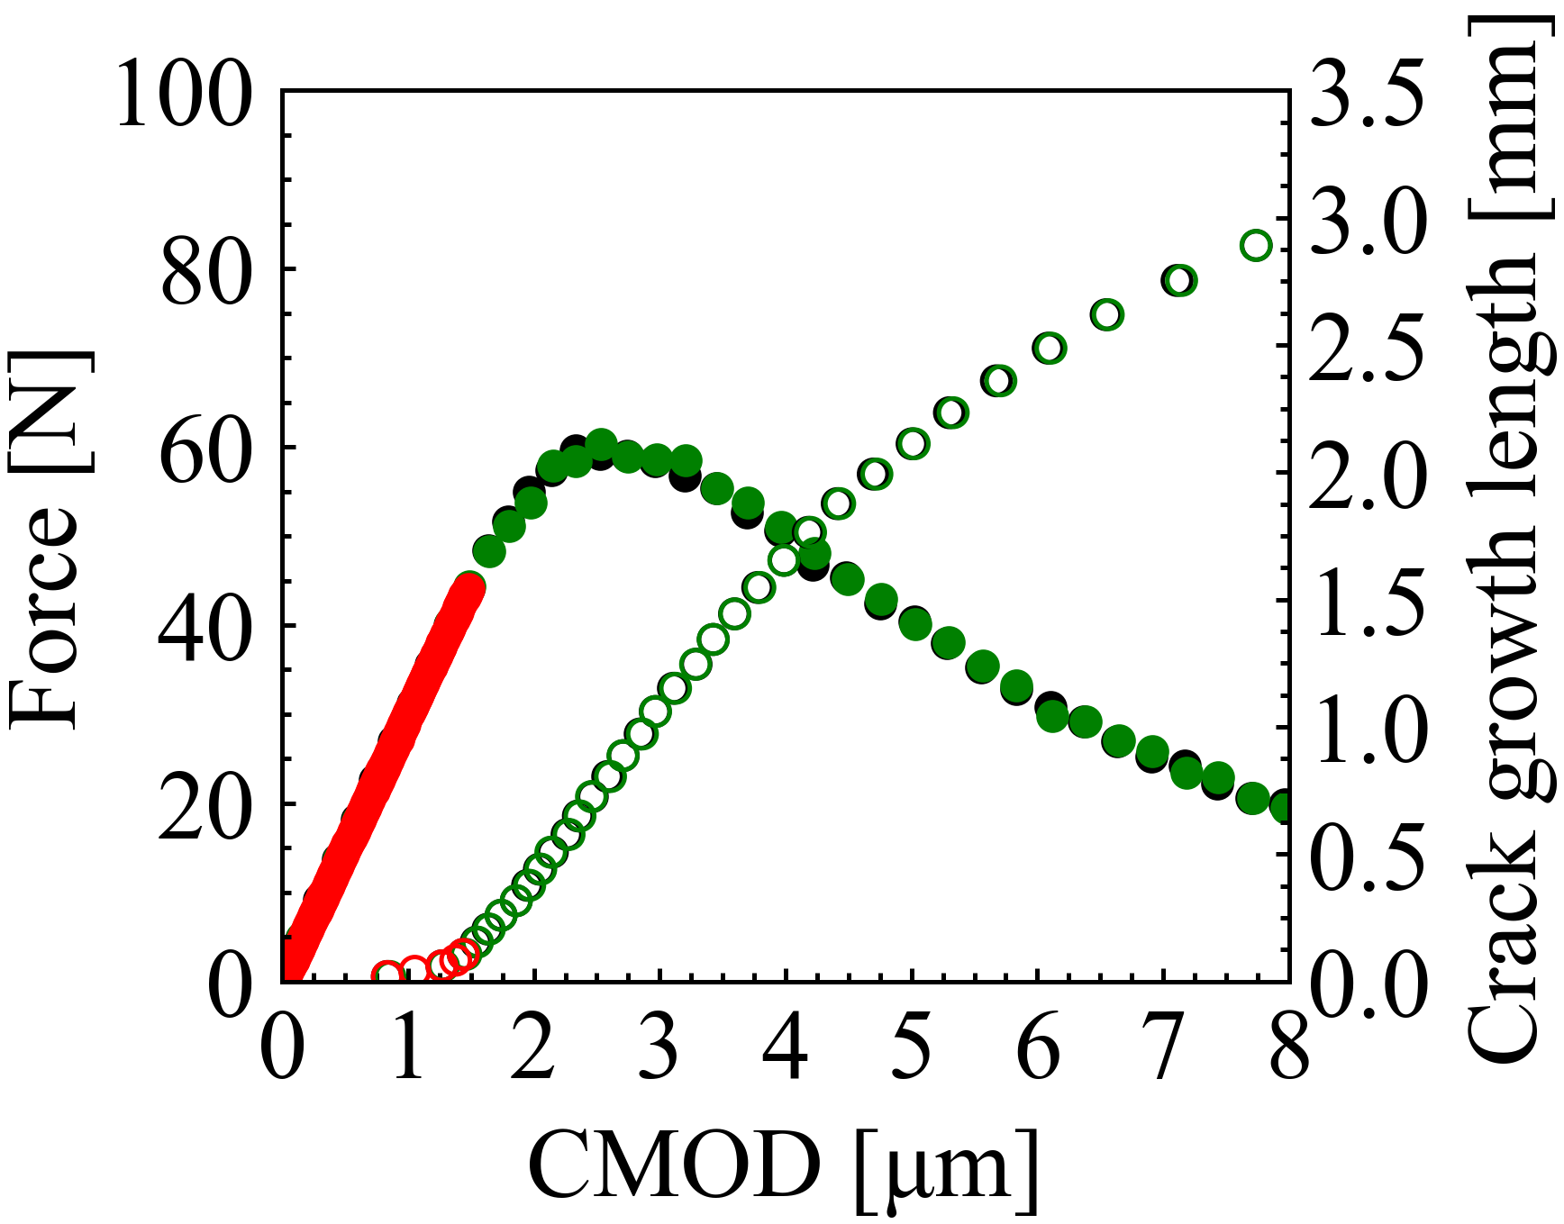
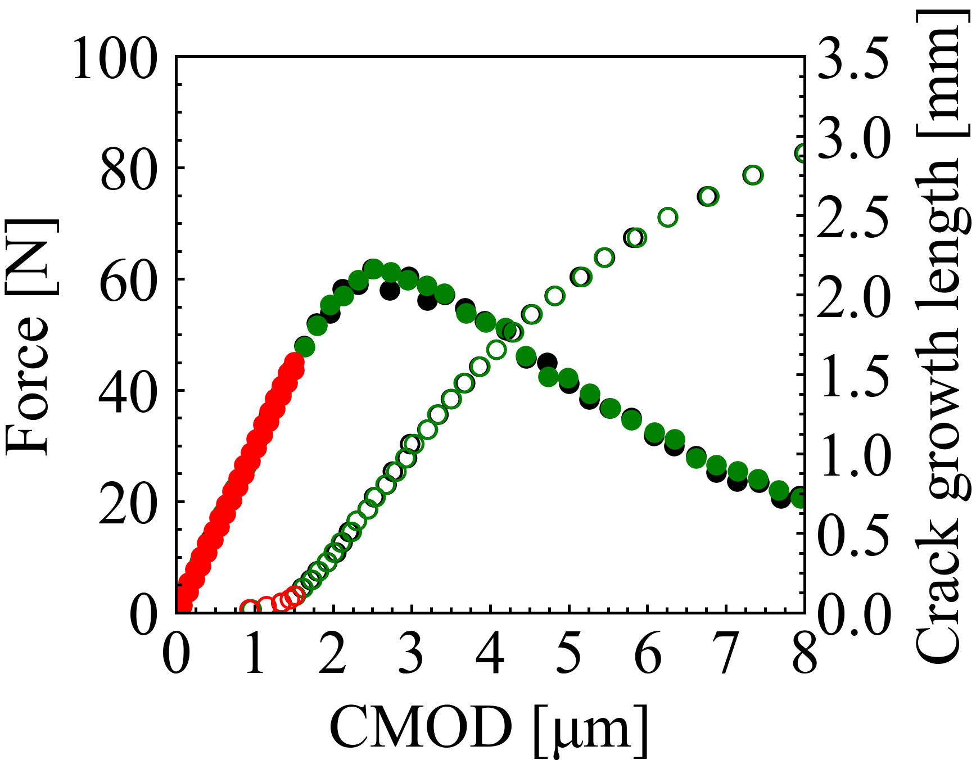
Figure: 09
Loading
Closed
: Force
Loading-unloading
Open
: Crack growth length
Reloading after healing
(a)
(b)
AS15P
AS30P
(c)
(d)
MS15P
MS20P
(e)
(f)
AT15P
AT30P

Slide 10
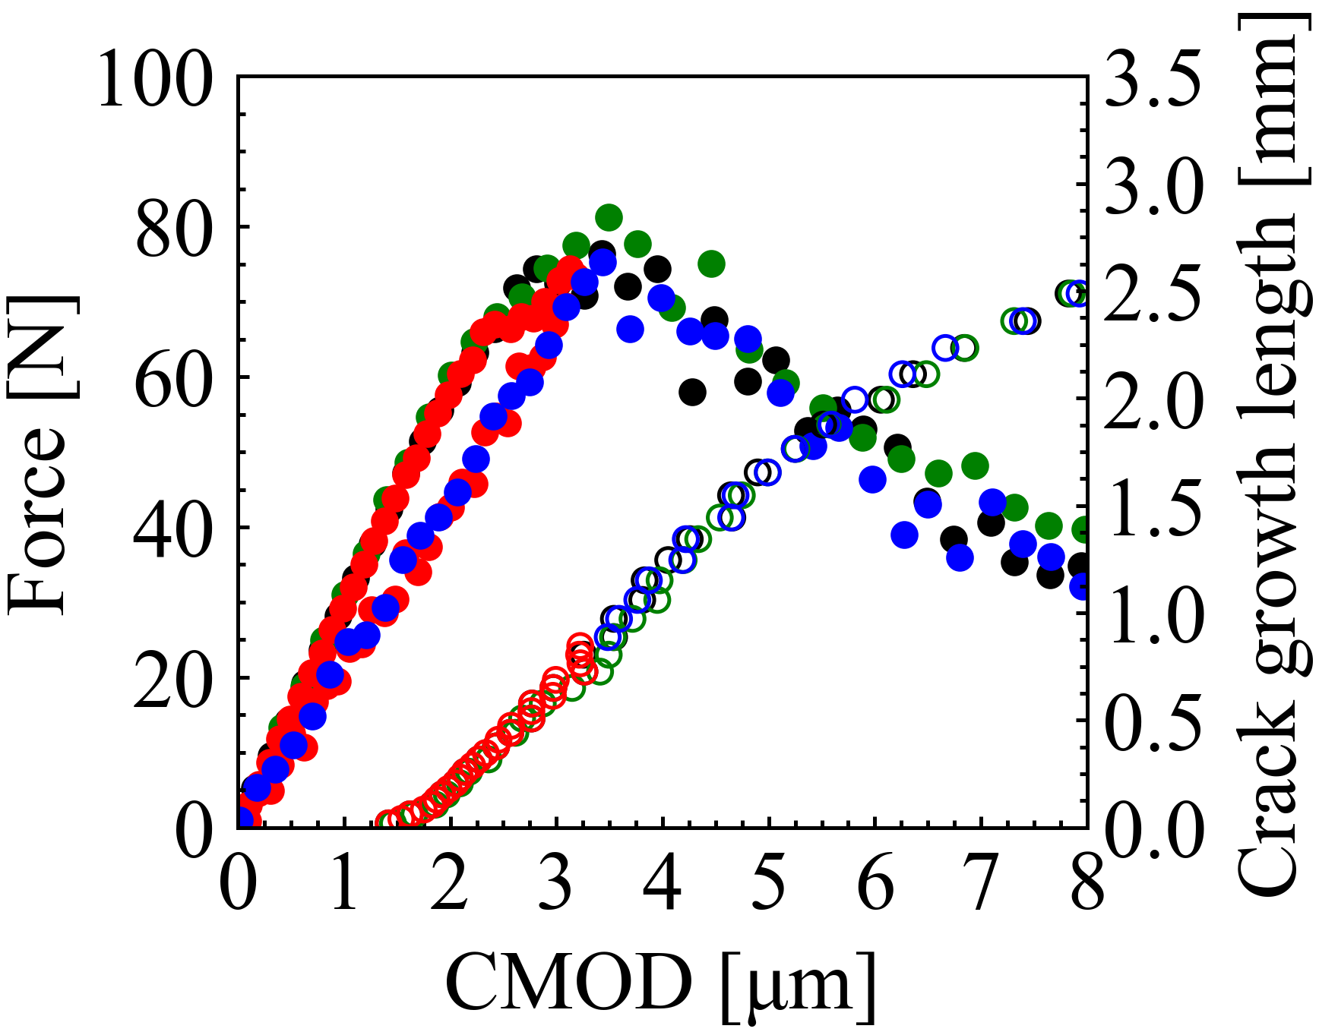
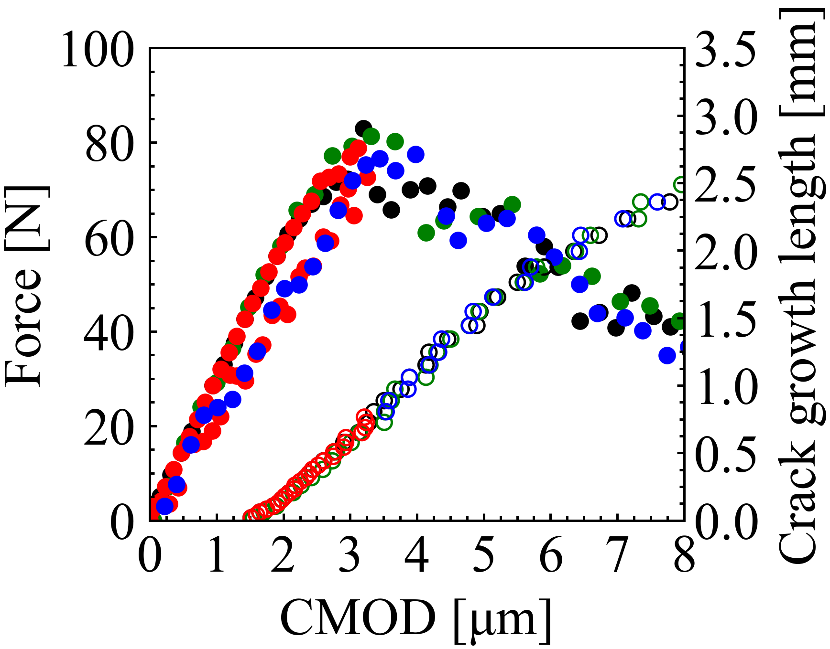
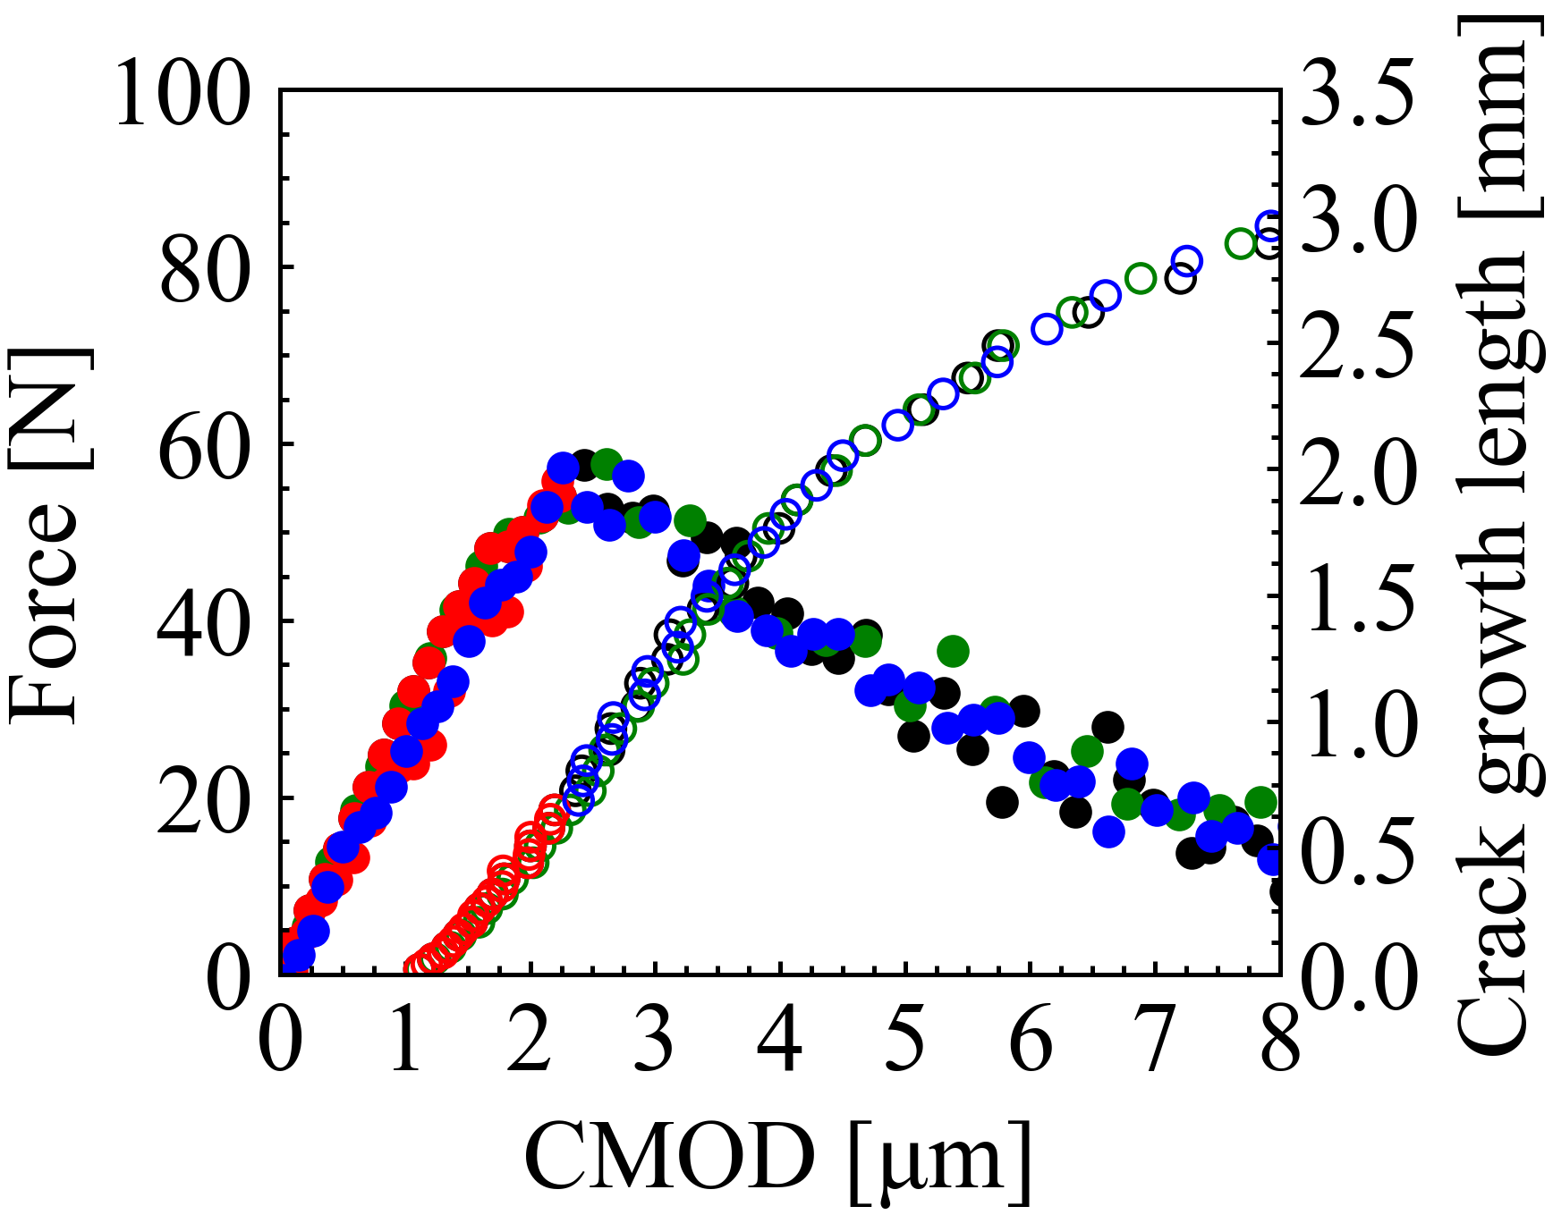
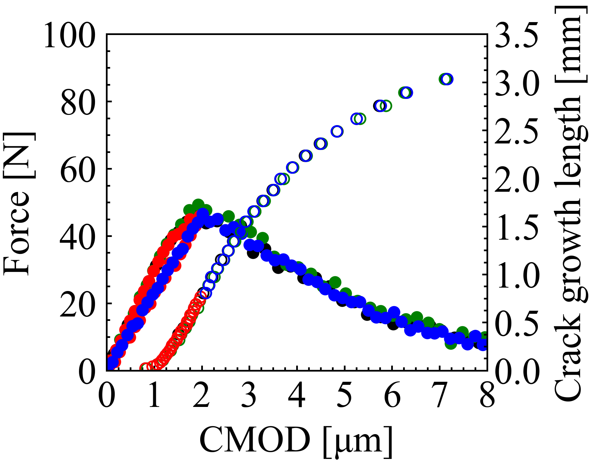
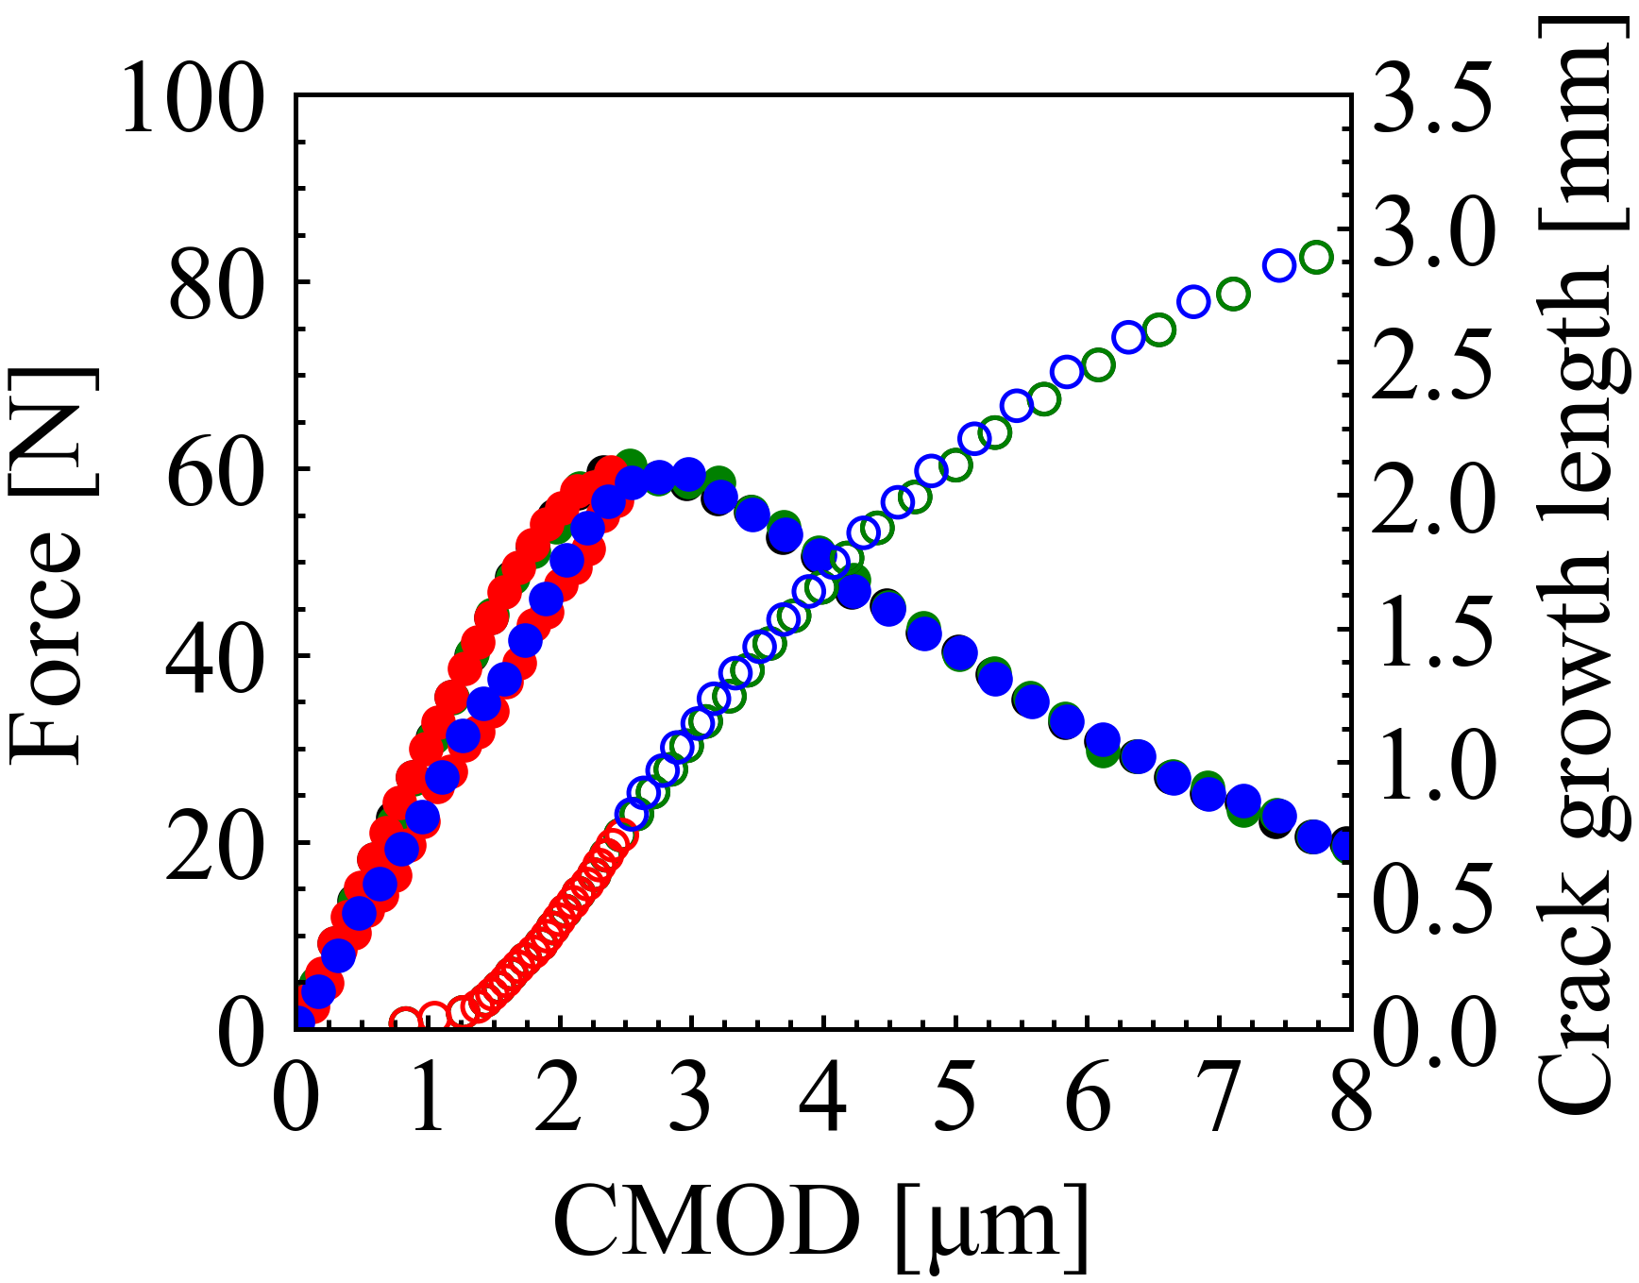
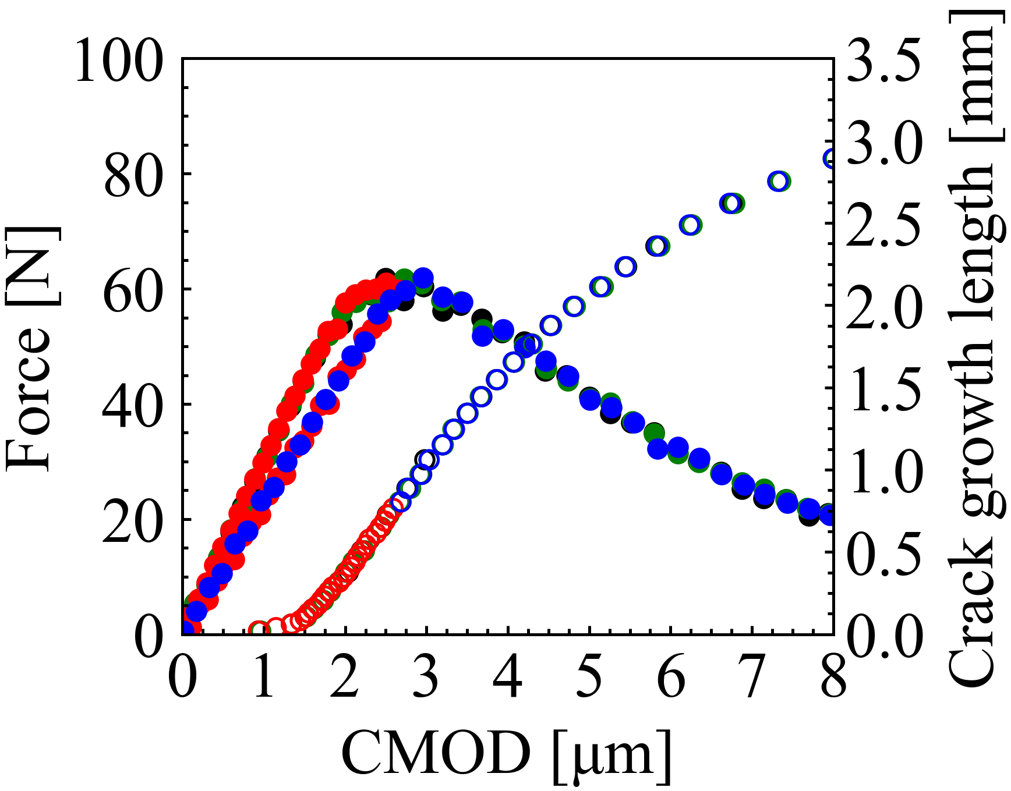
Figure: 10
Loading
Closed
Open
: Force
Loading-unloading
: Crack growth length
Reloading after healing
Reloading without healing
(a)
(b)
AS15P
AS30P
(c)
(d)
MS15P
MS20P
(e)
(f)
AT15P
AT30P

Slide 11
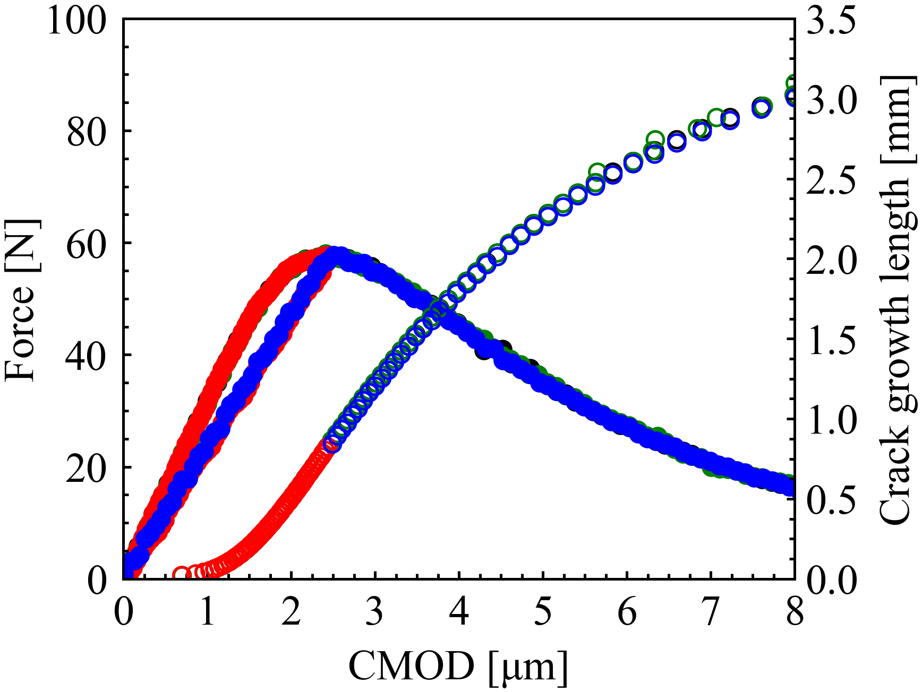
Figure: 11 Appendix B
Loading
Loading-unloading
Reloading after healing
Reloading without healing
Closed
Open
: Force
: Crack growth length
AT30P

