Slide 1
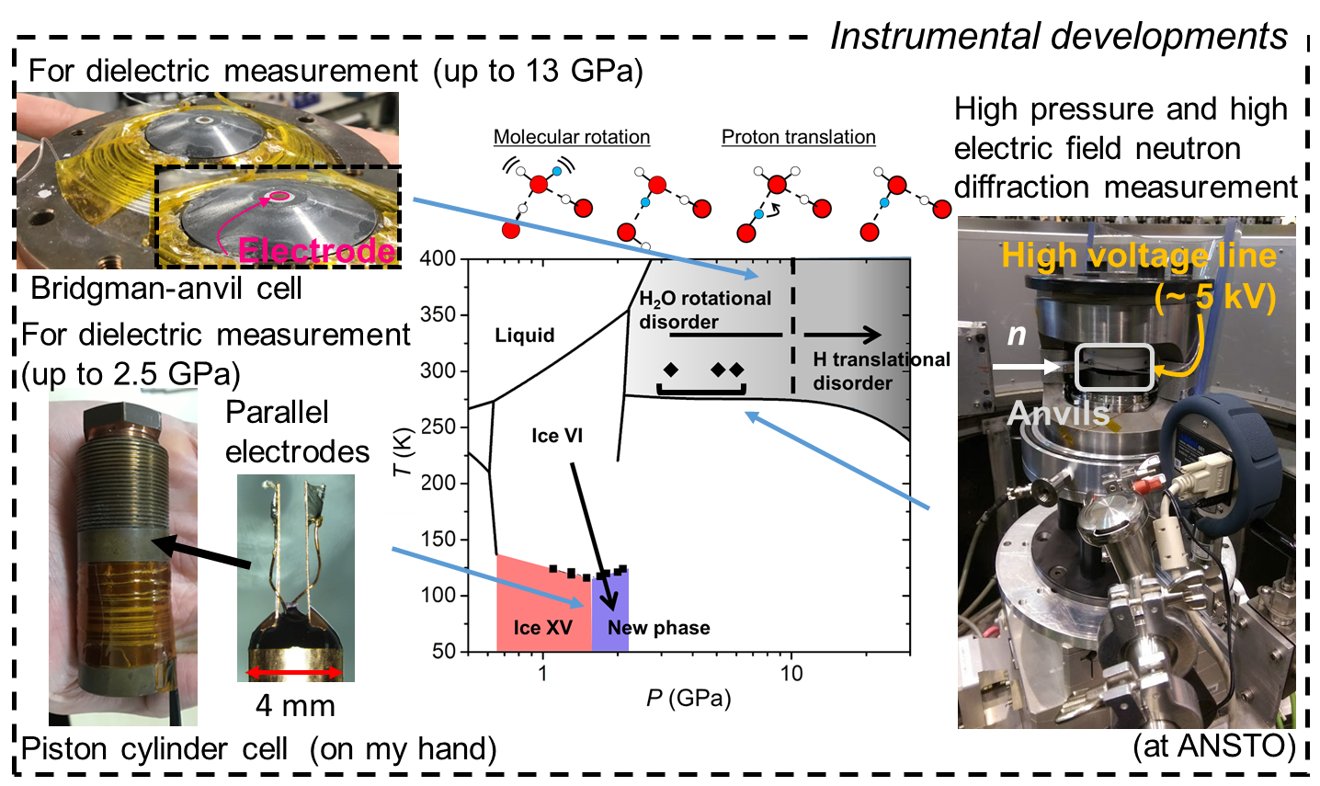
Search for a ferroelectric ice under high pressure
by dielectric and neutron diffraction measurements
using newly developed high-pressure cells
Ryo Yamane (NIMS)
Notes:
Thank you chair man for your introduction my name is Ryo yamane belonging to NIMS.
I’m going to talk about ice.
My talking is a little bit difference from the main topic of this session,
but It’s happy for me to give inspirations for your research from my talk.
(20 s)

Slide 2
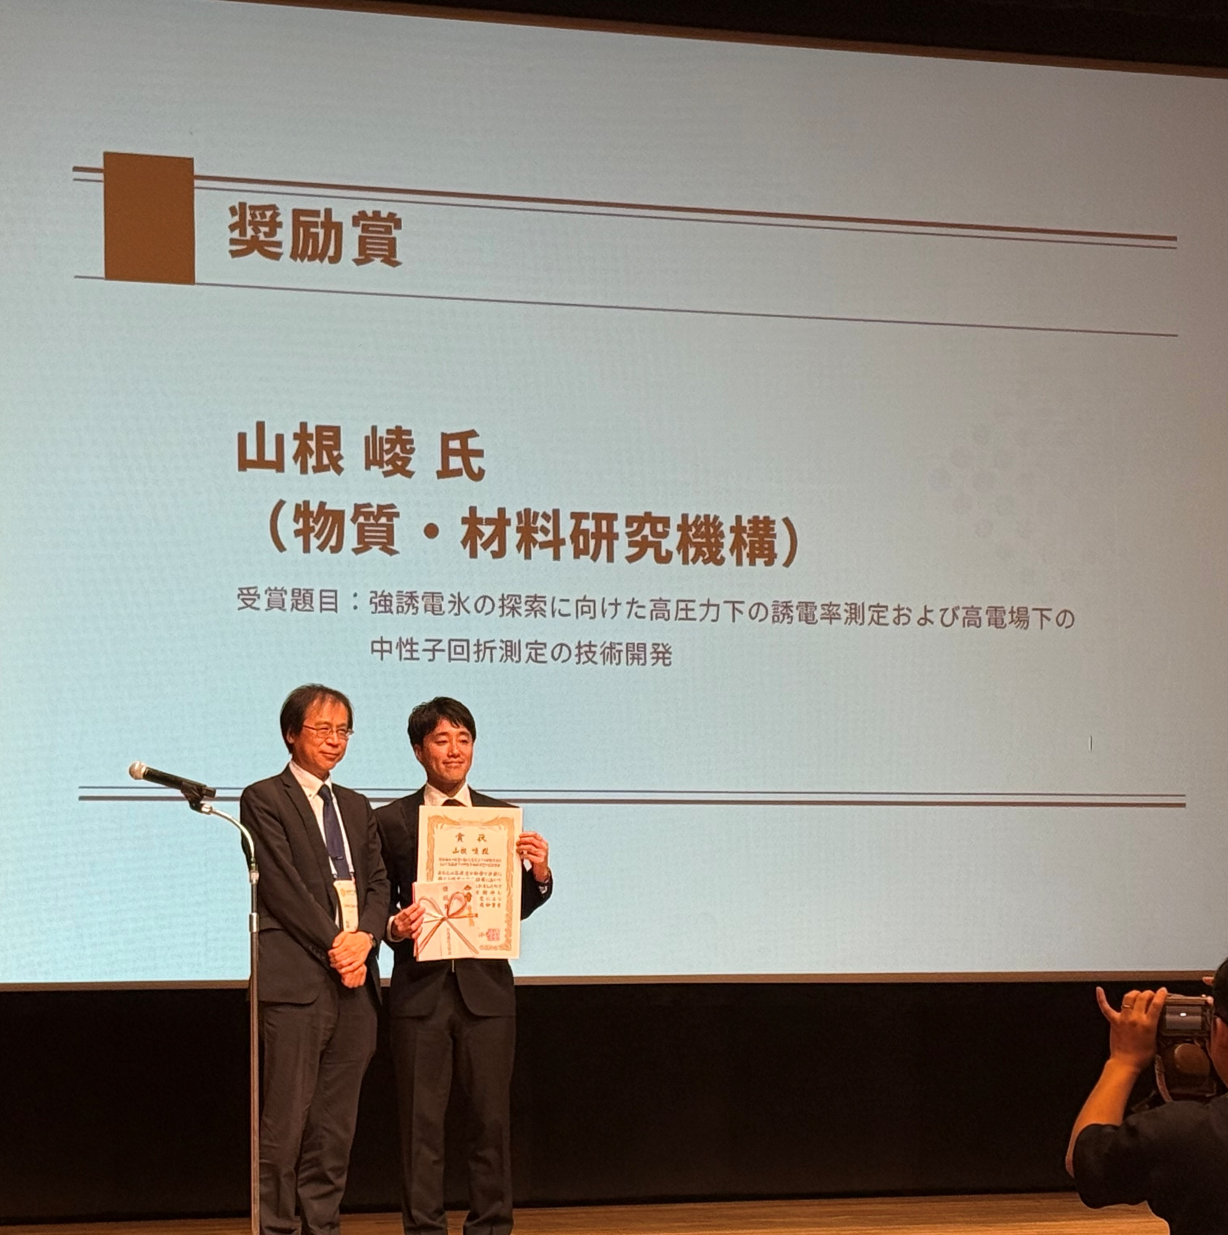


Acknowledgement
Young scientist award 2025
(Japan Society of High Pressure Science
and Technology)
2020 at the University of Tokyo with Kagi’s lab. staffs
(Yesterday’s photo)
Prof. Yagi
Prof. Kagi
Iizuka-san
Aoki-san
Komatsu-san
Notes:
First of all, I’m deeply honored to receive Young scientist award 2025 from Japan Society of High pressure Science and Technology.
I received the prize based on my Ph.D research about ice, and I’d like to express my sincere gratitude to everyone who supported me at Kagi’s Laboratry.
(30 s)

Slide 3
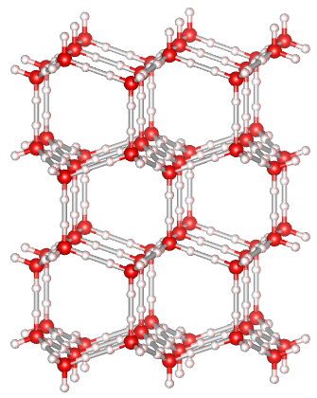
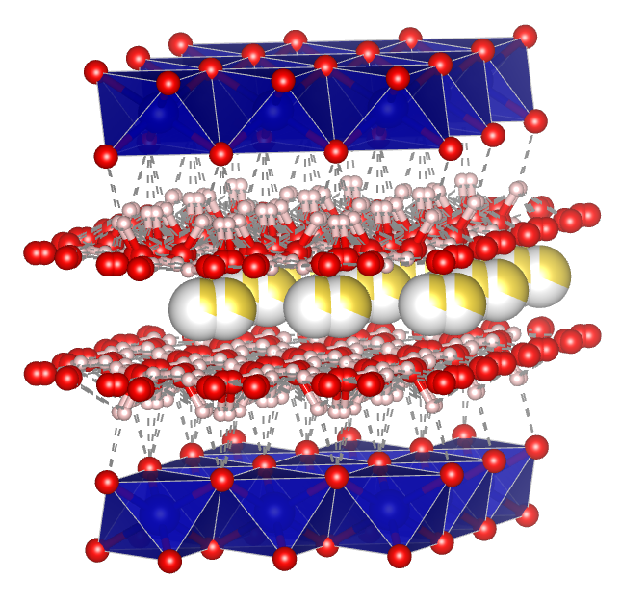
Water molecules in solids
Water molecules exist in many inorganic and organic materials.
Na_{x}CoO₂·yH₂O
(x ~ 0.35, y ~ 1.35)
？
Superconductivity
Takada et al., (2003)
Ice (H₂O)
Water content
The existence of water molecules
has great effect on physical properties of host materials.
Dehydration induced
structural collapse
Beryl
(Be₃Al₂Si₆O₁₈)
Vivianite
(Fe₃(PO4)₂･8H₂O)
Yamane et al., (2023)
Quantum paraelectricity
Gorshunov et al., (2016)
Notes:
Water molecule exist many inorganic and organic materials universally.
Some inorganic hydrates and its characteristics derived water molecules are shown here.
The existence of water molecules has great effect on physical properties of host materials.
In this context, physical properties of ice are intriguing as an extreme example case of solids including water molecules.
(30 s)

Slide 4
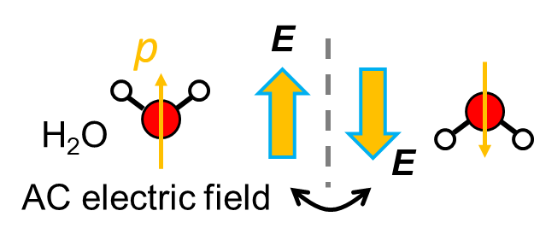
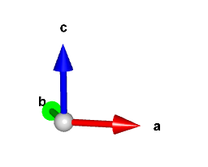
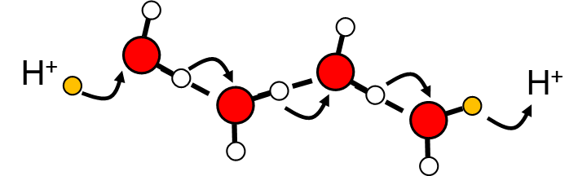
Introduction for ice
Water molecules of ice are in hydrogen-bond network
and they have the orientation freedom.
・Relatively high dielectric constant (ε): ~ 80 - 100
－other hydrated materials also have such high ε ? No.
・Proton conductivity
Crystal structure of ice I_{h}
・Many types of ice polymorphs
－20 crystalline phases have been known.
Next slide
Notes:
This is the crystal structure of ice Ih we can find in freezer. Water molecules in ice are in hydrogen-bond network and they have the orientation freedom.
And the orientation freedom of water molecules gives relatively high dielectric constant to ice at around 100.
For your information, other hydrated materials usually don’t show such high dielectric constant; they have 10, typically.
Also the freedom gives proton conductivity which is especially activated at high pressure and high temperature conditions,
And furthermore, one of the reasons of the many types of polymorphs of ice is the freedom of orientation; I will briefly explain this.
(60 s)

Slide 5
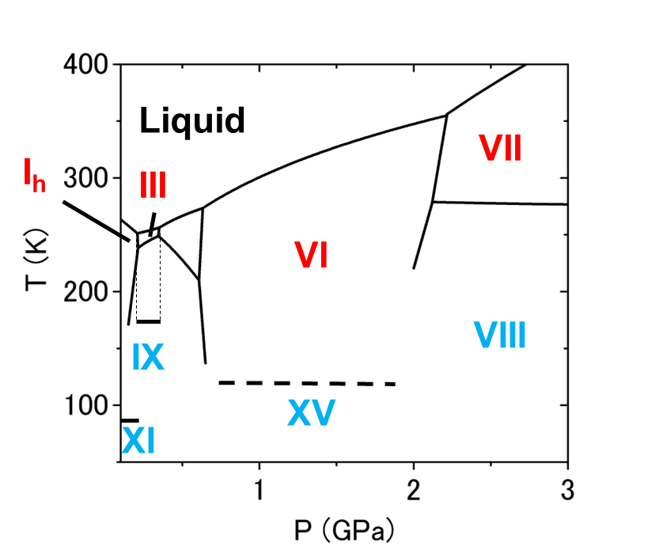
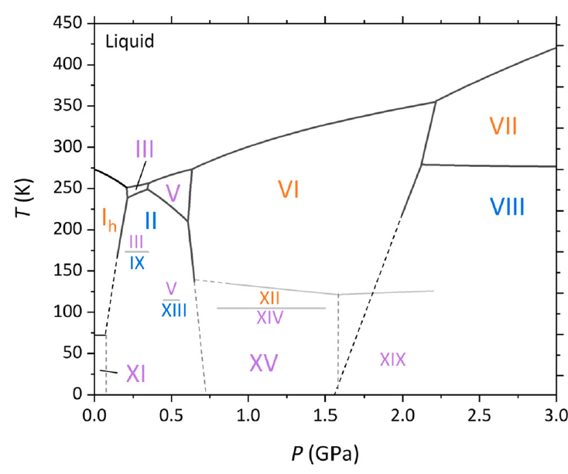
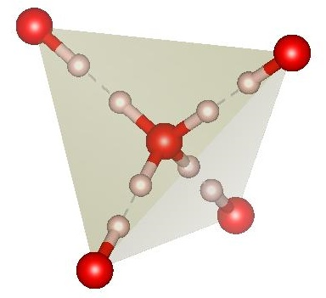
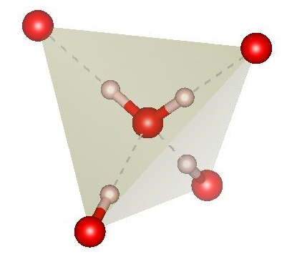
Basic knowledge of ice – disorder-order relationship
Ice polymorphs can be classified into disordered and ordered ices.
Phase diagram of ice
Disordered ice
Ordered ice
O
out
O
H
VII
H
III
in
T (K)
V
VI
100%
VIII
I_{h}
II
50%
III
IX
Site occupancy of
hydrogen atom: 100%
V
XII
Site occupancy of
hydrogen atom: 50%
XIII
XIV
XV
XIX
XI
…so-called
2-in 2-out (ice rule)
P (GPa)
Time-space averaged
Disorder-order relationship increases the number of ice polymorphs.
Notes:
In phase diagram of ice, we can classify ice polymorphs into disordered and ordered ices, and in each state site occupancy of hydrogen atom is 50 and 100%, respectively.
About the disordered ice the site occupancy is time and space averaged, and in the both state, so called 2-in 2-out or ice rule holds regarding hydrogen positions.
In these states, so called 2-in-2-out or ice rules holds in hydrogen configurations.
And this relationship increase the number of polymorphs
(30 s)

Slide 6
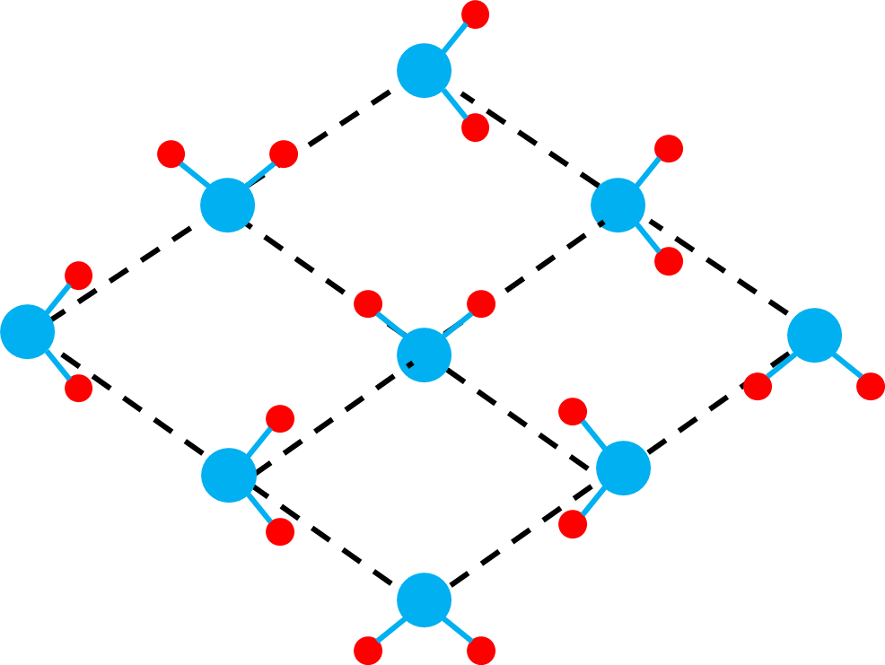
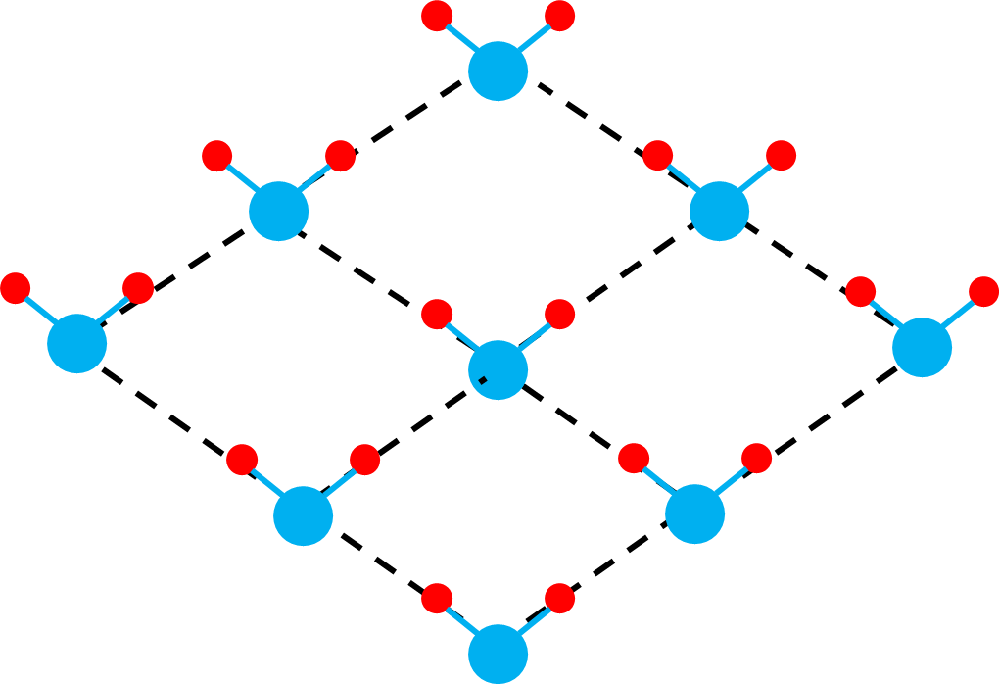
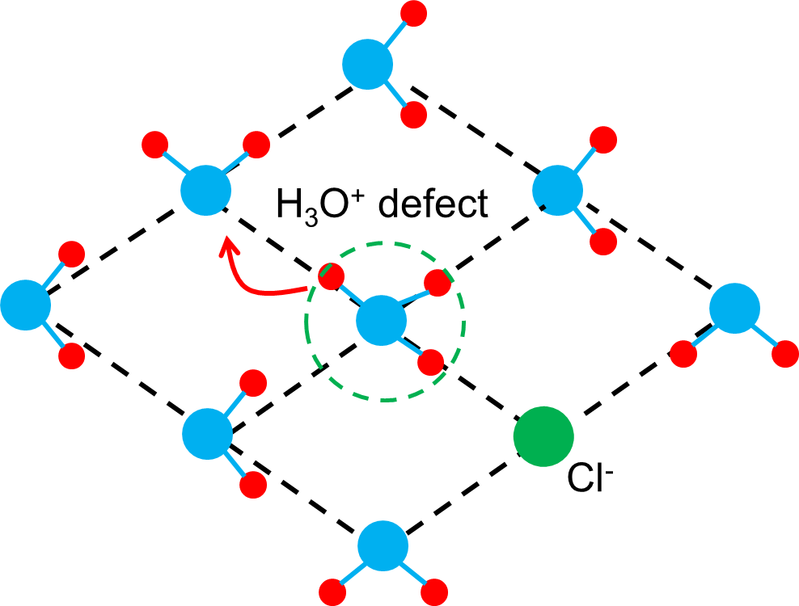

Basic knowledge of ice – doping effect
Many of disorder-order phase transitions of ice need dopants.
Disorder-order phase transitions in hypothetical 2D ice
Ice rule holds.
Hydrogen ordering
high activation barrier
to rotate water molecules
Ice rule restricts
the freedom of orientation.
To decrease activation energy
Notes:
However it should be noted many of disorder-order phase transitions need dopant.
This is disorder-order phase transitions in hypothetical 2D ice.
As I mentioned, ice rule locally holds in disordered state, and ice rule restricts the freedom of orientation.
and there is high activation barrier to rotate water molecules to transform into ordered state.
So we introduce dopants (such as HCl KOH) to decrease activation energy of the phase transition.
(45 s)

Slide 7
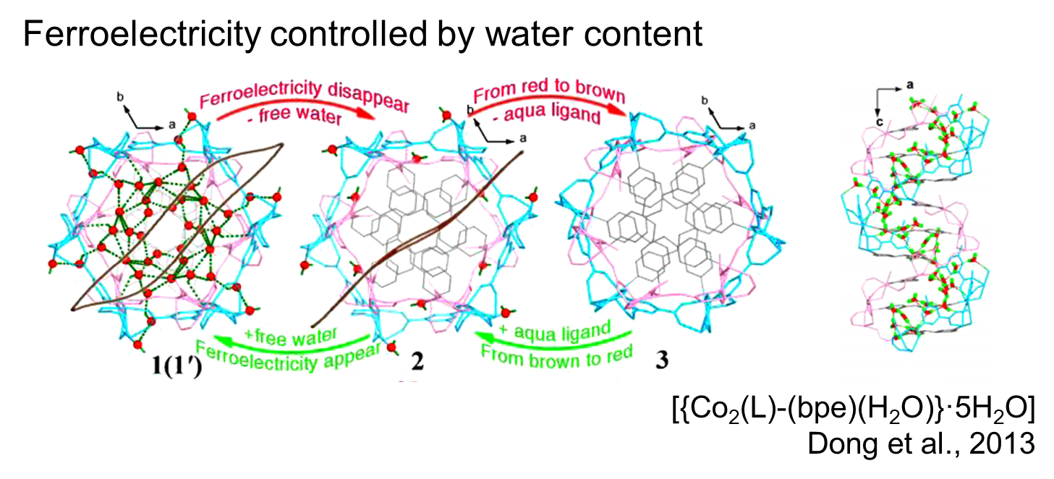
Research motivation
Ice is the most fundamental hydrogen-bonded molecular material.
Ice shows notable structural and physical properties owing to its hydrogen bond and freedom of orientation on the hydrogen bong network.
Very important!!
・Relatively high dielectric constant (ε)
－other hydrated materials also have high ε ? No.
Research motivation:
Can we control the orientation of water molecules of ice
by electric field ? → Ferroelectricity
－Not found yet.
・Proton conductivity
Crystal structure of ice I_{h}
・Many types of polymorphs
－20 clystalline phases have been recognized.
Notes:
Anyway, as I mentioned this molecular dynamics is very important in ice.
And my research motivation is shown here.
Can we control the orientation of water molecules by electric field in ice ? – this means ferroelectricity of ice.
And we have not found yet in bulk ice at least.
For your information, in a kind of organic hydrate ferroelectricity controlled by water contents have been reported.
(45 s)

Slide 8
Introduction for ice
Ice is the most fundamental hydrogen-bonded molecular material.
Ice shows notable structural and physical properties owing to its hydrogen bond and freedom of orientation on the hydrogen bong network.
Why high pressure?
VII
III
Many of ices appear
in high pressure,
and I expect at least one of them shows ferroelectricity.
T (K)
V
VI
VIII
I_{h}
II
・Relatively high dielectric constant (ε)
－other hydrated materials also have high ε ? No.
III
IX
V
XII
XIII
XIV
・Proton conductivity
XV
XIX
XI
P (GPa)
Crystal structure of ice I_{h}
・Many types of polymorphs
－20 clystalline phases have been recognized.
Notes:
And in terms of search for ferroelectric ice, high pressure is very useful tool.
Because many types of ices appear in high pressure region, and I hope at least one of them shows ferroelectricity.
(20 s)

Slide 9
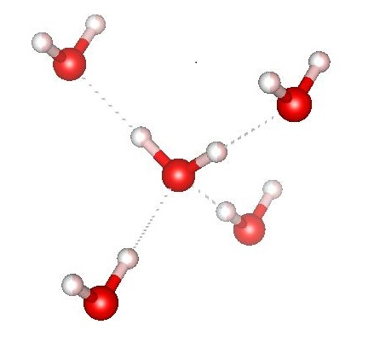
Measurement methods
1. Dielectric measurement
(Dynamical information)
2. Neutron diffraction measurement
(Structural information)
To observe water molecule and
proton dynamics through
each electric response
To observe
hydrogen atom position
Electric dipole moment
External fields
・High Pressure (HP)
・High-electric field (HE)
Notes:
In my research I focused on two measurement methods,
The first one is dielectric measurements. I employed this method “to observe water molecule and proton dynamics through each of electric dipole moment and charge”.
The next one is Neutron diffraction measurements. I employed this method “to observe hydrogen atom position in ice”.
Additionally I combined these measurements with pressure and high electric field.
(30 s)

Slide 10
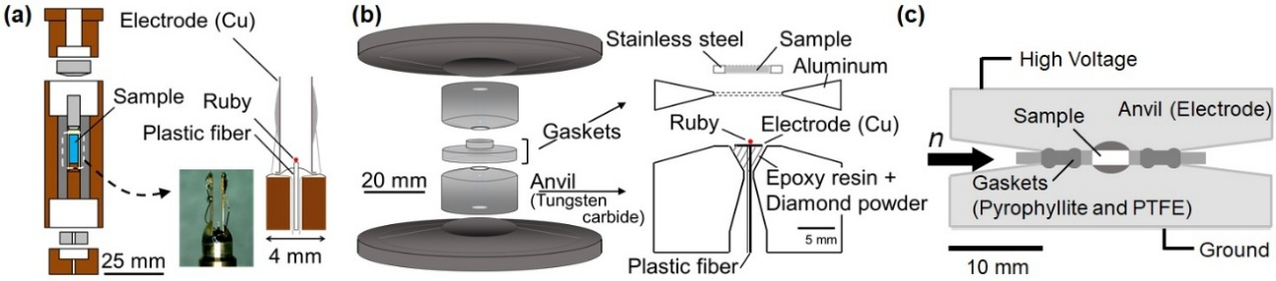
My developments
Piston cylinder
(~ up to 2.5 GPa)
Bridgman anvil cell
(> 10 GPa)
Characteristics
Dielectric
HP-HE neutron diffraction
(Up to 6.1 GPa, 10 kV/mm)
･Dielectric properties of liquid (or solid) samples can be measured.
((a): the electrodes are self-standing.
(b): the electrodes are immersed in anvils with diamond and epoxy resin.)
･Pressure can be measured by ruby-fluorescence method.
･In (c), 10 kV of high voltage is applied.
Notes:
Let me introduce some my developments,
These developments are for dielectric measurements using two different types of high pressure cells.
This is for HP-HE neutron diffraction measurement up to 6.1 GPa and 10 kV/mm.
As characteristics points, dielectric properties of liquid (or solid) samples can be measured in these cells.
In (a), the electrodes are self-standing. In (b) the electrodes are immersed in diamond and epoxy resin compounds in anvils.
And also pressure can be measured by ruby-fluorescence method in these cells.
In (c), 10 kV of high voltage was applied because of the large sample volume of neutron diffraction measurement.
(70 s)

Slide 11
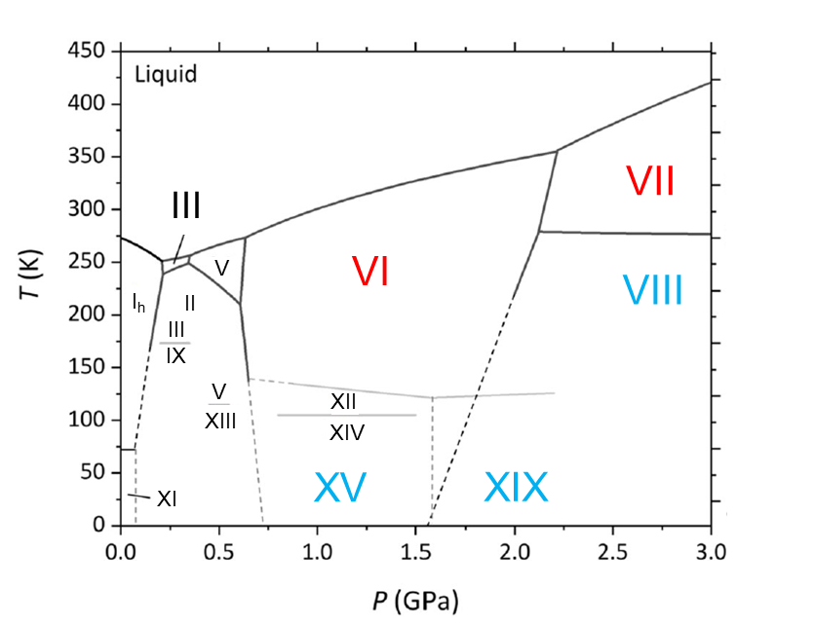
Topics
Discovery of
Ice XIX
Ice VII under high electric field
Proton-dynamics crossover
in ice VII
Notes:
In this presentation, I will talk three topics using these developments (10 s)

Slide 12
Ice VII under high electric field
Notes:
First topic is High pressure ice VII under high electric field

Slide 13
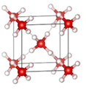
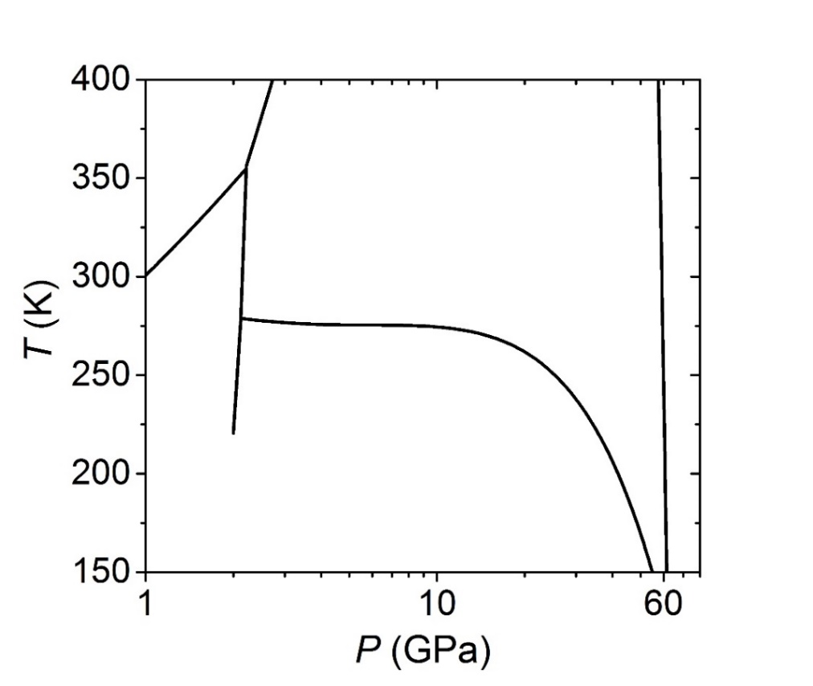
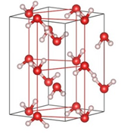
Short introduction for ice VII
Phase diagram of ice
Ice VII
（Disordered phase）
Liquid
VII
cubic
VI
VIII
Ice VIII
（Ordered phase）
tetragonal
Anti-ferroelectrically
ordered structure
Ice VII appears in a wide pressure range (2 – 60 GPa),
and its disordered state has been long investigated.
Notes:
Ice VII is a disordered high-pressure phase of ice and its ordered is ice VIII, this is anti-ferroelectrically molecular orientation.
“Ice VII appears … been long investigated”.
(30 s)

Slide 14
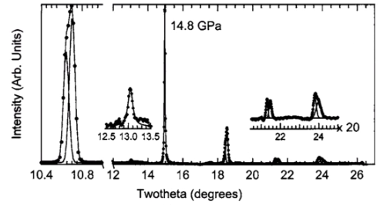
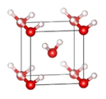
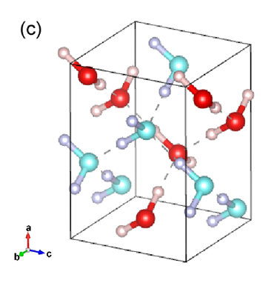
Short introduction for ferroelectrically-ordered form of ice VII
110
14.8 GPa
Two proposed
ferroelectrically-ordered forms
Somayazulu et al., (2008)
Intensity (a.u.)
Twotheta (degrees)
Caracas and Hemley (2015)
They reported a peak splitting of ice VII (for example: 110 reflection).
Symmetry lowering (?)
There is a possibility that ice VII cubic lattice is distorted to tetragonal lattice.
Fukui and Iitaka (2025)
A probability of coexistence of unknown ferroelectrically (FE) ordered form of ice VII has been suggested.
HE field can induce?
Notes:
Somayazulu et al reported a peak splitting of ice VII at 14.8 GPa,
and this might mean symmetry lowergin of ice VII, and there is a possibility that ice VII cubic lattice is distorted to tetragonal lattice.
From theoretical calculations, A probability of coexistence of unknown ferroelectrically ordered form has been suggested.
(40 s)

Slide 15
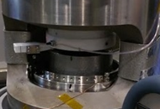
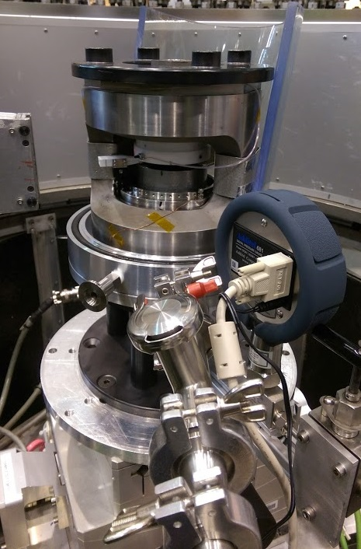
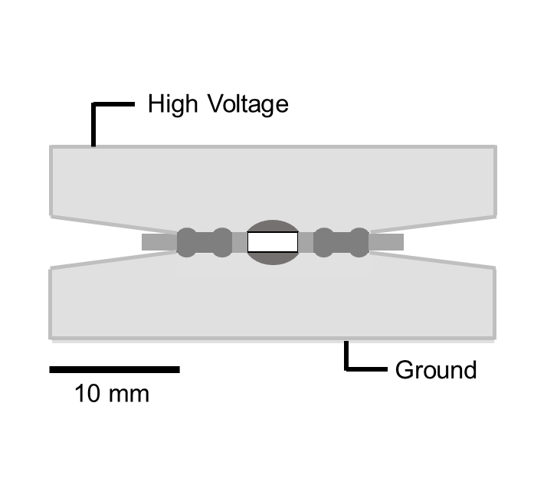
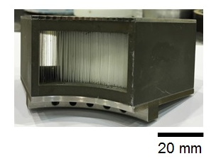
High pressure and high electric field neutron diffraction
Detector
Load
Neutron
High-pressure cell
Incident collimator
(hBN)
High voltage
n
Radial collimator
(Partitions: Gd₂O₃)
collaborators
10 mm
Ground
HP-HE applying system:
Dr. Helen Maynald-Casely
Dr. Norman Booth
(Put behind
the press)
HP-HE cell development:
Yamane (me)
20 mm
(at ANSTO, Australia)
Notes:
This slide shows the developed high pressure and high electric field neutron diffraction set up.
This study is supported by collaborators, Dr, Helen Maynald-Casely and Norman Booth corresponds to the work of HP-HE applying system,
Dr, Kazuki Komatsu corresponds to the work of collimators.
And I worked for HP-HE cell developments.
This system employs bridgeman anvil type cell and neutron comes from here and detector sets behinds. To decrease parasite scattering we introduces two collimators made of Gd2O3.
And details of cell assembly is explained in next slide.
(60 s)

Slide 16
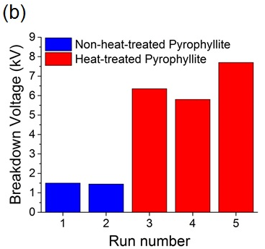
HP-HE cell development
700 ℃, 1 h
(Dehydration treatment)
Example
of improvements
Cell assembly
High Voltage (10 kV)
Sample
Anvil (Electrode)
n
Gaskets
(Pyrophyllite and PTFE)
Ground
10 mm
Yamane et al., (2021)
Load
Developing point
Electrodes (anvils) separation is narrowed under high pressure
and it is difficult to keep an electrical insulation.
Notes:
This is the cell assembly. High voltage is applied to the one of the anvils, the another is connected to ground.
The gasket is composed of the pyrophyllite and PTFE and they also works as insulator.
And, as shown here under high pressure, electrodes (anvils) separation is narrowed and it is difficult to keep an electric insulating.
This is example of gasket improvements, firstly we used row pyrophyllite, but it includes waters in microscale and easily electrical breakdown happens.
Then we heated pyrophyllite to 700℃ to dehydrate water, and as a result, it breakdown voltage had been improved.
(50 s)

Slide 17
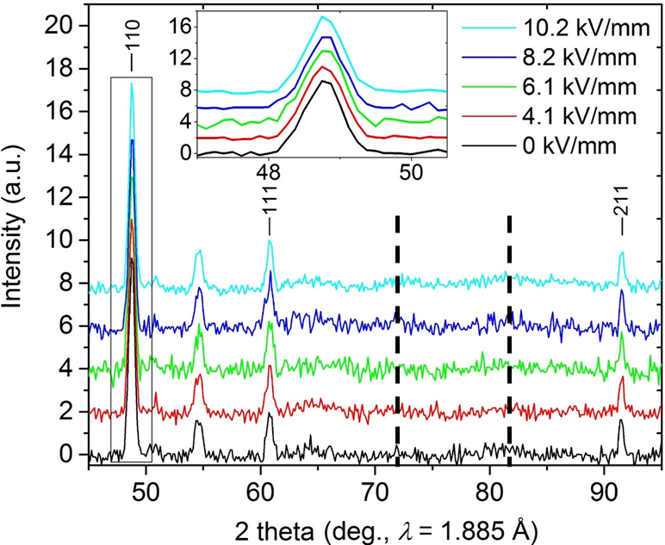
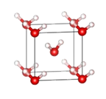
Results – HP-HE neutron diffraction experiments
Collected at 6.2 GPa
Expected peak positions
from the FE ordered structure
Estimation of volume fraction
of the HE-induced polarization
by P-E loop measurement
The expected ordered form was not detected
even under high-electric field.
Notes:
This is the result of the experiment.
Unfortunatelly, the expected ordered form was not detected even under high-electric field. These are expected peak positions from the ferroelectrically structure.
Then we estimated volume fraction of the HE-induced polarization.
(30 s)

Slide 18
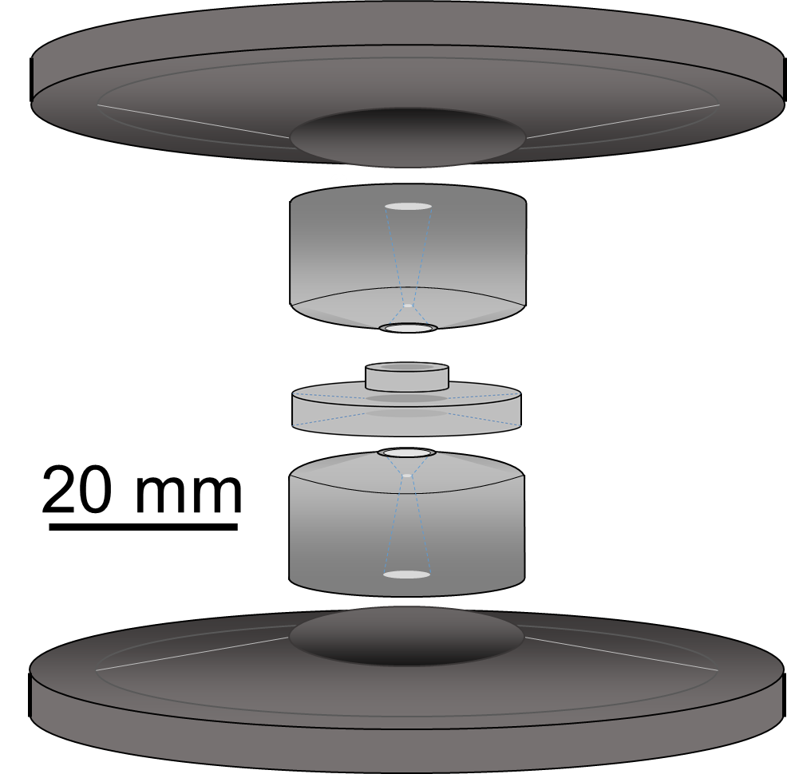
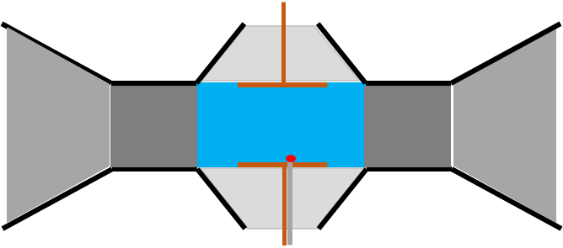
Another HP-HE cell development
High pressure cell for dielectric measurement was modified.
Yamane et al., (2021)
Diamond + Epoxy resin
(mass ratio, 3.8 :1)
4 mm
Gaskets
(SUS + Aluminum)
Sample
Anvil
(Tungsten carbide)
Ruby +
plastic fiber
Electrode and lead (Cu)
acknowledge
・Electrodes are immersed in anvils with diamond and epoxy resin.
・Pressure can be estimated by ruby-fluorescence methods.
Ruby-fluorescence system:
Prof. Kentaro Kitagwa
Dr. Takuya Aoyama
Notes:
For this purpose, to conduct P-E loop measurement, different high pressure cell for dielectric measurement was modified.
This is the cell assembly, and as I mentioned the electrodes are immersed in diamond and epoxy resin compounds in anvils.
(25 S)

Slide 19
HP-HE cell developments
High pressure cell for dielectric measurement was modified.
Newly developed high-pressure cell
4 mm
Kapton tube
Gaskets
(SUS + Aluminum)
Sample
Anvil
(Tungsten carbide)
Cu leads are covered with Kapton tube to prevent electrical breakdown.
→ P-E (polarization-electric field) loop measurements
Notes:
When the high voltage is applied in this cell, Cu leads are covered with Kapton tube to prevent electric break down.
(20 s)

Slide 20
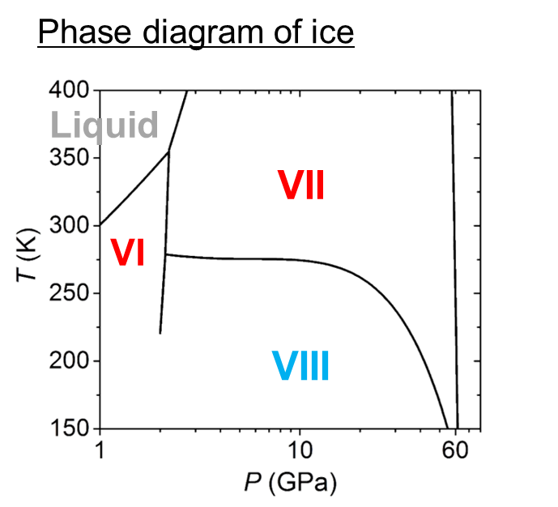
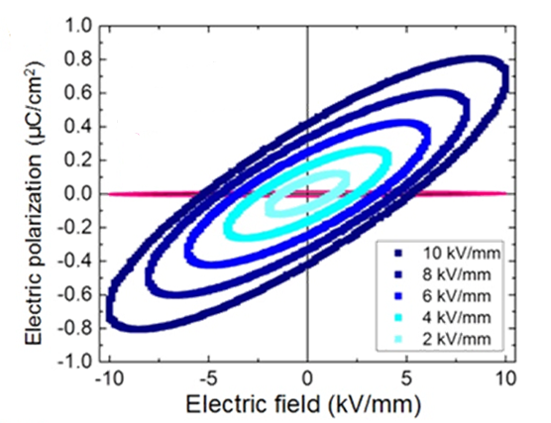
Results and discussion using P-E loop measurements
P-E loop
6.1 GPa
Ice VIII
(10 kV/mm, 263 K)
Ice VIII
（Ordered phase）
Paraelectric behavior of ice VII
was observed up to 10 kV/mm.
Notes:
As a result, paraelectric behavior was observed up to 10 kV/mm.
And maximum electric polarization is about 0.8μC/cm2. For your information, when ice VII turns into Ice VIII,
it shows almost 0 electric polarization. This is consistent with the antiferroelectrically configuration.
(30 s)

Slide 21
Results and discussion using P-E loop measurements
Electric polarization
P-E loop
P = μ(N·f)
6.1 GPa
Ice VIII
(10 kV/mm, 263 K)
μ : electric dipole moment
of water molecule
N: Number of density of
water molecules in ice VII
f: Volume fraction
of the FE ordered form
The volume fraction of the FE ordered form was estimated
about 0.02 under 10 kV/mm electric field, if the FE-ordered form coexisted with ice VII.
Notes:
And we calculated induced volume fraction of the ferroelectrically ordered form if they induced in ice VII.
Electric polarization can be written by this equation, and also from this structure model
the volume fraction of the ferroelectrically ordered form was estimated about 0.02 under 10 kV/mm electric field, if it coexisted with ice VII.
(30 s)

Slide 22
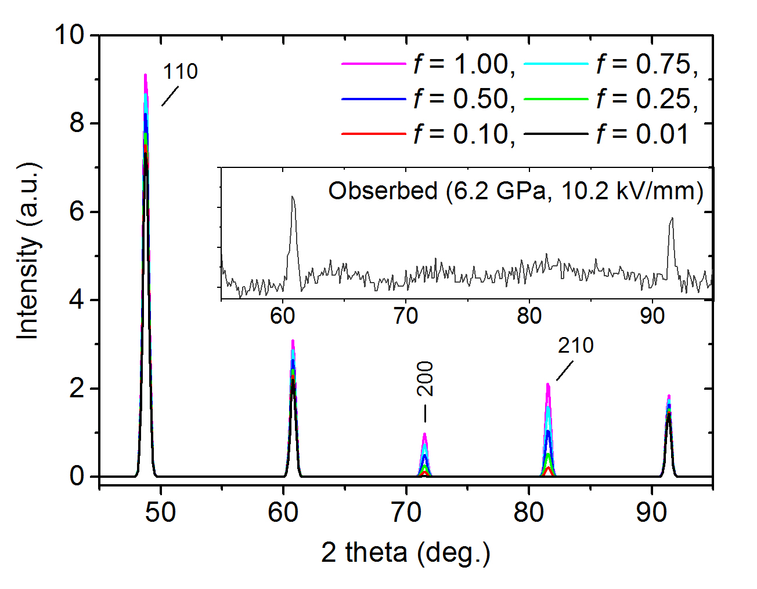
Simulation of neutron diffraction pattern
Collected at 6.2 GPa
P-T-E phase diagram of ice
VII
?
VIII
E (kV/mm)
If 50 kV/mm can be applied to ice VII,
the FE-ordered form might be detectable by neutron diffraction
→ First HE-induced ice phase !?
Electrical breakdown might occur in ice.
Notes:
This slide shows the neutron diffraction pattern simulation of coexistence of ice VII and the ferroelectrically ordered form.
And under the conditions of the observed 0.02 volume fraction, it was difficult to detect the existence of the ordered form.
And from this simulation if 50 kV/mm can be applied to ice VII, the expected peaks could be observed.
This might lead first HE-induced ice phase. But it should be noted that electrical breakdown might occur in ice.
(50 s)

Slide 23
Proton-dynamics crossover in ice VII
Notes:
Next I talk about Proton-dynamics crossover in ice VII briefly.

Slide 24
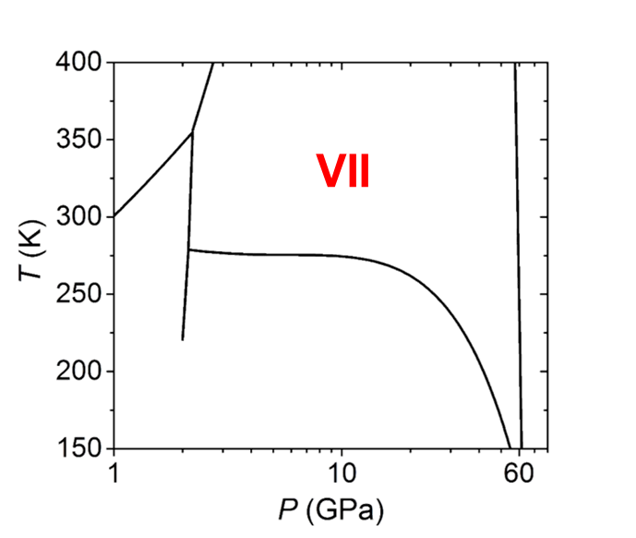
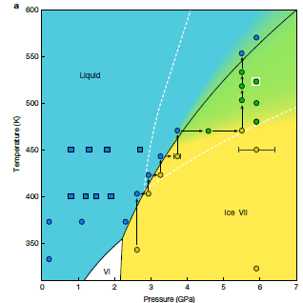
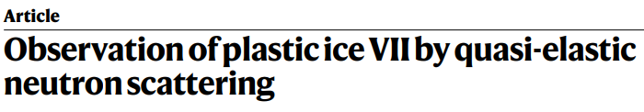
Introduction (Proton-dynamics crossover in ice VII)
What is the origin of the disordered state of ice VII ?
wide pressure range
Is that unchanged in the wide pressure region 2-60 GPa ?
This talk focuses on ~RT.
Plastic ice VII
(~ 5 GPa, 500 K)
Liquid
T (K)
Ice VII
Rescigno et al., (Nature, 2025)
Rescigno et al.,
(Nature, 2025; modified)
P (GPa)
Notes:
As I mentioned ice VII appears in the wide pressure range. Very recently plastic ice VII was reported in Nature.
Related to this reports, the disordered state of ice VII has been investigated so far.
And what is the disordered origins of ice VII ?, is that unchanged in the wide pressure region 2-60 GPa ?
(30 s)

Slide 25
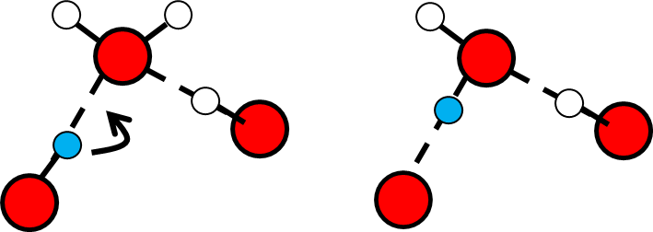
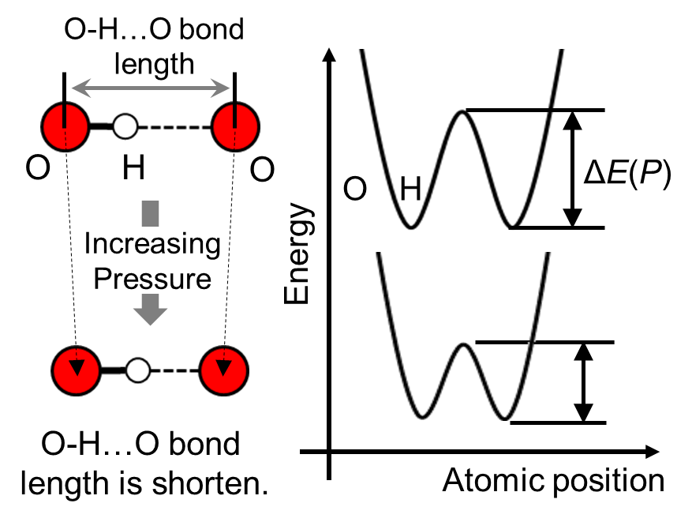
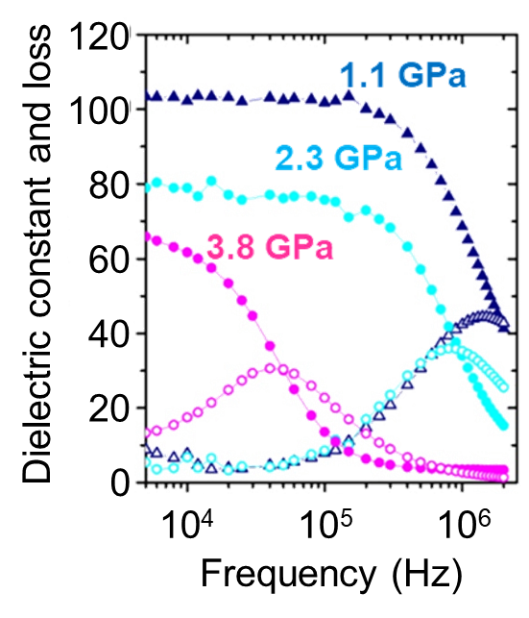
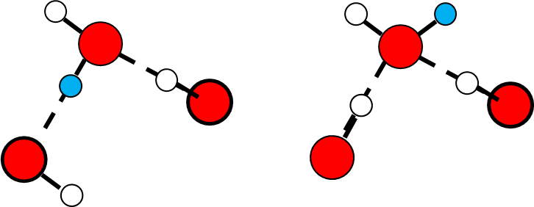
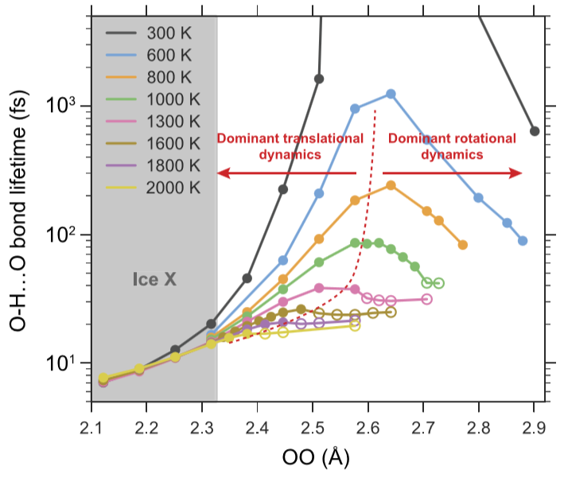
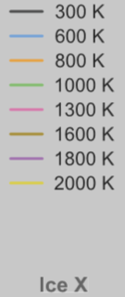
Scenario for proton dynamics in ice VII
A scenario that dominant dynamics of disordered state of ice VII changes from molecular rotation to proton translation.
Molecular rotation
Proton translation (hopping)
10³
Rotational
disorder
Translational
disorder
O-H…O bond lifetime (fs)
10²
High
temperature
(> 500 K)
High
pressure (40 – 60 GPa)
10¹
Hernandez and Caracas
(2018, modified)
Quantum effect appears.
(e.g. Sugimura et al. (2008))
Plastic ice VII ?
(the rotation is activated)
2.9
2.8
2.7
2.6
2.5
2.4
2.3
2.2
2.1
O-O (Å)
High pressure
Notes:
Hernandez and Caracas suggested from their DFT calculation that dominant dynamics of disordered state of ice VII changes from water rotation into proton translation at around 10 GPa.
In their calculation, they traced each dynamics and evaluated pressure dependence of O-H…O bond lifetime.
The molecular rotation is basic ice molecular dynamics can be also observed in dielectric measurement, and this rotation is activated by temperature, and it is reasonable that plastic ice VII appears.
On the other hand, due to the positive activation volume of the dynamics, the rotation will be weaken with increasing pressure.
And instead, proton translation will be activated with increasing pressure, because of the potential lowering between hydrogen-bonded oxygen atoms.
And further increase, quantum nature will appear.
And I observed the crossover of the dynamics using dielectric measurements.
(90 s)

Slide 26
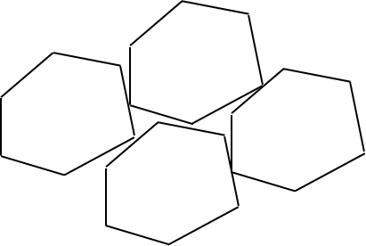
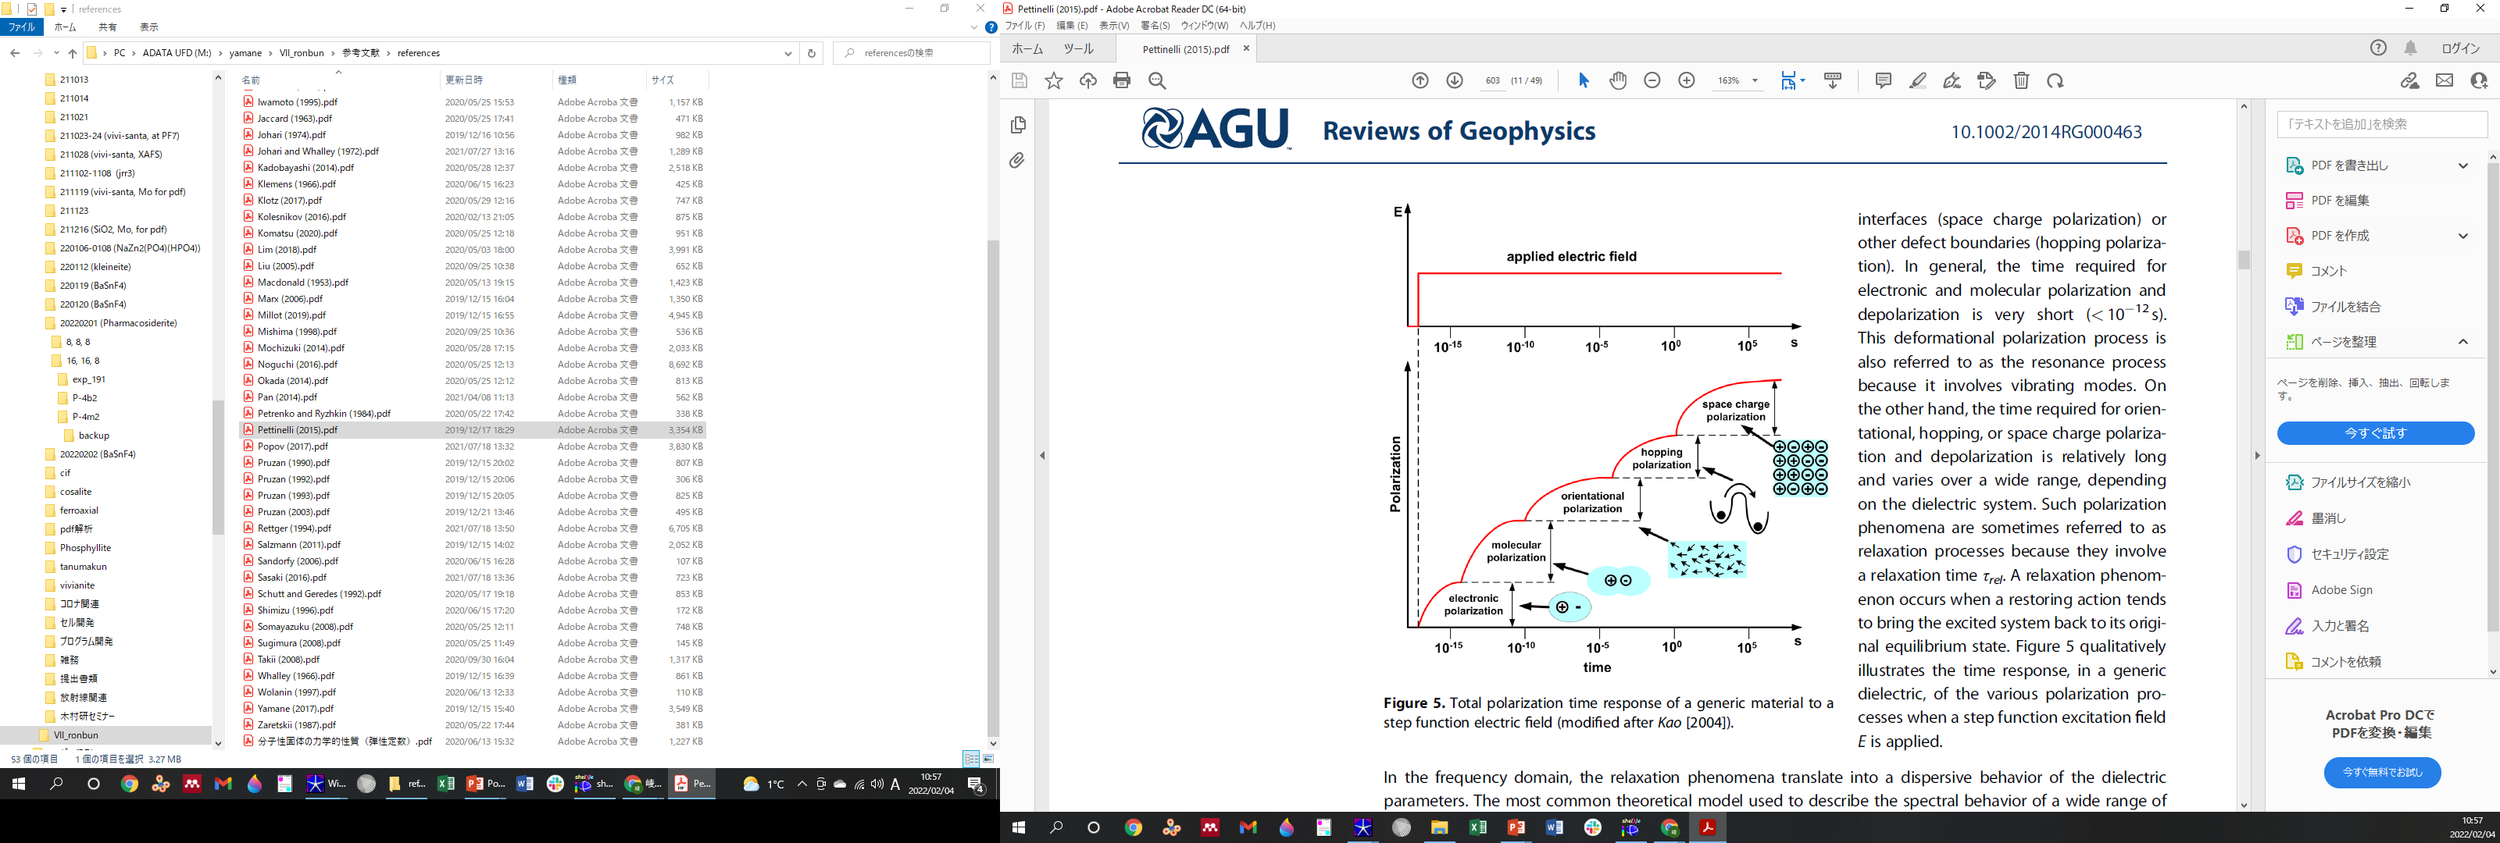
Frequency dependence of dielectric relaxations in ice
Space charge
polarization
Proton translation
Hopping polarization
Molecular rotation
Orientational
polarization
Dielectric constant
Ionic polarization
Electronic polarization
10⁵
10⁰
10⁻⁵
10⁻¹⁰
10⁻¹⁵
Frequency (Hz)
(Pettinelli et al., Rev. Geophysics, 2015, modified)
Notes:
This is the schematic drawings of the frequency dependence of the dielectric relaxations, and the two dynamics can be observed this region,
and we can detect by dielectric measurement.
and they should shift like this with opposed tendency in frequency.
(30 s)

Slide 27
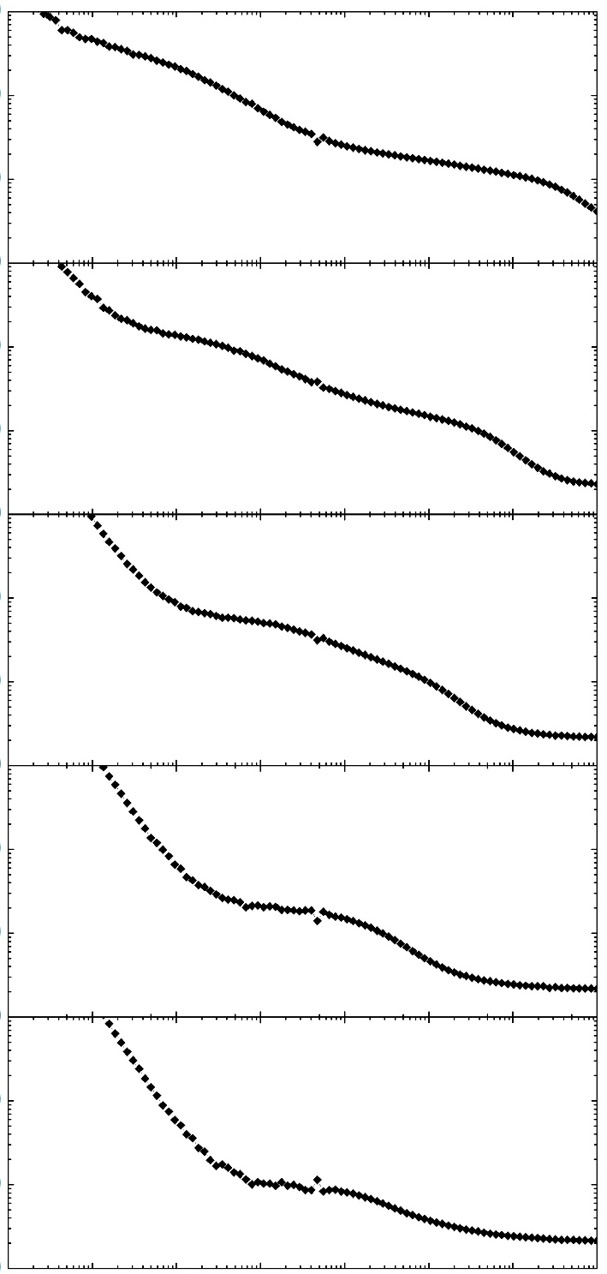
10⁴
Pressure dependence
of dielectric relaxations
4.5 GPa
10³
Proton translation
(hopping)
10²
10⁴
6.2 GPa
10³
Shifts to
higher frequency
10²
10⁴
7.7 GPa
10³
Dielectric constant
Shifts to lower frequency
10²
10⁴
10³
9.3 GPa
10²
Molecular rotation
10⁴
10.5 GPa
10³
10²
The two relaxations merged
at around 10 GPa.
10⁻²
10⁰
10²
10⁴
Frequency (Hz)
Notes:
This slide shows pressure dependence of dielectric constant.
As you can see the higher frequency relaxation shifts to lower frequency region with increasing pressure.
On the other hand lower frequency relaxation shifts to higher frequency region.
And “the two relaxations merge at around 10 GPa”.
(30 s)

Slide 28
Proton-dynamics crossover in ice VII
What is the disordered origins
of ice VII ?
Disordered state
transformation
Is that unchanged in the wide pressure region 2-60 GPa ?
Plastic ice VII
Rescigno et al., (Nature, 2025)
Notes:
So the disordered state changes from molecular rotation to proton translation at around this region.
Also ice VII remains unresolved problems for example, the bending phase boundaries at around this.
I think ice VII is quite exciting phase.
(30 s)

Slide 29
Discovery of ice XIX
Notes:
This is the last topic of my talk, discovery of ice XIX

Slide 30
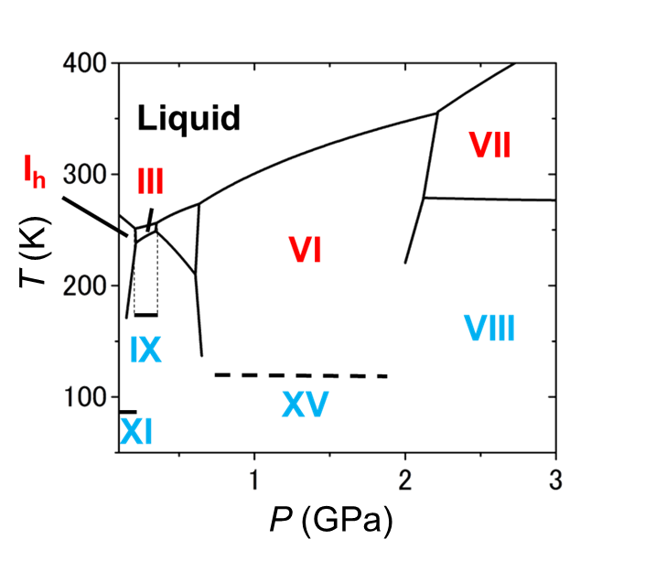
Basic knowledge of ice polymorphism － one-to-one correspondence
Before the discovery of ice XIX,
one-to-one correspondence held among disordered/ordered ices.
Phase diagram of ice
One-to-one correspondence
Disordered
Ordered
I_{h}
XI
III
IX
V
XIII
VI
XV
VII
VIII
XII
XIV
This study focused on these high-pressure phases, ice VI and XV.
Notes:
Before the discovery of ice XIX, one-to-one correspondence holds among disordered/ordered ices.
As shown this phase diagram, a disordered ice has its ordered phase, respectively.
And this study focused on these high-pressure phases, ice VI and XV.

Slide 31
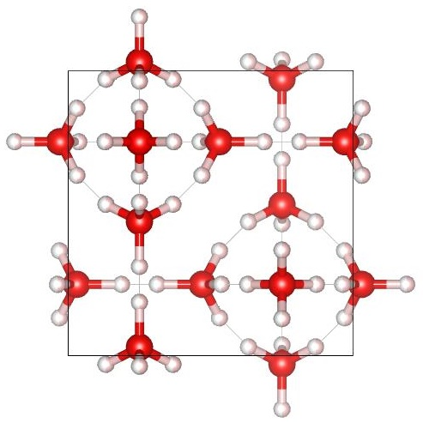


Energetic degeneracy of hydrogen ordered configurations
Salzman et al., (2009)
Ice VI
Ice XV (AFE)
$$⋮$$
45 configurations
Other hydrogen-ordered
configurations
45 hydrogen ordered configurations corresponding to the unit cell of ice VI
Komatsu et al., (2016)
1
11.3 meV
45
The most stable (FE)
Close energy compared
to phase-transition temp. (~130 K).
Ice XV (AFE)
Notes:
Ice XV is antiferroelectrically ordered structure of ice VI.
Generally, disordered phase has many hydrogen ordered configurations, and there are 45 hydrogen ordered configurations corresponding to the unit cell of ice VI.
Komatsu et al., calculated relative energy of the configurations, and they reported they have close energy compared phase transition temperature between ice VI and XV.
In addition the most stable structure was ferroelectrically ordered configuration.

Slide 32

Multiple hydrogen ordered phases of ice VI ?
Phase diagram of ice
Hydrogen ordering of ice VI is slowly and locally occur.
Raman, X-ray, Neutron
Sensitive to detect hydrogen ordering
of ice
Dielectric
？
？
collaborators
Piston cylinder know-how:
Prof. Yoshiya Uwatoko
Dr. Jun Gouchi
Yamane et al., (2021)
Notes:
So, I investigated whether there are more than one hydrogen ordered phases for a disordered phase.
Hydrogen ordered of ice VI is slowly and locally occur, so it is difficult to detect its ordering by typical raman or XRD, nuetron measurement.
Hence I focused on dielectric measurement, it has been known very sensitive to detect hydrogen ordering of ice, using developed piston cylinder cell.
And here I applicate my collaborators Prof. Yoshiya Uwatoko and Dr. Jun Gouchi. They thought me basic piston cylinder know-how.
(80 s)

Slide 33

Experimental conditions (Dielectric measurements)
P-T condition
0.88–2.2 GPa
100–150 K
To accelerate
hydrogen ordering of ice VI
H₂O with a dopant HCl (concentration：10⁻² mol/L)
Notes:
This slide shows experimental conditions for dielectric measurements.
Measured pressure and temperature region is shown here. And I used HCl as a dopant to accelerate hydrogen ordering of ice VI.
(15 s)

Slide 34


Comparison of dielectric properties between pure and doped ice VI
Pure
Doped
Low temp.
Low temp.
With decreasing temperature,
frequency-dispersion shifts
to lower frequency region
due to slowdown
of the molecular dynamics.
In pure ice VI, the molecular dynamics could not be observed
at relatively higher temperature.
Notes:
This slide shows comparison between pure and doped dielectric properties of ice VI.
In the both of them, with decreasing temperature, frequency-dispersion shifts to lower frequency region due to slowdown of the molecular dynamics.
And in pure ice VI, the molecular dynamics can not observe by dielectric measurement relatively high temperature.
(30 s)

Slide 35

Comparison of dielectric properties between pure and doped ice VI
Pure
Doped
Temperature dependence
of dielectric relaxation time
pure
doped
The activation energy
of the dynamics was decreased by dopant.
Notes:
And in this temperature dependence of dielectric relaxation time, the activation energy of the dynamics was decreased by dopant.
(15 s)

Slide 36

Temperature dependence of dielectric properties of ice VI and its ordered phase
0.01 Hz
0.1 Hz
1 Hz
1.9 GPa
126 K
124 K
136 K
122 K
150 K
118 K
Peak disappearance
Dielectric response decreased at around 124 K.
Notes:
Drastic change was observed in the both of dielectric constant and loss data of ice VI at 124 K.
(15 s)

Slide 37

Temperature dependence of dielectric properties of ice VI and its ordered phase
Hydrogen ordering causes
a limitation of dynamics
of water molecules.
1.9 GPa
Decreasing of
dielectric constant and loss
(Kawada 1972)
126 K
124 K
136 K
122 K
150 K
118 K
The drastic decreasing
of dielectric response can be assigned
to hydrogen ordering of ice VI.
Notes:
Generally hydrogen ordering causes a limitation of dynamics of water molecules.
This causes decreasing of dielectric constant and loss
The drastic decreasing of dielectric response is assigned to hydrogen ordering of ice VI.
(25 s)

Slide 38

Phase diagram of ice VI and its ordered phases
A sign of dT/dP changes from negative
to positive at around 1.6 GPa.
Ice VI
(Ordering: ΔS < 0)
ΔV > 0
ΔV < 0
Ice XV
A volume change from ice VI
to ice XV is ΔV > 0 (at 0.4 GPa).
The unknown ordered phase is
in the higher-pressure region.
(Komatsu et al., 2016)
dT
ΔV
Clausius-Clapeyron:
=
dP
ΔS
Notes:
Based on the dielectric measurements, I plotted phase transition temperatures in this graph.
As you can see “a sign od dT/dP change from negative to positive at around 1.6 GPa”.
From Clausius-Clapeyron equation, there are two ordered phases which have different volume change comparing with ice VI, because ΔS<0 holds in hydrogen ordering.
Since a volume change from ice VI to ice XV is ΔV > 0, the unknown ordered phase is in the higher-pressure region.

Slide 39

Experimental conditions (Neutron diffraction)
P-T condition
1.6, 2.2 GPa
80–150 K
D₂O with a dopant DCl (concentration：10⁻² mol/L)
High-pressure neutron experiment：PLANET(BL11) at J-PARC
Notes:
This slide shows experimental conditions for dielectric measurements.
Measured pressure and temperature region is shown here. And I used HCl as a dopant to accelerate hydrogen ordering of ice VI.
(15 s)

Slide 40


HP neutron diffraction experiment
Diffraction pattern of new phase
（1.6 GPa, 80 K）
Super lattice reflection
Ice VI and XV unit cell
New ordered phase unit cell
The new ordered phase has $\sqrt{2}×\sqrt{2}×1$ unit cell comparing with ice VI.
Notes:
From time limitation, I do not talk of details of neutron diffraction measurement, but this new phase has √2×√2×1 unit cell comparing with ice VI and XV.

Slide 41
HP neutron diffraction experiment
Diffraction pattern of new phase
（1.6 GPa, 80 K）
Super lattice reflection
Ice VI and XV unit cell
New ordered phase unit cell
Based on structural analysis, there are two plausible structure models
for ice XIX (Space group: P-4 and Pcc2).
Notes:
And there are two plausible structure models for ice XIX whose space group are P-4 and Pcc2, respectively.

Slide 42


Remains problems of ice XIX
Pcc2
Site occupancy of D3 (hydrogen) positions
are identically 0.5.
Pcc2 (and also P-4) structure models
indicate ice XIX is partially ordered phase.
・Which space group is correct ?
・Are there fully hydrogen ordered phases ?
(Fully ordering could not be observed by dielectric measurements.)
・How ice XIX responses under high electric field ?

Slide 43


Summary
Not only for ice,
High pressure × High electric field
is a frontier research region !
thank you for listening !
Notes:
As a summary, I focused on the molecular dynamics of ice, and I developed high pressure cells.
And using them, I studied high pressure ices to search ferroelectric ice.
Not only in hydrates but also water is important solvent in chemical reactions and crystal growth,
so I believe the high pressure developments has great potential in wide scientific field, thank you!

Slide 44
Supporting information

Slide 45



Results at 5.4 GPa
Dielectric constant and loss
Previous study (e.g. Yamane et al., 2017)
10⁴
120
Higher frequency
relaxation
100
10³
Dielectric constant
80
10²
Lower frequency
relaxation
Dielectric constant and loss
60
10¹
40
10⁵
20
10⁴
0
10⁴
10⁵
10⁶
Dielectric loss
Loss peak
10³
Frequency (Hz)
？
・Two clear dielectric relaxations
were observed.
10²
10¹
・The higher frequency relaxation
is assigned to a molecular rotation
in previous studies.
10⁻²
10⁻¹
10⁰
10¹
10²
10³
10⁴
10⁵
Frequency (Hz)
Notes:
This slide shows results at 5.4 GPa, and the left side shows dielectric constant and loss.
As you can see, we observed two clear dielectric relaxations.
Higher frequency relaxation is assigned to water rotation in previous studies as I mentioned after.
In dielectric loss data, the higher frequency relaxation has loss peak. But the lower frequency relaxation seems to not have a loss peak.
In much lower frequency region, another relaxation was observed and this is derived between sample and electrode and generally
this dielectric relaxation cause larger dielectric loss as you can see here.
So I think loss peak derive from lower relaxation might be hidden.
(60 s)

