Slide 1
Figure 1
(a)
Pores within grains
and on boundaries
Pores on
triple points
Pore distribution of possible fracture initiation points
Frequency
Defects comprising agglomerated pores
GP model
Extreme value side
Pore size
(b)
Pores within grain and on boundary
Pores on
triple points
Large defect comprising
agglomerated pores around the unsintered grains
Crack on grain boundary

Slide 2
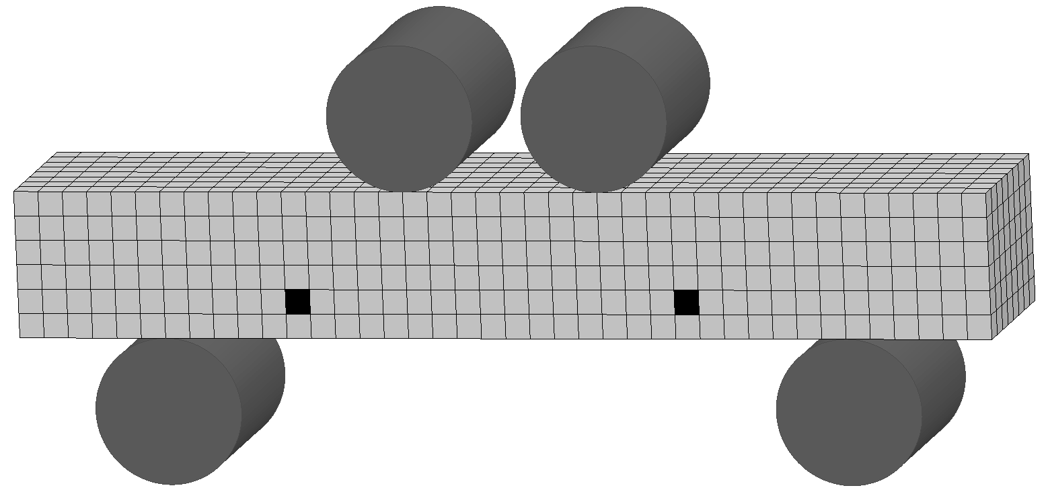
Figure 2
(a)
N_{E} pores
N_{E} pores
S₂
t
W
X_{E}
X_{E}
Y_{E}
S₁
(b)
Cracks on grain boundaries
y
c
ρ
R
σ_{F}
x
σ_{F}
z
Pore
R_{b}

Slide 3
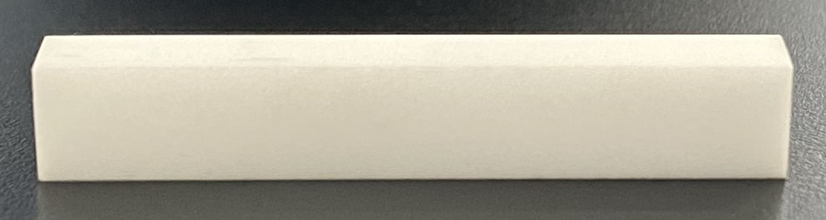
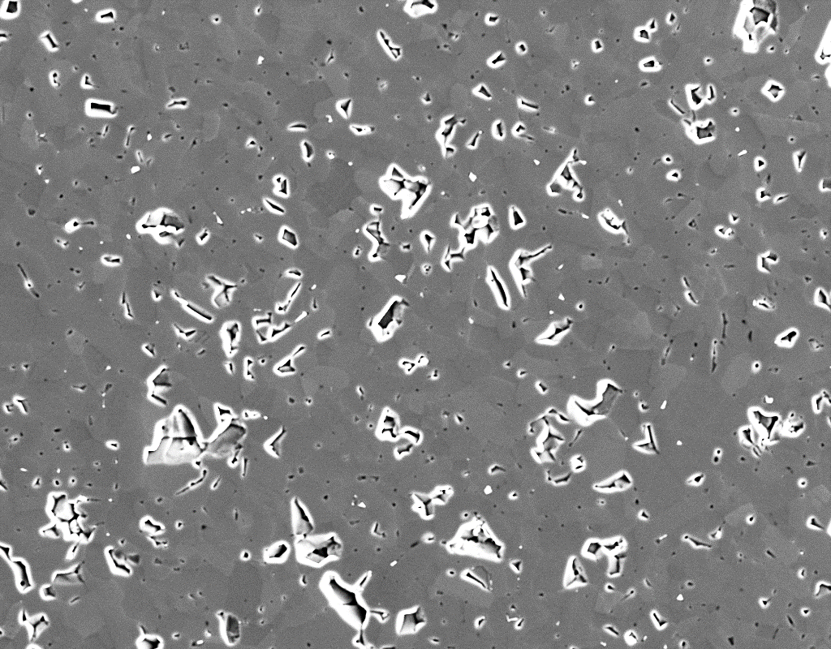
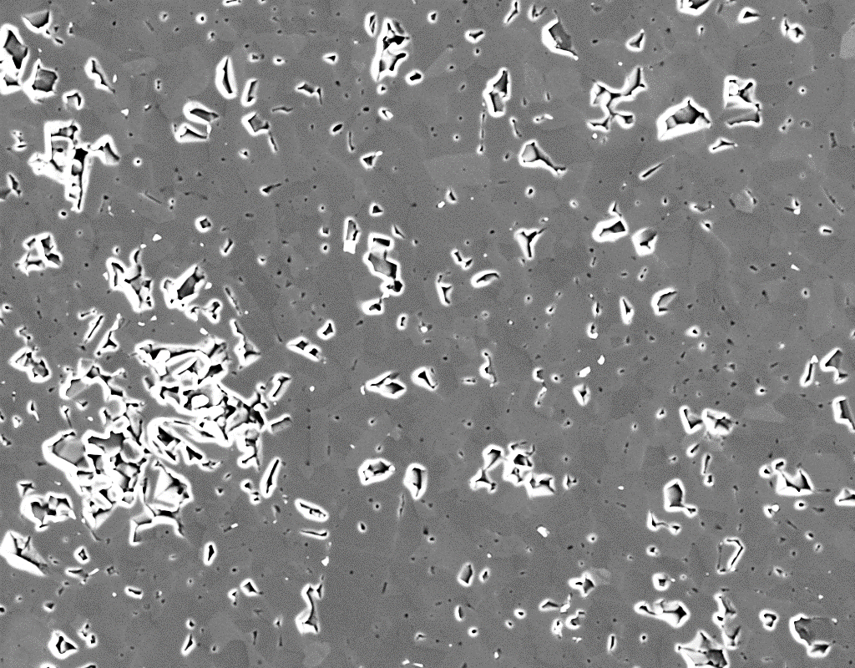

Figure 3
(a)
Stress direction
Observed area
4.085 mm
(b)
$⋯$ × 18
3.08 mm
$$⋮$$
× 18
Total observed area: 12.58 mm²
(c)
Small pores within grains and on boundaries
Medium pores on triple points
Large pore including
unsintered powders
Crack on grain boundaries
around large defect
50 μm

Slide 4
Figure 4
80 μm

Slide 5
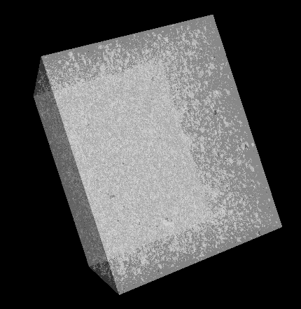
Figure 5
214.02 µm
220.52 µm
279.85 µm

Slide 6
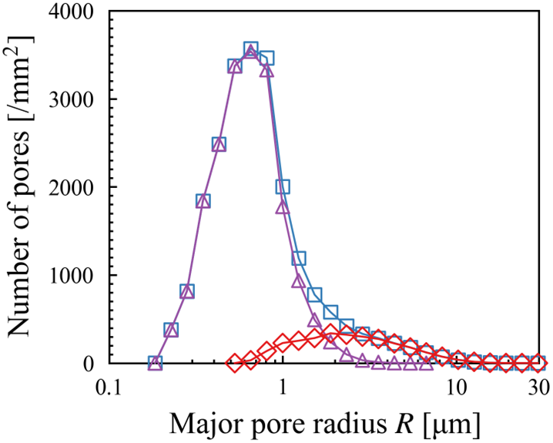
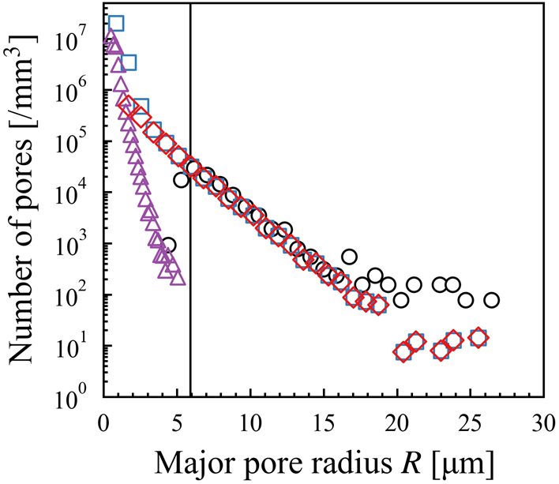
Figure 6
(a)
All
Small
Large
(b)
X-Ray CT
SEM (SS method)
All
Small
Large
Threshold: 5.9 µm

Slide 7
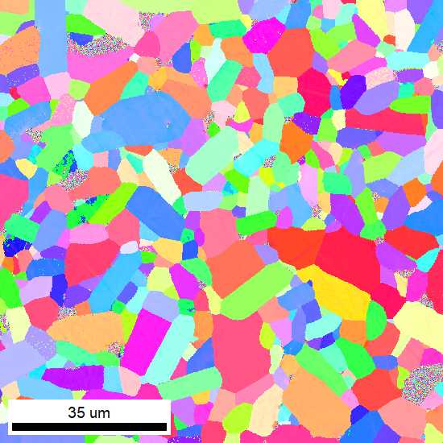
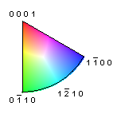
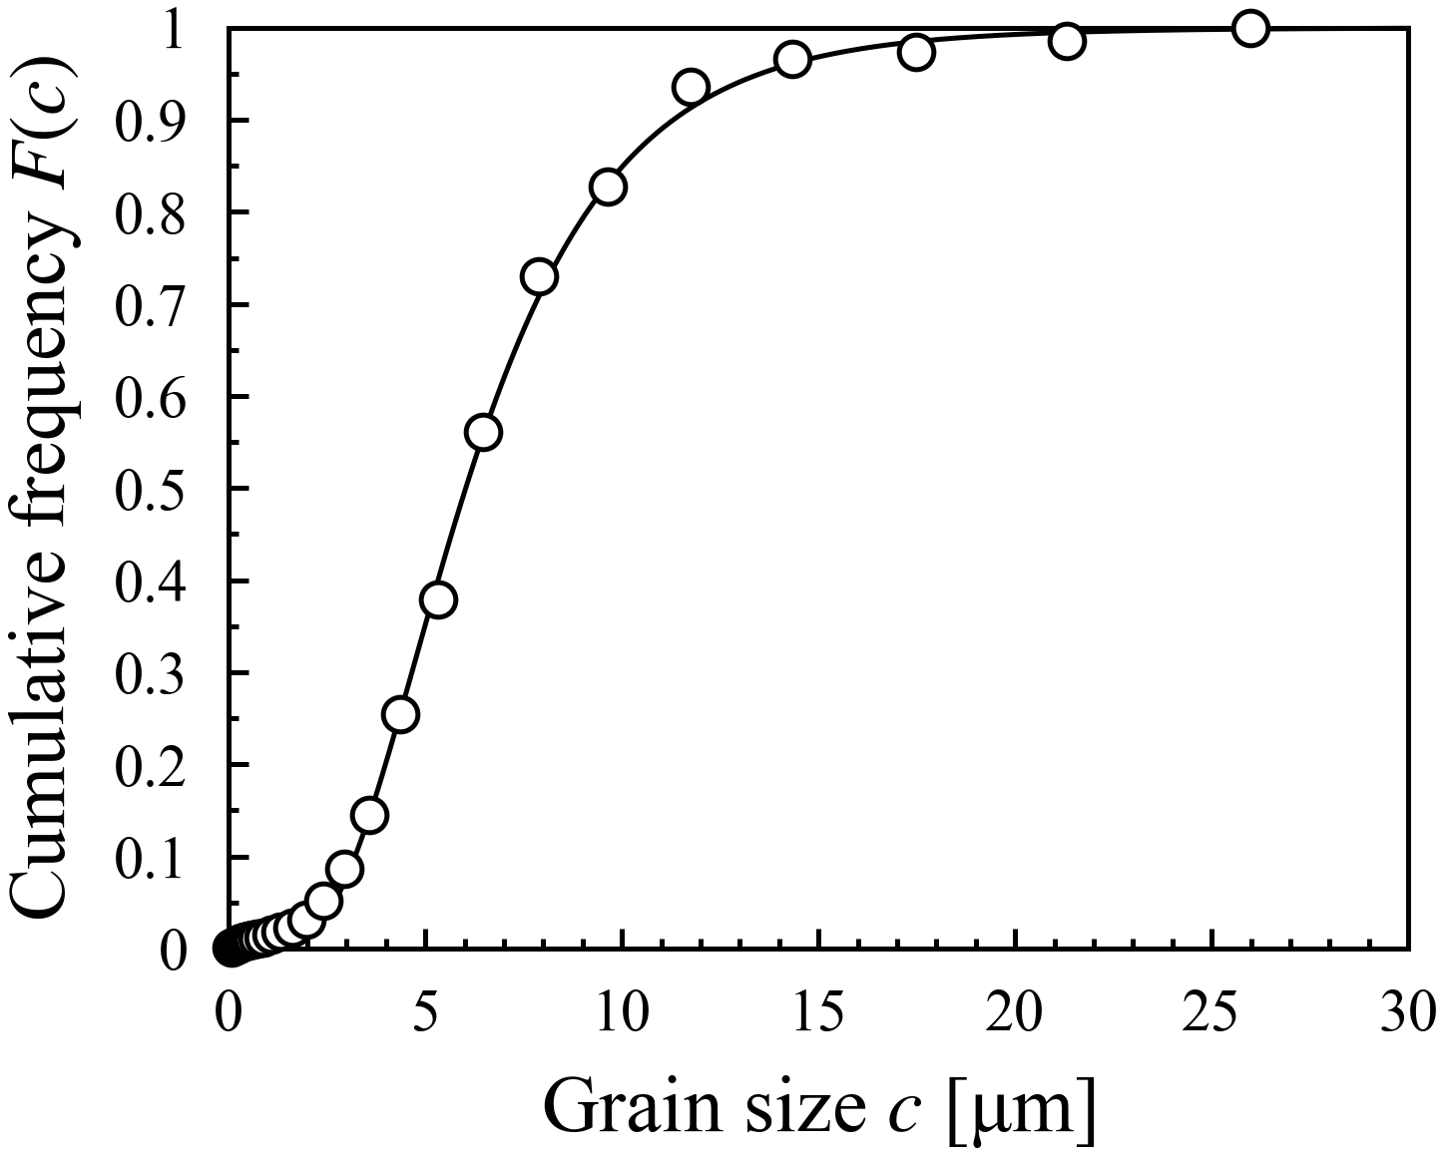



Figure 7
(a)
0001
35 μm
$$\text{1}\overline{\text{1}}\text{0}\text{0}$$
$$\text{0}\overline{\text{1}}\text{10}$$
$$\text{1}\overline{\text{2}}\text{10}$$
(b)
EBSD
Fitting

Slide 8
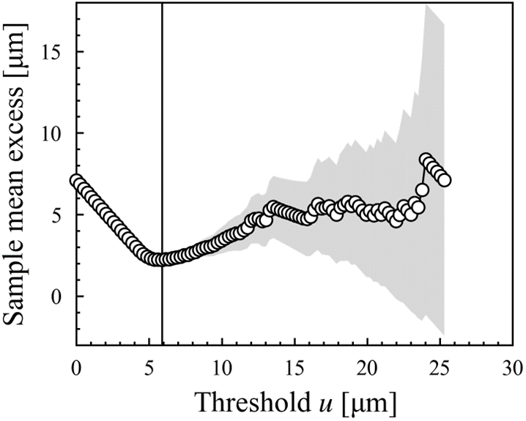
Figure 8
95% Confidence interval
Linear approximation
Threshold: 5.9 µm

Slide 9
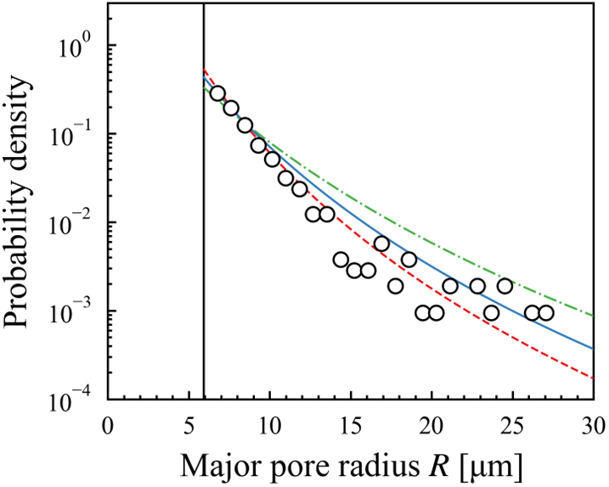
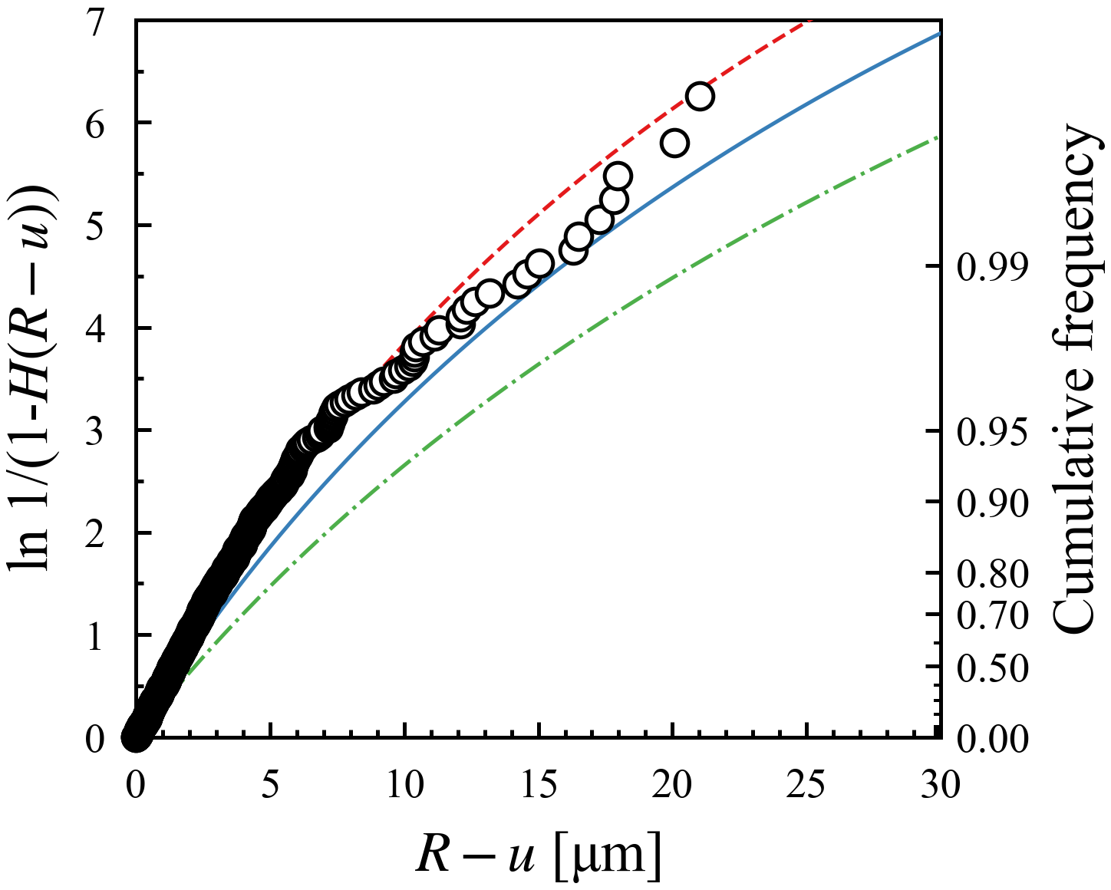
Figure 9
(a)
u=5.9 µm
Distribution
ξ [–]
σ [μm]
A
1.86
B
0.166
3.0
C
2.3
X-Ray CT
Distribution A
Distribution B
Distribution C
(b)
Cumulative frequency H(R – u)
X-Ray CT
Distribution A
Distribution B
Distribution C
Threshold excess of major pore radius

Slide 10
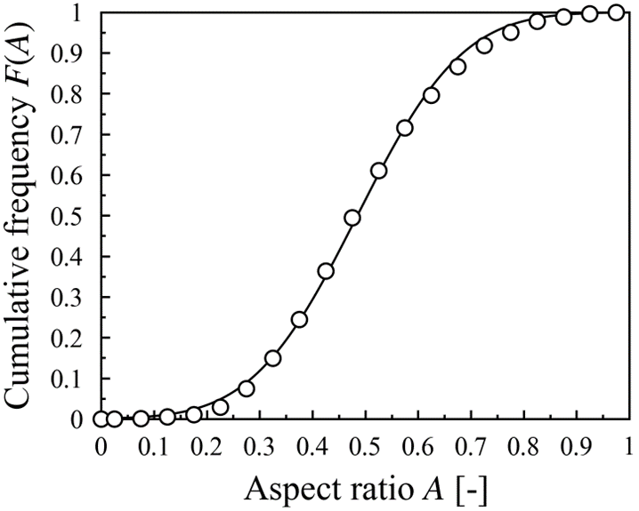
Figure 10
SEM
Fitting

Slide 11
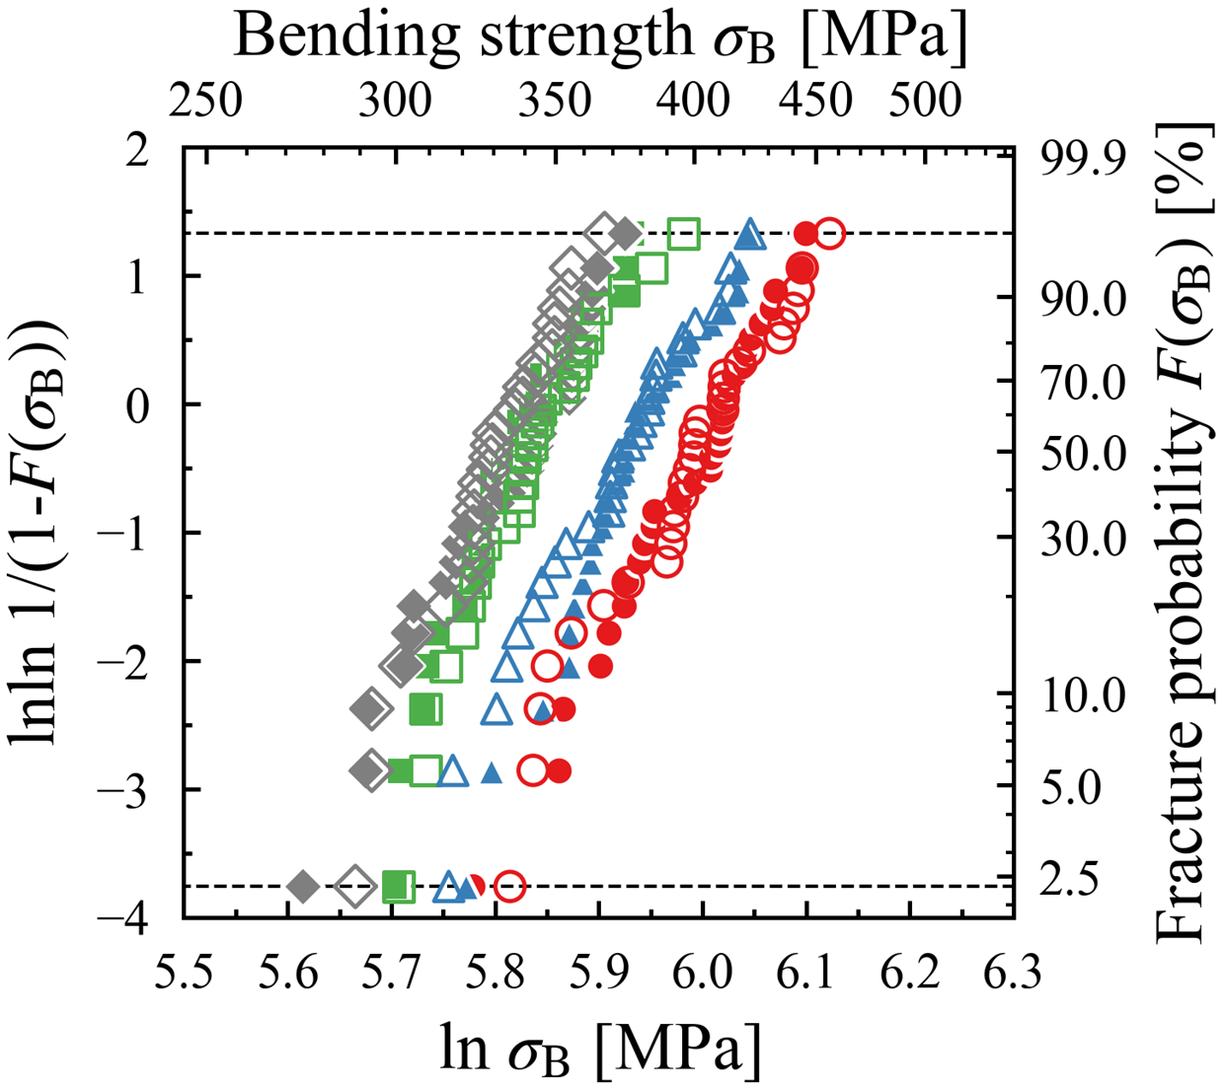
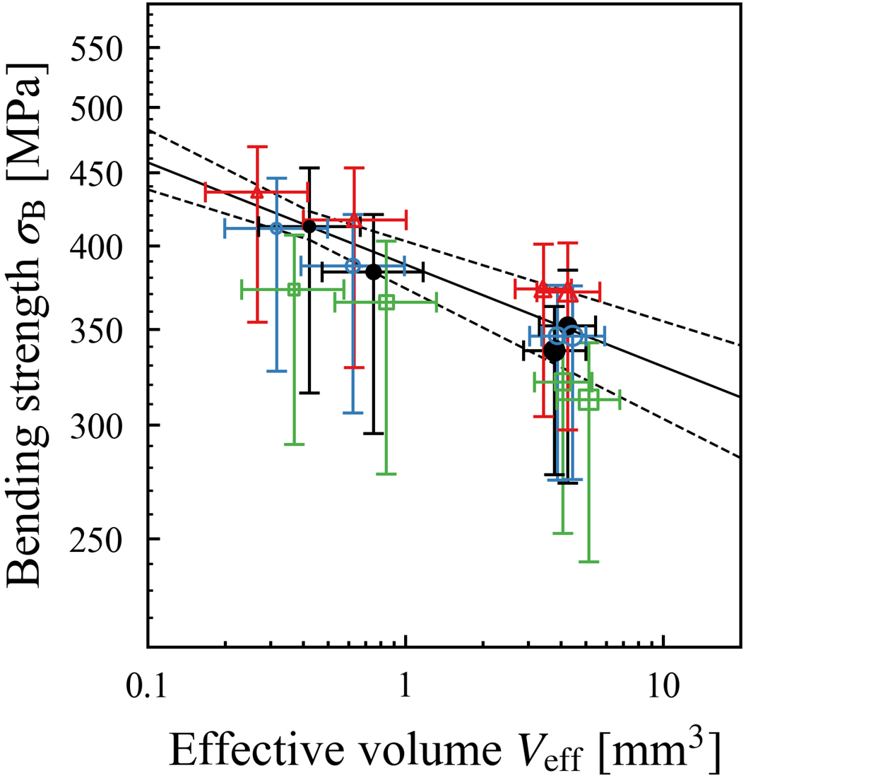
Figure 11
(a)
97.7 %
h_{e}=0.25 mm
Exp.
Sim.
3pb-S
3pb-L
4pb-S
2.3 %
4pb-L
(b)
Exp.
Distribution A
Eq. (4)
Distribution B
Distribution C

Slide 12
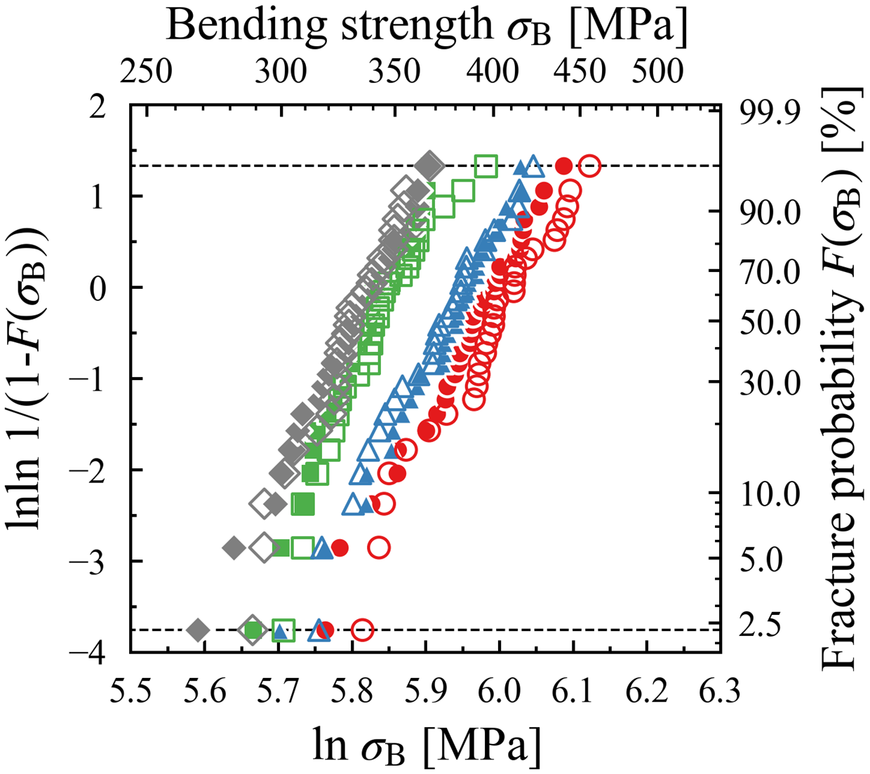
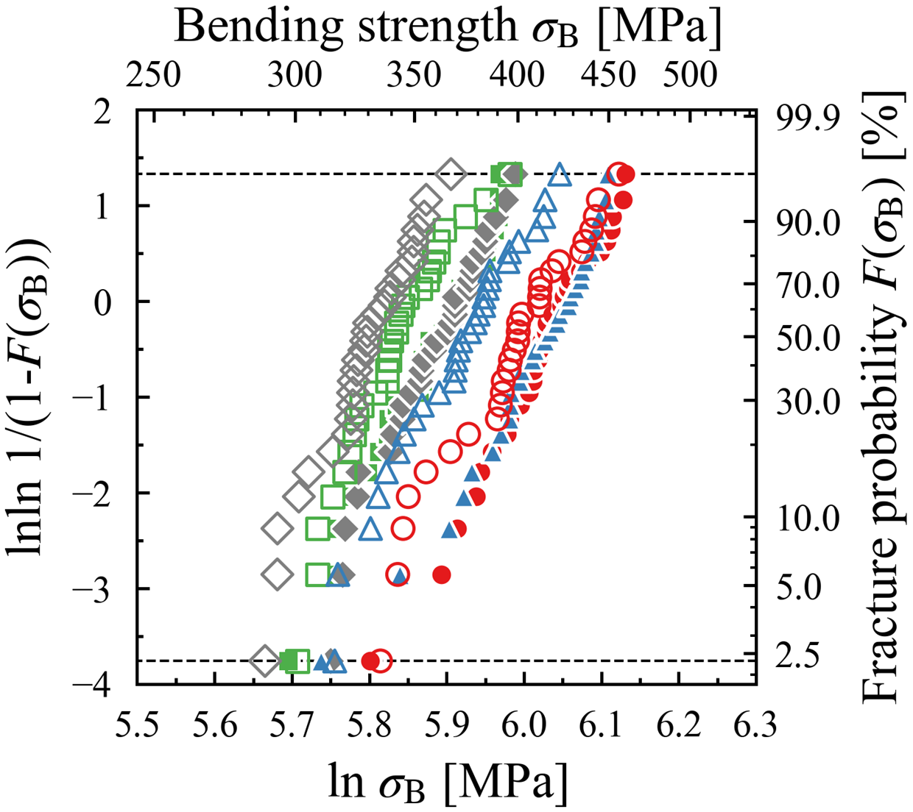
Figure 12
(a)
97.7 %
h_{e}=0.125 mm
Exp.
Sim.
3pb-S
3pb-L
4pb-S
2.3 %
4pb-L
(b)
97.7 %
h_{e}=0.5 mm
Exp.
Sim.
3pb-S
3pb-L
4pb-S
2.3 %
4pb-L

Slide 13
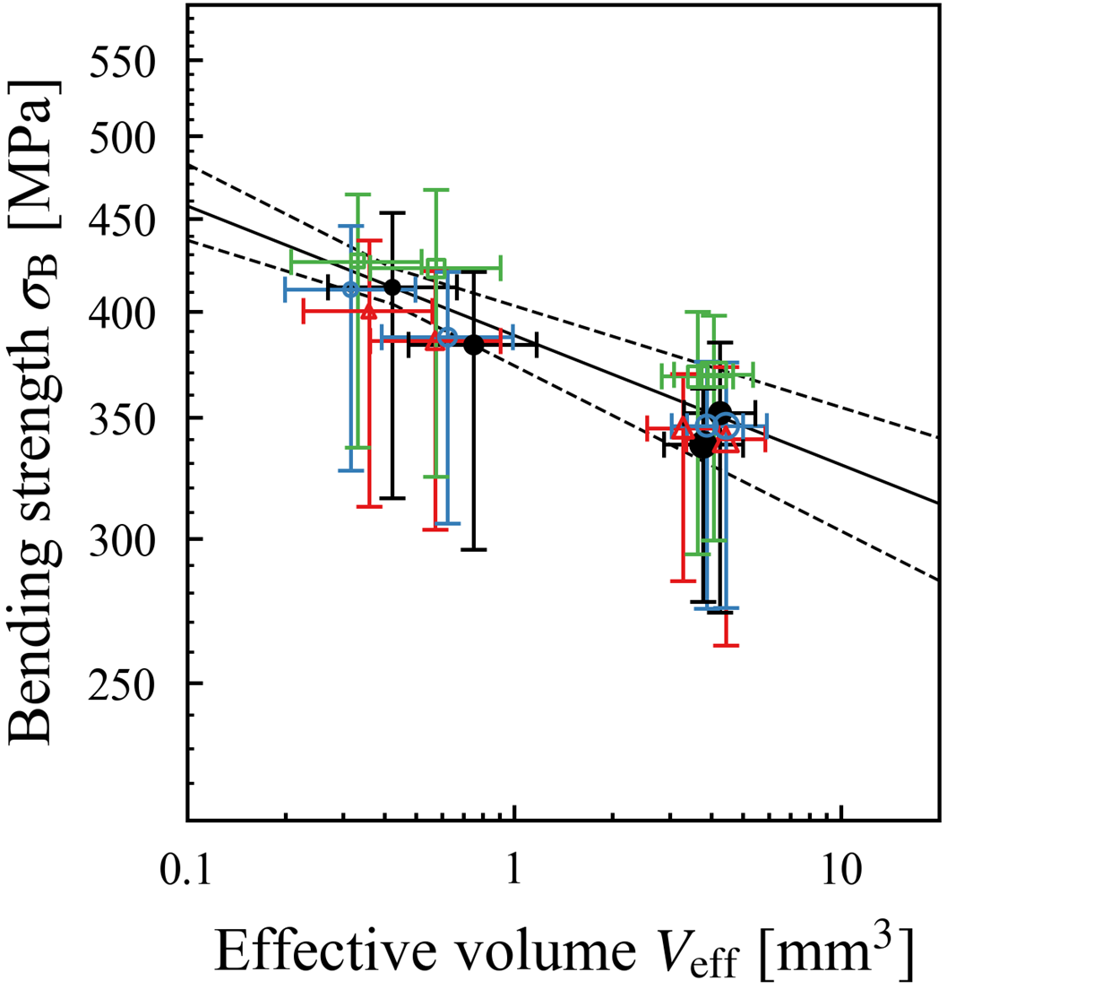
Figure 13
Exp.
0.125 mm
Eq. (4)
0.25 mm
0.5 mm

Slide 14
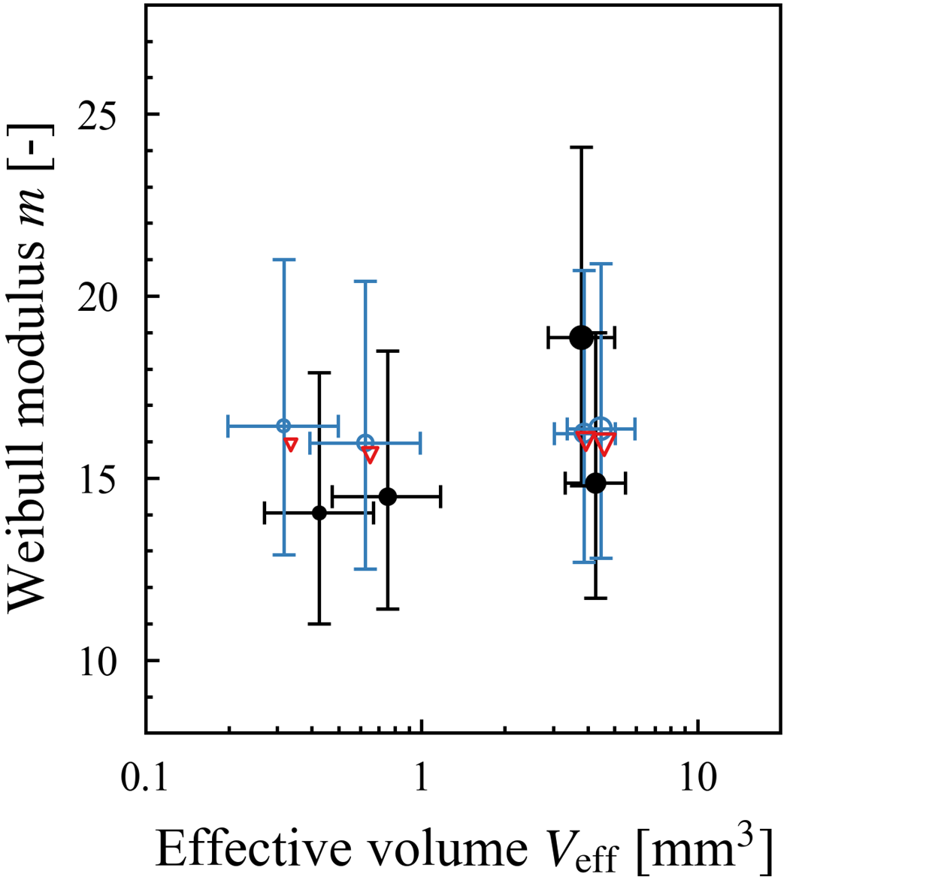
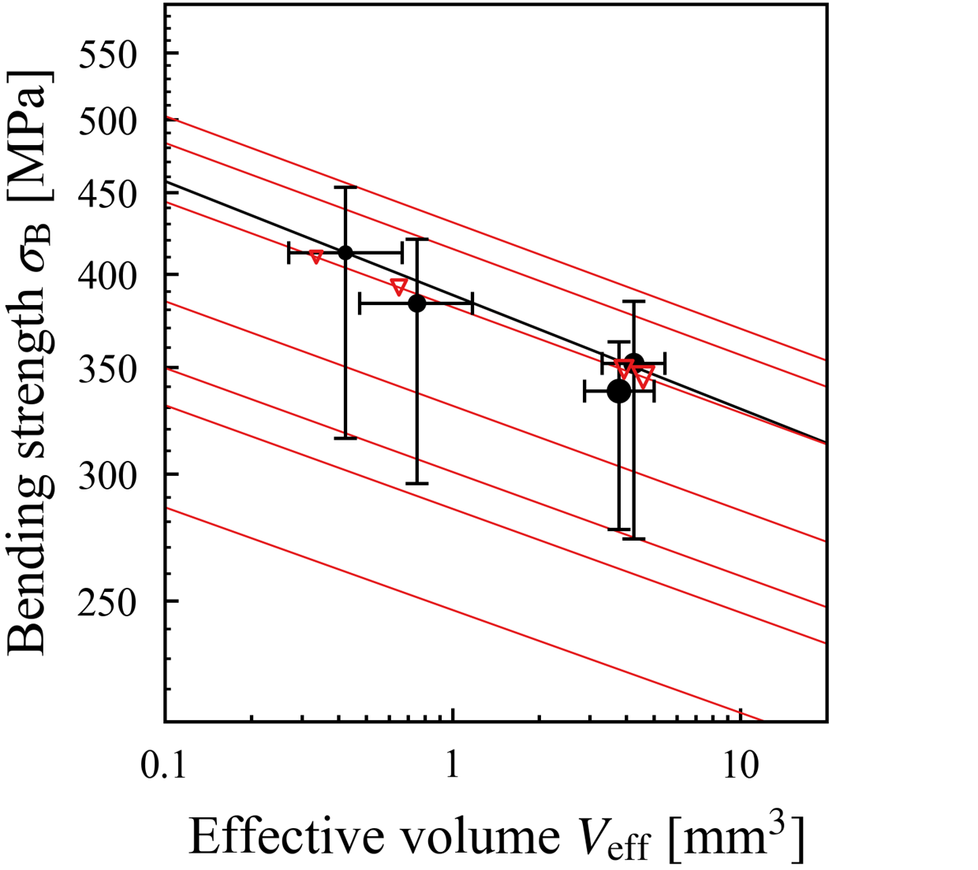
Figure 14
(a)
Exp.
Sim. (N=1000)
Sim. (N=30)
(b)
Exp.
Sim. (N=1000)
99.9 %
Eq. (4)
97.7 %
β
10 %
2.3 %
1 %
0.1 %

Slide 15
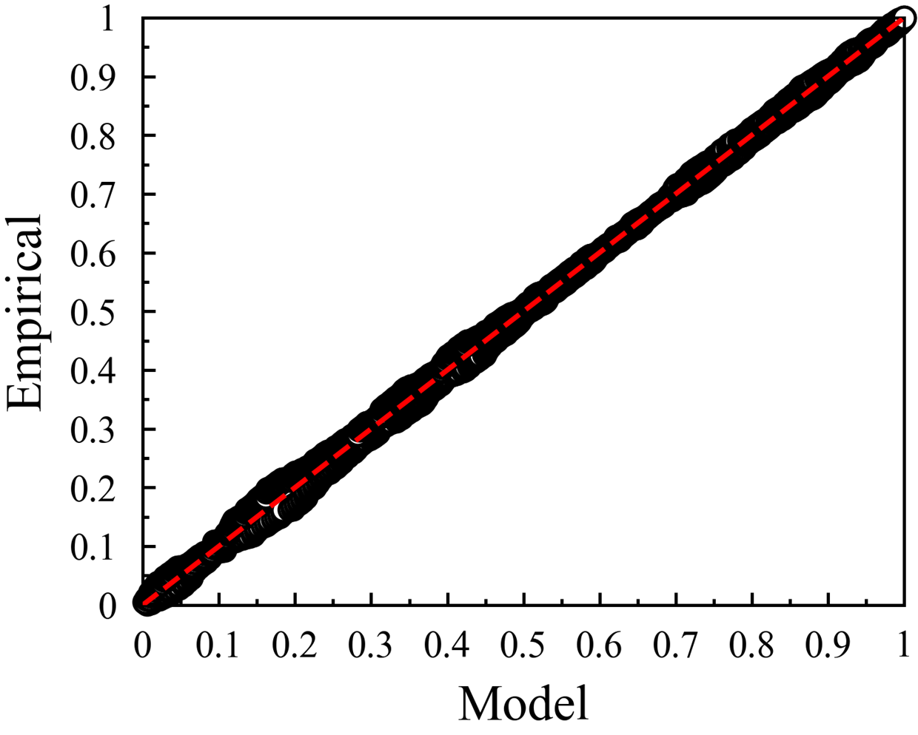
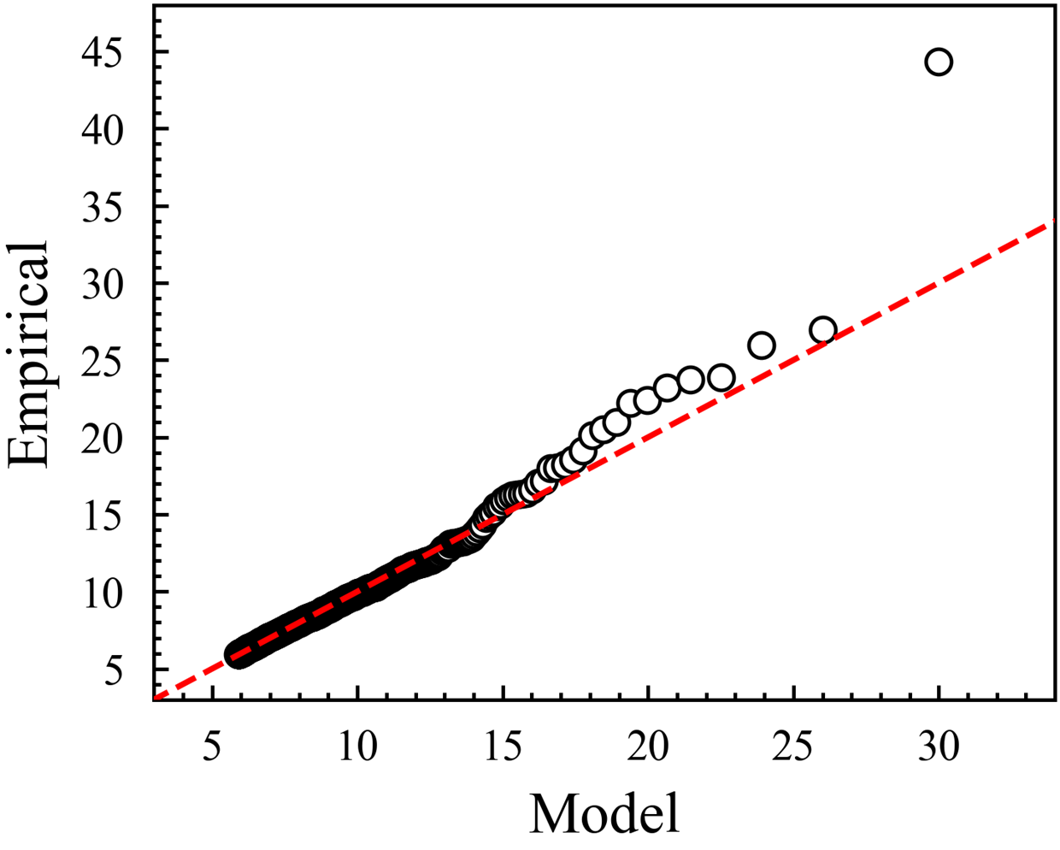
Figure 15
(a)
Observed data by X-Ray CT
Fitting
(b)
Observed data by X-Ray CT
Fitting

Slide 16
Table 1
Test type | Specimen geometry |  |  | Test geometry
Specimen type | t [mm] | w [mm] |  | S₁ [mm] | S₂ [mm]
3pb-S | 4 | 3 |  | 16 | 0
3pb-L |  |  |  | 30
4pb-S |  |  |  | 30 | 10
4pb-L |  |  |  | 60
Table 2
Discretized size h_{e} [mm] | ξ [-] | σ [μm] | u [μm] | Pore number [/element] (=N_{D}*h_{e}³)
0.125 | 0.166 | 2.3 | 5.9 | 135
0.25 |  |  |  | 1080
0.5 |  |  |  | 8640
Table 3
Test type | Experiment |  |  | Simulation (Distribution C)
Specimen type | m [-] | β [MPa] |  | m [-] | β [MPa]
3pb-S | 14.1 | 412.6 |  | 16.4 | 411.3
3pb-L | 14.5 | 383.9 |  | 16.0 | 387.3
4pb-S | 14.9 | 352.1 |  | 16.2 | 346.2
4pb-L | 18.9 | 338.3 |  | 16.4 | 346.1

