Slide 1


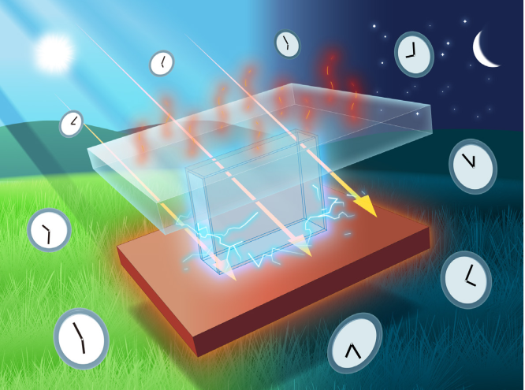
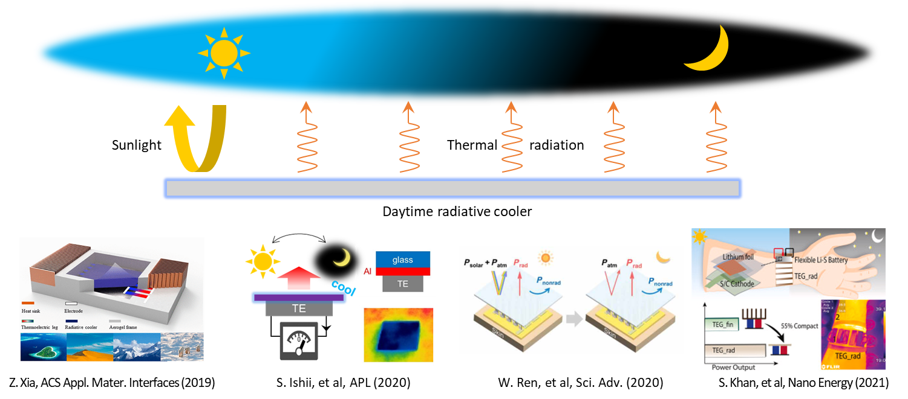
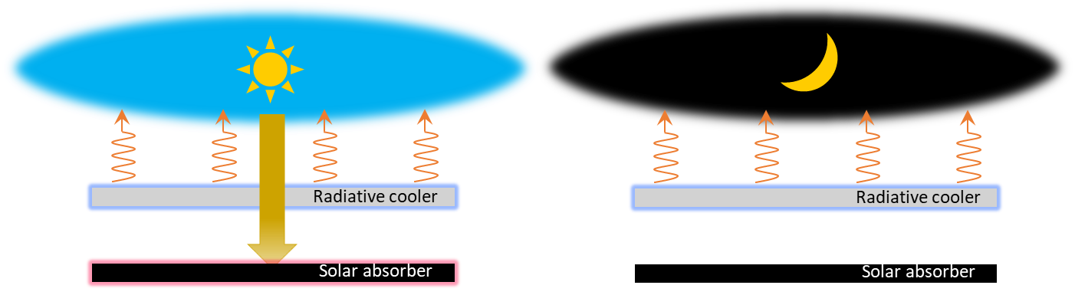
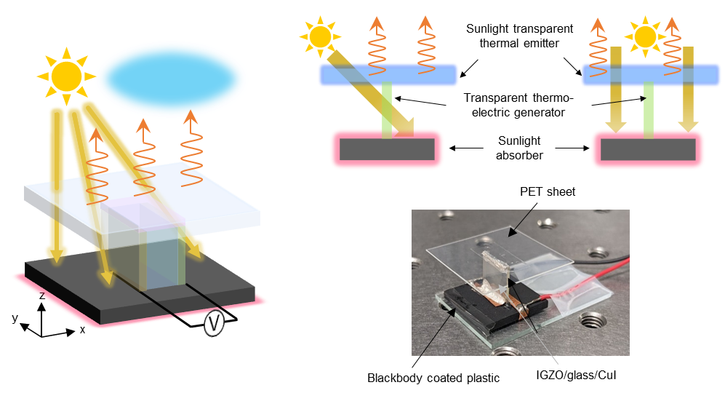
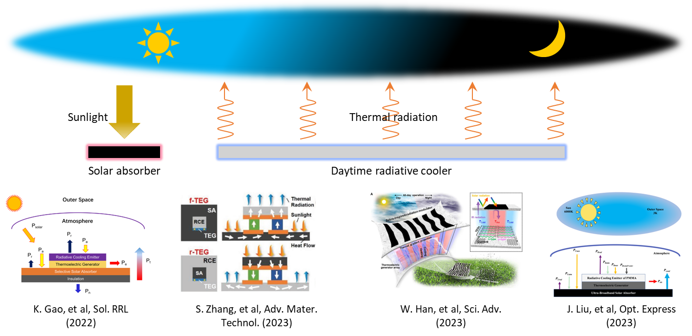
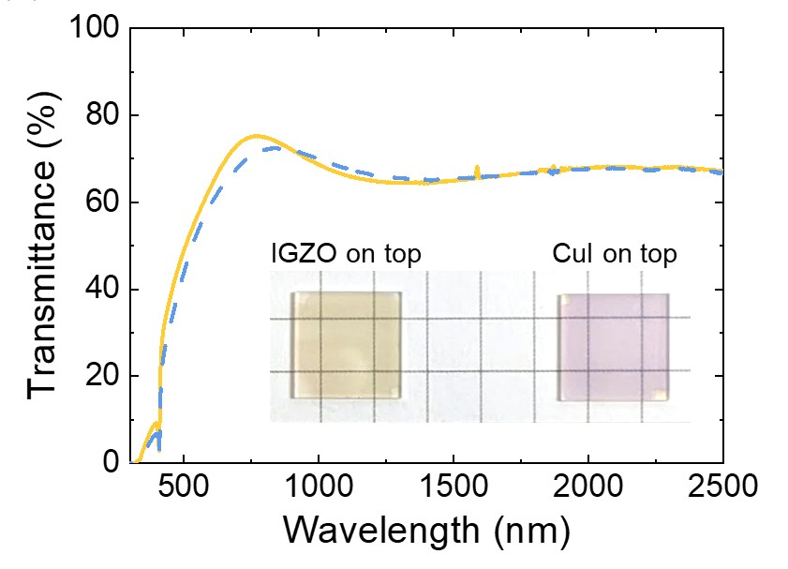
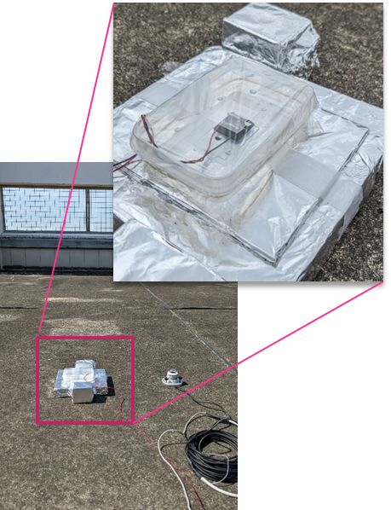
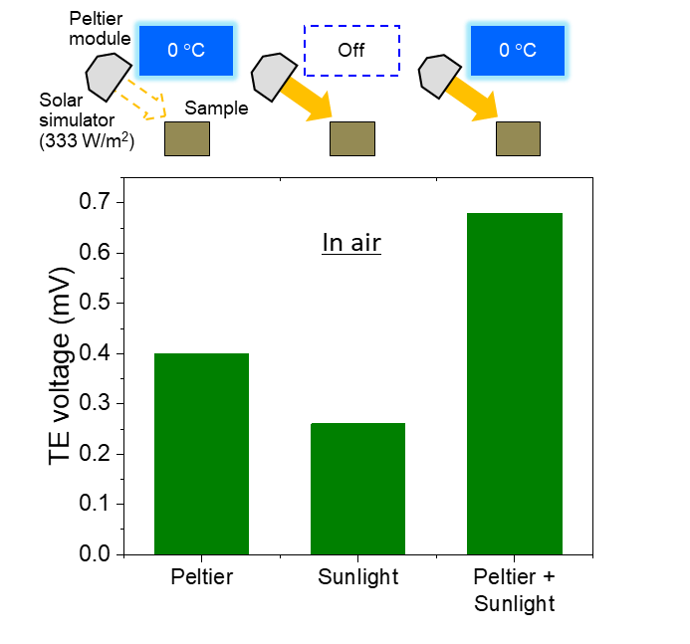
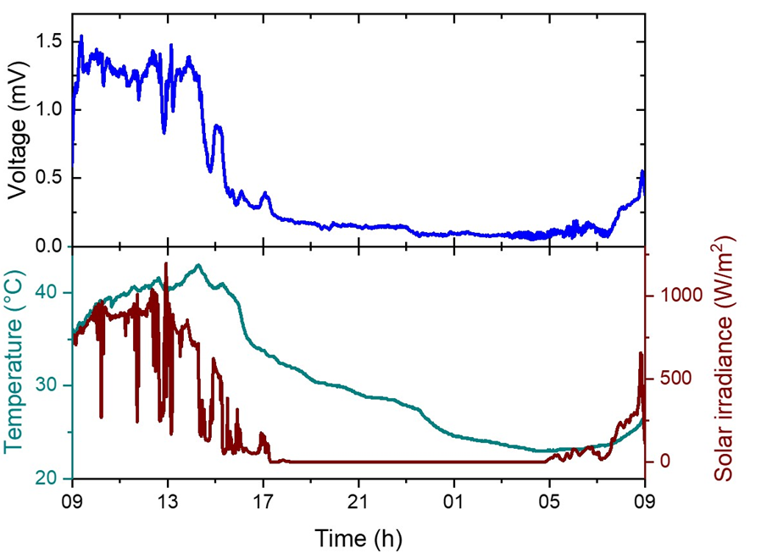
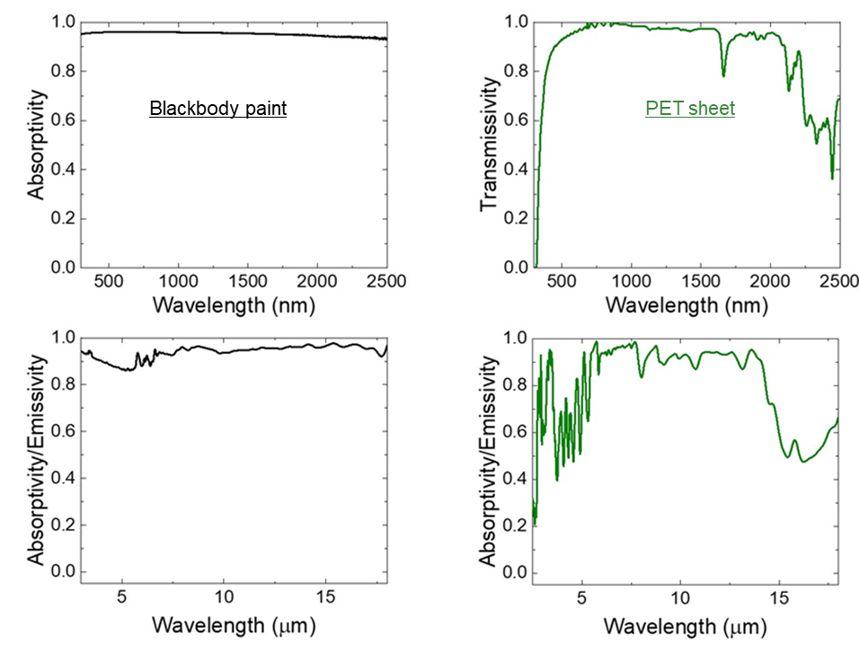
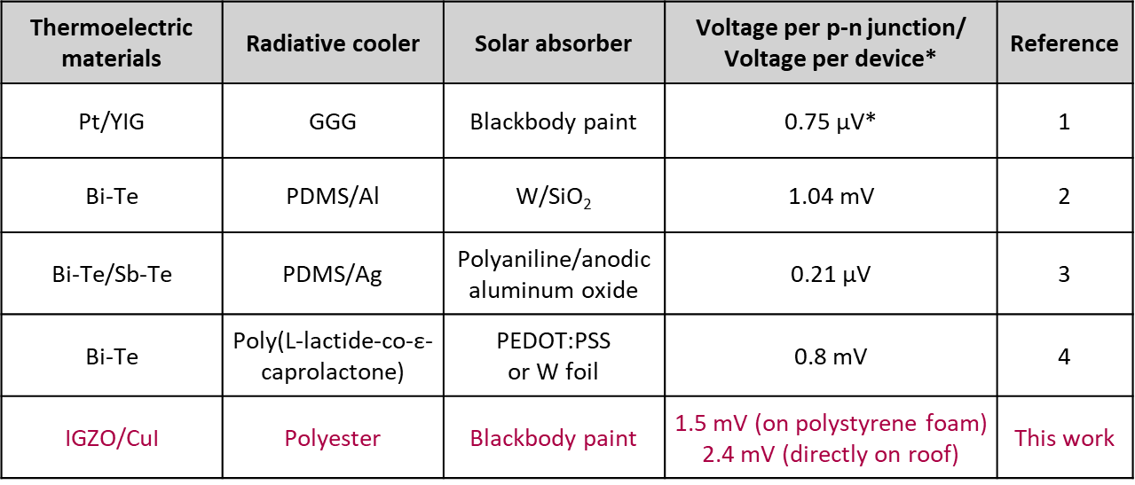


, , ,
, , ,
Harvesting radiative cooling and solar heating
with transparent thermoelectric device
Satoshi Ishii,^{1,2} Cédric Bourgès,^{1,3} Nicholaus K. Tanjaya,^{1,2} Takao Mori^{1,2}
¹ Research Center for Materials Nanoarchitectonics (MANA), National Institute for Materials Science (NIMS),, Japan
² Subprogram in Materials Science and Engineering, Graduate School of Science and Technology, University of Tsukuba, Japan
³ International Center for Young Scientists, National Institute for Materials Science (NIMS), Japan
Abstract
A thermoelectric device which can simultaneously harvest radiative cooling and solar heating is presented. By sandwiching the transparent thermoelectric module by a transparent plate at the top and a black plate at the bottom, the device is capable of harvesting radiative cooling and solar heat with the co-planar geometry in day and harvesting radiative cooling in night confirmed by outdoor and indoor measurements. Our device can be an efficient method to judiciously harvesting solar heating and radiative cooling simultaneously, paving the way for efficient energy harvesters which can be used as stand-alone power supplies for off-gird sensor modules.
Designs for harvesting radiative cooling and solar heating
Past works
This work
Solar absorbers and radiative coolers are coplanar
⇒ Improving TEG per unit area
Thermoelectric generation (TEG) by radiative cooling to the sky
⇔ Sunlight reflection by daytime radiative cooler
Harvesting radiative cooling & solar heating in day for TEG
⇔ Solar absorbers and radiative coolers are non-coplanar
Transparent thermoelectric materials allow coplanar design
⇒ IGZO as n-type, CuI as p-type TE thin films
Optical properties and thermoelectric performances
IGZO/glass/CuI
IGZO and CuI fabricated on each side of the glass substrate are transparent
Simultaneously harvesting radiative cooling and solar heating for TEG with the coplanar structure confirmed by indoor and outdoor measurements
Satoshi Ishii, Cédric Bourgès, Nicholaus K. Tanjaya, Takao Mori, Mater. Today 75, 20-26 (2024)
Blackbody paint: absorptive in VIS-NIR & MIR
PET sheet: transparent in VIS-NIR, absorptive in MIR
1. S. Ishii, et al, Sci. Technol. Adv. Mater., 2021, 22, 441-448; 2. K. Gao, et al, Solar RRL, 2022, 6, 2100975; 3. S. Zhang, et al, Adv. Mater. Technol., 2022, 7, 2200478; 4. W. B. Han, et al, Sci. Adv., 2023, 9, eadf5883.
sishii@nims.go.jp

